Slide 1
Physics of the Cosmos Program Analysis Group Report pcos.gsfc.nasa.gov
Mark Bautz
Massachusetts Institute of Technology
Chair of the Physics of the Cosmos Program Analysis Group

Slide 2
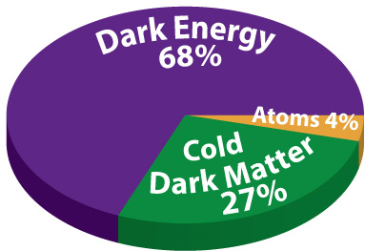
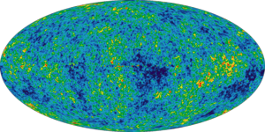
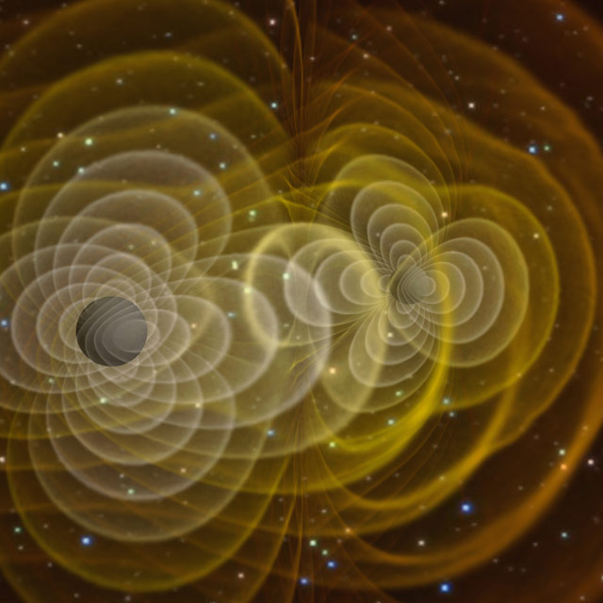
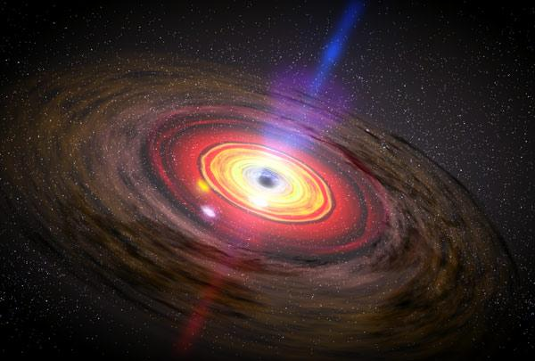
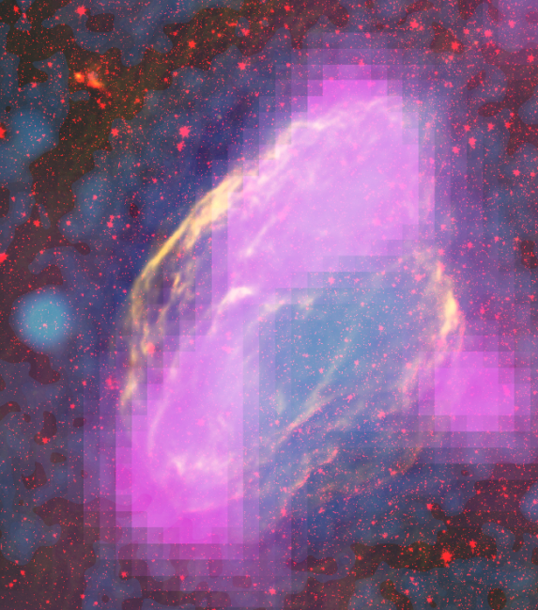
Physics of the Cosmos Science Objectives
Increase our knowledge of dark energy
Precisely measure the cosmological parameters governing the evolution of the universe and test the inflation hypothesis of the Big Bang
Test the validity of Einstein's General Theory of Relativity and investigate the nature of spacetime
Understand the formation and growth of massive black holes and their role in the evolution of galaxies
Explore the behavior of matter and energy in its most extreme environments

Slide 3
Physics of the Cosmos Program Analysis Group
Six Science Interest Groups (SIGs):
Cosmic Rays (Cosmic SIG)
Cosmic Structure (CosSIG)
Gamma-ray Astrophysics (Gamma SIG)
Gravitational Waves (GWSIG)
Inflation Probe (IPSIG)
X-ray Astrophysics (X-Ray SIG)

Slide 4
Activities
PCOS General
PhysPAG and Joint PAG meetings at the AAS, Grapevine, TX, January 2017
PCOS mini-symposium at the APS, Washington, DC January 2017
Probe Concept Study Selections: 5 of 9 mission concepts selected by NASA for study are PCOS- related
PCOS Town Hall planned for meeting of the High Energy Astrophysics Division of AAS,
Sun Valley, ID, August 2017
Inflation Probe SIG
General interest:
AAS Special Session: “The Polarization of the Cosmic Microwave Background” San Diego, June, 2016
Ongoing activities: Proposals pending response:
SPHEREx: An All-Sky Near-Infrared Spectral Survey MIDEX proposal
(selections anticipated ~ summer 2017) PIXIE: Primordial Inflation Explorer MIDEX proposal (selections anticipated ~ summer 2017) CORE++ proposal for ESA M5 (Response expected ~ Spring 2017)
Upcoming activities:
Probe-Scale Mission CMB Polarization Study Selected (S. Hanany / UMn PI)

Slide 5
Gravitational Wave SIG
L3ST Activities
Community meeting following APS, January 2017
Supported the LISA Consortium in the delivery of the LISA (not eLISA) mission concept in January 2017
LISA concept undergoing Concurrent Design Facility (CDF) assessment at ESA
CDF will be followed by a competitive Phase A study
Special LISA/GW session at the 2017 HEAD meeting
Last GWSIG meeting:
April APS meeting (in late January 2017), Washington, DC
Next GWSIG meeting:
January 2018 AAS or April 2018 APS

Slide 6
X-ray SIG
General Interest
NICER delivered and awaiting launch to ISS ~June 2017
X-ray polarimeter IXPE funded to flight (PI: M. Weisskopf)
X-ray Astrophysics Recovery Mission (XARM) proceeding – formal MOU between NASA and JAXA going through clearance process
X-ray probe concepts: Strobe-X (Ray/NRL PI), Transient Astrophysics Probe (Camp, GSFC), and AXIS high angular resolution (Mushotzky/MD)
Lynx F2F meeting, April 6-7, 2017, MSFC
Recent XRSIG activities:
Winter AAS meeting, January 2017, Grapevine TX
April APS meeting (in late January 2017), Washington, DC
Upcoming XRSIG activities:
Aug 2017 From Chandra to Lynx, Harvard University, Cambridge, MA
Aug 2017 AAS/HEAD meeting, Sun Valley, ID

Slide 7
Gamma SIG
General Interest
Workshop on MeV-band probe mission concept, GSFC, May 2017
Recent Activities
Gamma SIG Mini-symposium at APS Meeting, January, 2017
Upcoming Activities:
Special Session on X-ray and Gamma-Ray Polarimetry organized by PhysPAG EC members Tomsick & Krawczynski, with contributions on IXPE, INTEGRAL, POLAR, X-Calibur, COSI & AstroSAT at AAS HEAD Meeting, August 2017
Gamma SIG Town Hall at AAS HEAD meeting, August, 2017

Slide 8
Cosmic-Ray & Cosmic Structure SIGs
Cosmic-Ray SIG
General interest:
ISS-CREAM delivered and awaiting launch at Cape ~1 August 2017
Calorimetric Electron Telescope (CALET, JAXA/US/Italy; TeV e⁻ & γ’s )on ISS, now in science operations
BACCUS (boron & carbon C.R. balloon payload, E. Seo, PI) flew
EUSO-SPB (Extreme Universe Space Observatory balloon, A. Olinto, PI) flight imminent
AMS-02 cosmic-ray nuclei data coming soon
Probe of Extreme Multi-messenger Astrophysics (A. Olinto/Chicago, PI) selected for mission concept study
International Cosmic Ray Conference, Seoul, July 2017
Recent activities:
Two special sessions at APS, Washington, DC January 2017
Min-symposium on ‘Cosmic-Ray Research Today and Tomorrow’,
University of Maryland, January 2017
Cosmic Structure SIG
General interest:
Supporting large-structure science in flagship mission concept studies
SPHEREx mission concept submitted MIDEX proposal (inflation & large-scale structure)

Slide 9
PhysPAG EC membership
Name | Affiliation | Area of Expertise | Term Ends
M. Bautz (Chair) | MIT | X-ray astrophysics | Dec 2017
R. Bean | Cornell University | Dark energy | Dec 2017
J. Beatty | Ohio State University | Particle astrophysics | Dec 2019
J. Conklin (Vice Chair) | Univ. of Florida | Gravitational waves | Dec 2017
O. Doré | JPL | Dark energy | Dec 2017
S. Guiriec | George Washington Univ. | Gamma-ray astrophysics | Dec 2019
K. Holley-Bockelmann | Vanderbilt University | Gravitational waves | Dec 2019
R. Kraft | SAO | X-ray astrophysics | Dec 2018
H. Krawczynski | Washington University | Gamma-ray astrophysics | Dec 2017
A. Miller | Columbia University | CMB | Dec 2017
I. Moskalenko | Stanford University | Particle astrophysics | Dec 2018
J. Tomsick | UC Berkeley | X-ray and Gamma-ray astrophysics | Dec 2019
E. Wollack | NASA/GSFC | CMB | Dec 2017
New Members

