Slide 1



Presentation to the NASA Astrophysics Advisory Committee
April 25, 2017
Dr. Denise Smith, on behalf of the
NASA’s Universe of Learning Leadership Team

Slide 2
Background

Slide 3
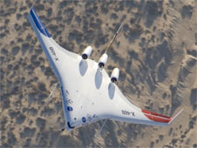
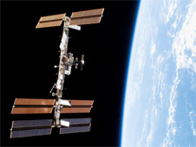
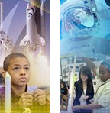
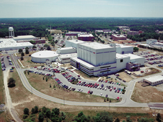
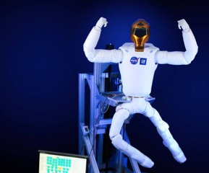

Education within NASA
4 Mission Directorates
Office of Education
10 Field Centers
Aeronautics Research
Human Exploration and Operations
Office of Communications
Science
Space Technology
Science Education Cooperative Agreements are funded and managed by SMD.
Notes:
NASA Headquarters provides overall guidance and direction to the agency. Ten field centers carry out the day-to-day work, in laboratories, on air fields, in wind tunnels and in control rooms. NASA conducts its work in four principal organizations, called mission directorates:
Aeronautics: works to solve the challenges that still exist in our nation's air transportation system: air traffic congestion, safety and environmental impacts.
Human Exploration and Operations: focuses on International Space Station operations, development of commercial spaceflight opportunities and human exploration beyond low Earth orbit.
Science: explores the Earth, solar system and universe beyond; charts the best route of discovery; and reaps the benefits of Earth and space exploration for society.
Space Technology: rapidly develops, demonstrates, and infuses revolutionary, high-payoff technologies, expanding the boundaries of the aerospace enterprise. https://www.nasa.gov/directorates/spacetech/stmd-images

Slide 4
NASA SMD Science Education:
Cooperative Agreement Notice (CAN)
The desired outcome of this CAN is to increase the overall coherence of the SMD science education program leading to more effective, sustainable, and efficient utilization of SMD science discoveries and learning experiences and to meet overall SMD science education objectives.
Fundamental to achieving this outcome is to enable NASA scientists and engineers to engage more effectively with learners of all ages.
Enable STEM Education
Advance National Education Goals
Improve U.S. Scientific Literacy
Leverage Through Partnerships
SMD selected 27 teams via the CAN.

Slide 5
Education and Communications: A Practitioner’s View
Education
Communications
Uses NASA’s unique capabilities to enhance STEM learning
Funded via Cooperative Agreement Notice for SMD
Focuses on themes of NASA science
Refers to:
  Learning in museums, science centers, libraries, etc.
  Higher education
  [K-12 classroom learning]
Conveys and promotes interest in the NASA program; fosters appreciation for STEM
Funded via missions / program offices for SMD
Plan for each mission / program; connects to NASA-wide communication themes
Refers to:
  Media
  Web and social media
  Outreach activities

Slide 6
An Integrated Astrophysics STEM Learning and Literacy Program

Slide 7
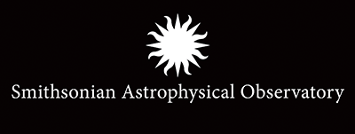




NASA’s Universe of Learning
Leadership Team
PI: Dr. Denise Smith
Co-I: Kathy Lestition
Co-I: Dr. Gordon Squires
Co-I: Michael Greene / Anya Biferno
Co-I: Dr. Lynn Cominsky
External Evaluation
Irene Goodman, Ed.D.
Allyson Walker, Ed.D.

Slide 8
Teaming Partners
Association of Science-Technology Centers
McAuliffe Center / Framingham State University
National Girls Collaborative Project
National Science Olympiad
Project PANOPTES
Rutgers University
SAO Science Education Department
Smithsonian Affiliations
Smithsonian Center for Learning and Digital Access
Space Science Institute
University of Arizona Center for Astronomy Education
University of Texas-San Antonio College of Education

Slide 9
Phase I: Laying the Foundation
(2016-2017)
Aspect | Focus
Program Development | Establish funding, subcontracts, and infrastructure. Develop program model; pilot initial products and activities. Develop pathways for Subject Matter Expert (SME) involvement. Identify key Astrophysics science and technology milestones to leverage. Develop collaborations with other CAN awardees.
Program Evaluation | Develop and refine evaluation plan. Conduct needs assessments. Conduct baseline surveys. Monitoring of outputs.

Slide 10
Our Vision
Learners of all ages and backgrounds are engaged and immersed in exploring the universe for themselves.

Slide 11
Our Audiences
Educators working in informal education venues:
  Museums, science centers, planetaria
  Libraries, community-based organizations (local and national)
Public audiences attending informal education venues or community based programs (e.g. youth, families, adults).
Public audiences seeking online learning experiences from their homes.
Faculty/instructors who are training students to become classroom educators, and their students (pre-service educators).
Faculty/instructors who are teaching Astronomy 101.

Slide 12
Needs of the Education Community
A review of the education literature identifies needs for:
User-friendly astronomical data tools and interfaces
Multimedia resources and immersive experiences
Astronomical exhibits and interactives
Community programs and resources for underserved / underrepresented audiences
Informal education resources and professional development
Pre-service professional development
Faculty professional development

Slide 13
Logic Model
Inputs
Outputs
Outcomes
Astrophysics Discoveries & Technology
Scientific Data
Subject Matter Experts
Partnerships
Existing EPO Expertise & Infrastructure
Audience Needs
Data Tools and Participatory Experiences
Multimedia and Immersive Experiences
Exhibits and Community Programs
Professional Learning Experiences
Resources for Underserved / Under-represented
Increased understanding of NASA science and the process of science.
Educators are better prepared to use Astrophysics content to support learning goals and standards.
The cross section of educators and learners we reach is expanded.
Subject Matter Experts are actively involved in ways that add value.

Slide 14
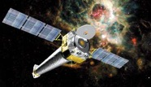
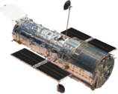
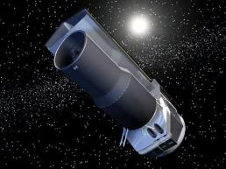
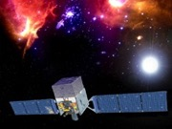
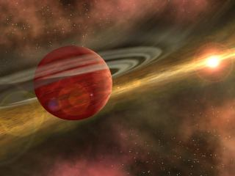
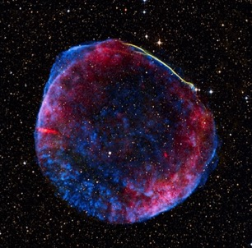
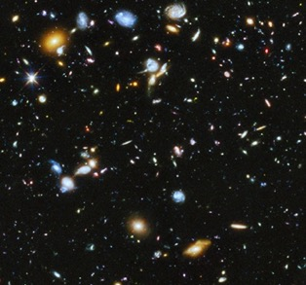
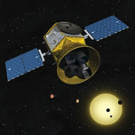
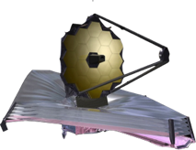
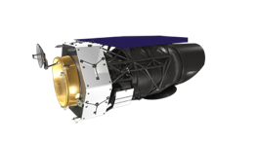
A Thematic Approach Grounded in the Science
Are we alone?
How does the universe work?
How did we get here?

Slide 15
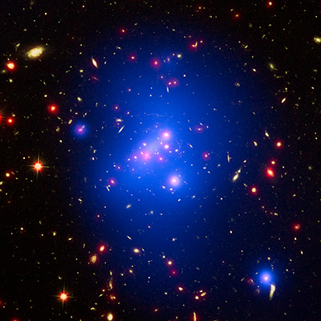
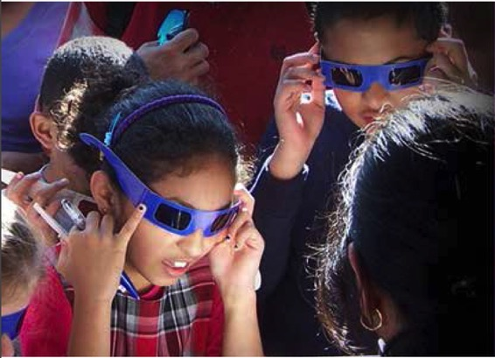
Our Model: Integrating NASA Astrophysics into
Audience-Driven Programs
Exhibits and Community Programs
Data Tools & Participatory Experiences
Multimedia and Immersive Experiences
Professional Development
NASA Astrophysics Science &
Technology, EPO Professionals,
Subject Matter Experts
Audience Needs

Slide 16
Portfolio Overview
Category | Projects
Data Tools and Participatory Experiences | JS9, MicroObservatory, Global Telescope Network, Exoplanet Spectroscopy Lab, Project PANOPTES Astropix MAST Archival Data Coding Workshops Challenger Learning Center, National Science Olympiad Partnerships
Multimedia and Immersive Experiences | ViewSpace Celebrity Education Videos Eyes on Exoplanets Visualizations, Augmented/Virtual Reality
Exhibits and Community Programs | Source Materials for Program Developers Here, There, Everywhere, Light Beyond the Bulb, Visions of the Universe Exhibits Girls STEAM Ahead with NASA Community Programs Tactile/Spanish Resources
Professional Development | Museum Alliance Science Briefings Informal Education Program Models Pre-Service Partnerships Astro101 / Center for Astronomy Education Partnership STEMdex Database

Slide 17
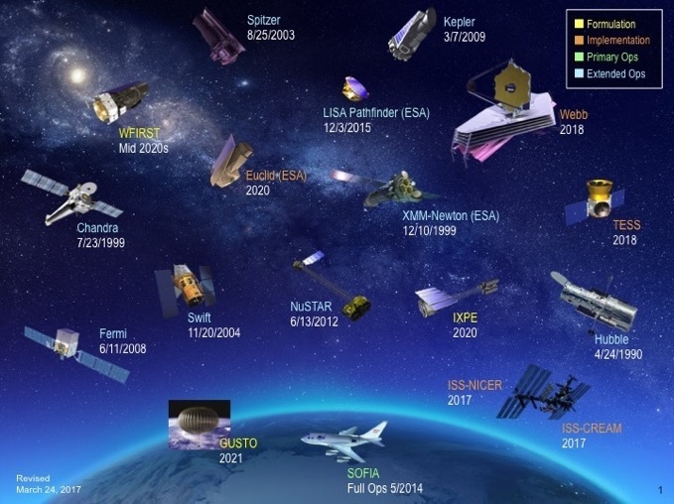
Our Partnership Provides
a Direct Connection to the Science
Existing relationships with scientists from across NASA Astrophysics.
Access to and expertise with data from across NASA Astrophysics.
Education and communications professionals with expertise spanning the full spectrum of NASA Astrophysics.

Slide 18
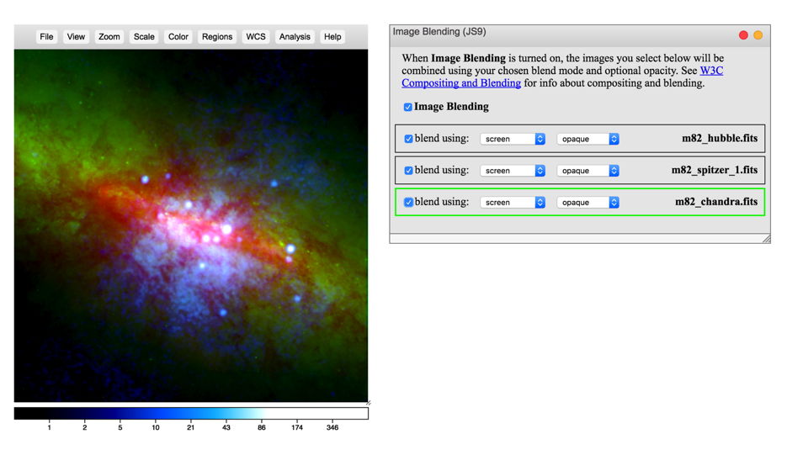

Direct Connection to the Science Enables…
Guided interactions with data from across the
electromagnetic spectrum.
Year 1 Prototype: JS9 multiwavelength exploration of Messier 82 (Data Tools and Participatory Experiences)

Slide 19
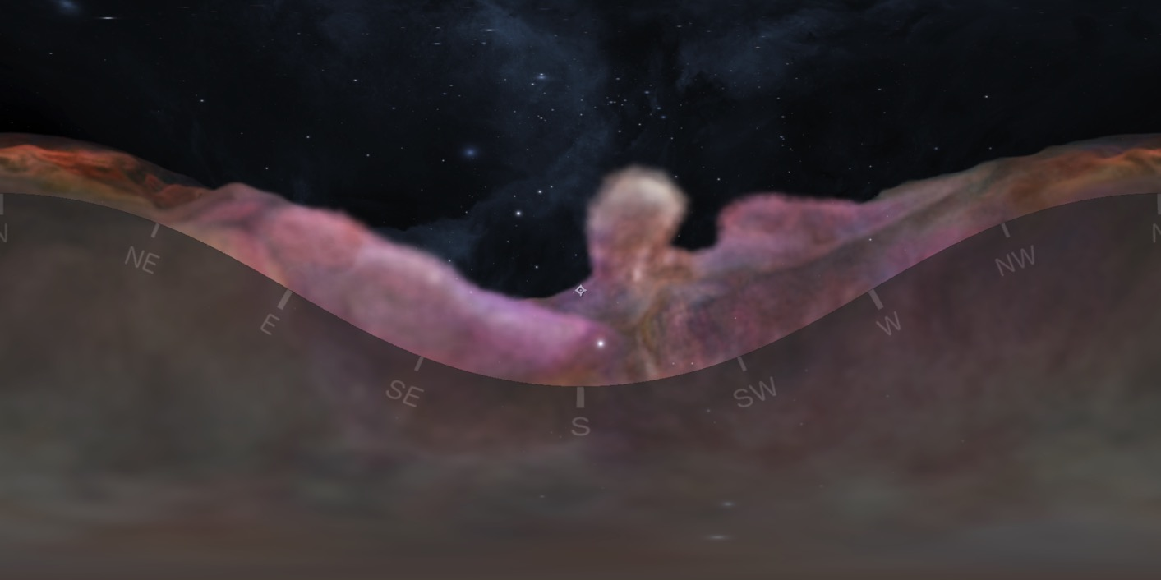
Direct Connection to the Science Enables…
Scientifically-driven, Hollywood-quality visualizations
and immersive experiences.
Year 1 Prototype: Full-Dome Orion Nebula Visualization (Multimedia and Immersive Experiences)

Slide 20
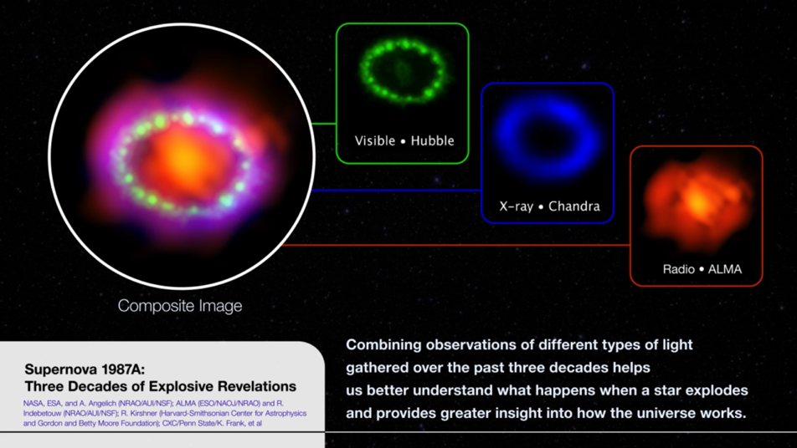
Direct Connection to the Science Enables:
Scientifically-accurate and pedagogically-sound education content.
ViewSpace segment highlighting three decades of studies of SN1987A (Year 2; Multimedia and Immersive Experiences)

Slide 21
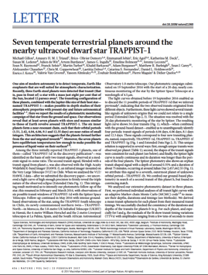
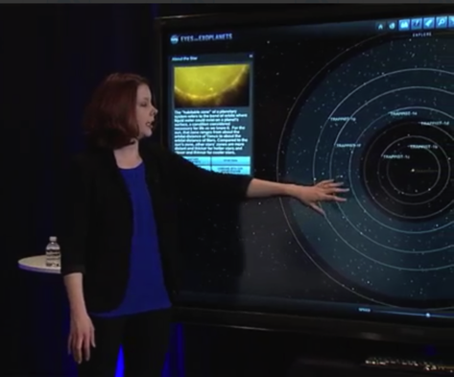
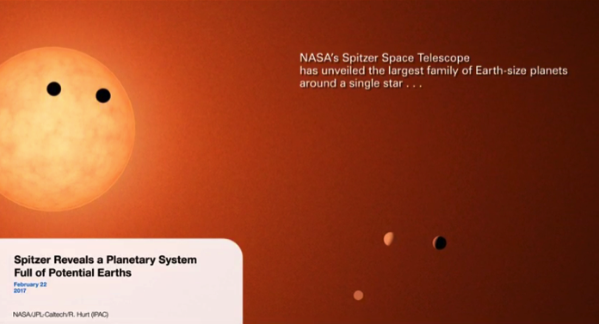
Timely Resources that Leverage Communications
Scientific Research
Communications
ViewSpace Trappist-1 Segment
Within Two Weeks
Informal Education

Slide 22
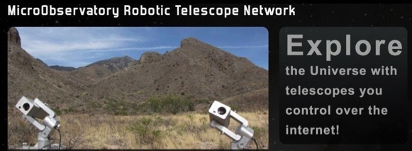
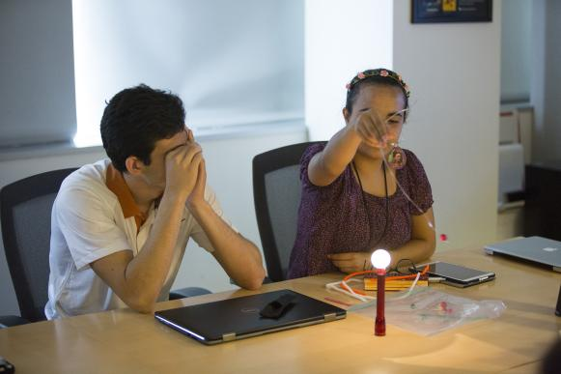
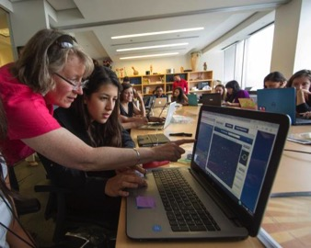
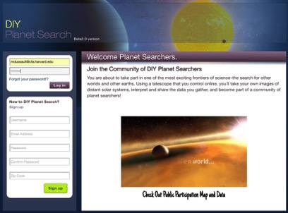
Data Tools Emerge Audiences in the
Process of Science
1. How scientists obtain data:
Workshops provide an introduction to the transit method of detecting exoplanets.
2. Interacting with the data:
In DIY Planet Search, users remotely use telescopes to capture the transits of known exoplanets.
3. Understanding what the data tell us:
MicroObservatory tools help users model various exoplanet characteristics.
4. Experiencing the data in new and innovative ways:
DIY Planet search’s interface and community allows users to share their science with others.
Notes:
DIY Planet Search is a NASA-funded interface to the MicroObservatory Robotic Telescope Network, operated by the Harvard-Smithsonian Center for Astrophysics.
It allows anyone who creates an account to use one of our telescopes in Arizona to capture images of recently-discovered exoplanets, almost every night of the year (weather permitting).

Slide 23
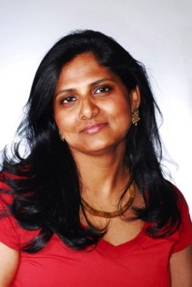
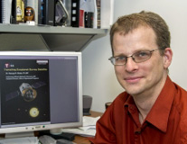
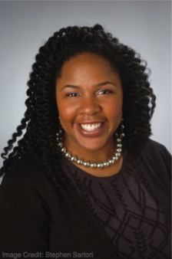

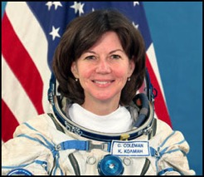
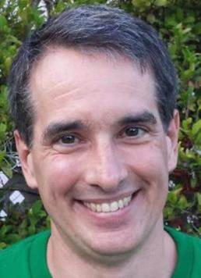
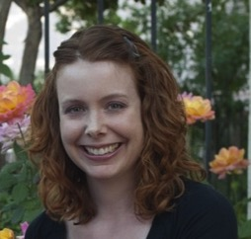
Subject Matter Experts (SMEs)
Connecting SMES with education audiences is a key component of our work.
SMEs provide the direct voice of science.
SMEs are role models that help build STEM identity.

Slide 24
Needs and Best Practices for
Effectively Involving SMEs
We incorporate best practices from the literature and prior work.
We are determining needs via a SME survey:
  More than 160 respondents to date.
  Gauges interest in various types of education and outreach opportunities.
  Seeks information about barriers encountered when trying to engage in education and outreach opportunities.
  Requests input on actions that could be taken to make engagement easier.

Slide 25
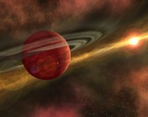
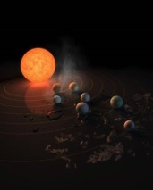

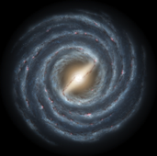
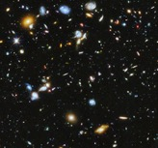
Building a Network of Subject Matter Experts
(Museum Alliance Briefings)
Dr. Jennifer Lotz, STScI
Dr. Peter Capak, IPAC
Dr. Georgiana Ogrean, Stanford
Dr. Sean Carey, SSC
Dr. Dan Patnaude, CXC
Dr. Jessie Christiansen, NExScI
Dr. Seth Digel, SLAC National Accelerator Laboratory
Dr. Brandon Lawton, STScI
Dr. Nikole Lewis, STScI
Dr. Stephen Rinehart, GSFC
Dr. Kevin Stevenson, STScI
Dr. Reinout van Weeren, Harvard-Smithsonian CfA
Julia Zachary, Wesleyan
Dr. Peter Edmonds, CXC
Ian Steer, IPAC NED
Dr. Jedidah Isler, Vanderbilt
Dr. Cady Coleman, retired USAF and former astronaut
Dr. Julie McEnery, GSFC
Dr. Robert Hurt, IPAC
Dr. Kari Frank, Penn State
Dr. Steven Boggs, UC San Diego
Dr. Robert Kirshner, Harvard University and Gordon and Betty Moore Foundation
Dr. Priyamvada Natarajan, Yale
Dr. Jason Rhodes, JPL
Dr. Lynn Cominsky, Sonoma State
Star and Planet Formation
Exoplanets
Stellar Evolution
Galaxies
Universe
Notes:
Note – these are only the SMEs that participated in the UoL Science Briefings.

Slide 26

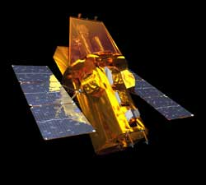
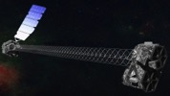

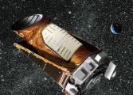

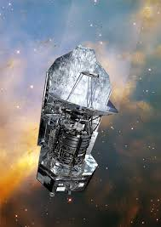
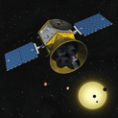

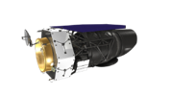
Building a Network of Subject Matter Experts
(Museum Alliance Briefings)
Dr. Jennifer Lotz, STScI
Dr. Peter Capak, IPAC
Dr. Georgiana Ogrean, Stanford
Dr. Sean Carey, SSC
Dr. Dan Patnaude, CXC
Dr. Jessie Christiansen, NExScI
Dr. Seth Digel, SLAC National Accelerator Laboratory
Dr. Brandon Lawton, STScI
Dr. Nikole Lewis, STScI
Dr. Stephen Rinehart, GSFC
Dr. Kevin Stevenson, STScI
Dr. Reinout van Weeren, Harvard-Smithsonian CfA
Julia Zachary, Wesleyan
Fermi
Dr. Peter Edmonds, CXC
Ian Steer, IPAC NED
Dr. Jedidah Isler, Vanderbilt
Dr. Cady Coleman, retired USAF and former astronaut
Dr. Julie McEnery, GSFC
Dr. Robert Hurt, IPAC
Dr. Kari Frank, Penn State
Dr. Steven Boggs, UC San Diego
Dr. Robert Kirshner, Harvard University and Gordon and Betty Moore Foundation
Dr. Priyamvada Natarajan, Yale
Dr. Jason Rhodes, JPL
Dr. Lynn Cominsky, Sonoma State
Swift
NuSTAR
Chandra
Hubble
Kepler
Spitzer
Herschel
TESS
JWST
WFIRST

Slide 27
Broadening Our Audiences: The Need
A review of the education literature identifies needs for:
Community programs to reach, and engage, underrepresented audiences in STEM.
Programs to engage and encourage girls in STEM and to build awareness of, and interest in, STEM careers.
Freely available, accessible astronomy materials to support the participation of blind/visually impaired populations in STEM.
Spanish language astronomy materials to engage Spanish speaking populations.
We are providing accessible products and programs that feature
NASA Astrophysics content and interactions with Subject Matter Experts
to foster STEM identity and expand our reach.

Slide 28
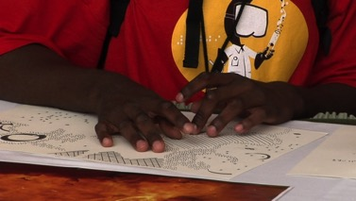
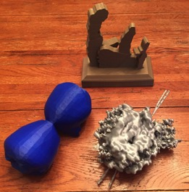
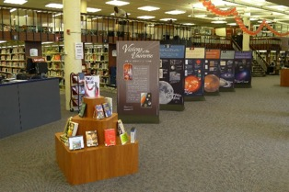
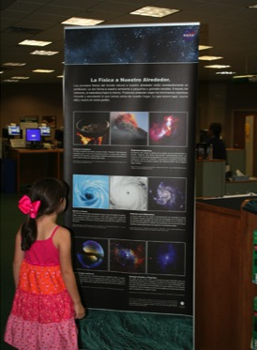
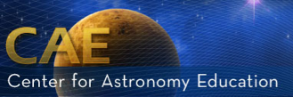
We Partner to Bring NASA Astrophysics to a Broader Audience
Special Needs: National Federation for the Blind
Rural Areas: Library Networks
Minority Serving Institutions:
Pre-service initiative with California State University System, University of Texas-San Antonio
Astro101 workshops serving HBCUs and Community Colleges
Tactile/Braille materials
Libraries reach geographically isolated populations
Spanish-language materials in development

Slide 29







Girls STEAM Ahead with NASA
We are working together to empower public libraries and community-based organizations to engage girls and their families in STEM.
Events use hands-on activities, exhibits, and SME role models to engage girls in STEM.
Data-driven learning experiences
Coding activities involve astronomical image processing.
Subject Matter Experts as role models
We are engaging a diverse range of women in astronomy.
We are developing new technologies, e.g. Eyes on Exoplanet kiosks, for use in libraries.
Multimedia experiences

Slide 30





Girls STEAM Ahead with NASA
We collaborate with girl-serving organizations and NASA-funded programs to engage extensive networks of libraries and informal educators.
Professional development supports librarians.
Libraries are community-centered, free access venues.
Science Briefings engage expanded range of informal education practitioners.
58% of attendees for this briefing attended for first time.
SSI’s STAR_Net community includes 3,900+ librarians/STEM professionals.
Partners’ networks enable us to reach new audiences.
National Girls Collaborative expands our reach to rural WV and MT Native Americans.

Slide 31
Girls STEAM Ahead with NASA
In 2017:
72 libraries across 27 states

Slide 32

Making Science Accessible to New Audiences
Migrating the ViewSpace Network
Science-mad A.I. system voiced by GLaDOS actress Ellen McLain; over 327,000 views
Pilot celebrity education video series on life and death of stars is in progress.
Notes:
When a science-mad A.I. system (voiced by GLaDOS actress Ellen McLain) is installed at NASA, two hapless computer technicians learn the process behind nuclear fusion in the Sun, and how it differs from fission.

Slide 33


Emerging Technology
We are piloting new technologies for use in informal learning environments.
Oculus Rift
360° Videos
(Surface of TRAPPIST-1 system)
Augmented Reality

Slide 34

Leveraging New Technology:
Prototype ViewSpace App
On schedule for deployment in summer 2017.

Slide 35
Design of Universe of Learning
Program Evaluation
Portfolio analysis
Process studies (e.g., collaboration)
  Surveys of Co-Is, project leads
  Site visits to Co-I institutions
  Focus groups with team members
  Surveys of stakeholders
Study of reach (target audiences, SMEs)
Studies of impact on participants for selected projects
Shared measurement system

Slide 36
Key Principles of Our Program
NASA’s Universe of Learning emphasizes:
Direct Connection to the Science
Involvement of Subject Matter Experts
Working with the science community to reflect full range of NASA Astrophysics
Partnerships to ensure authentic engagement of underserved / underrepresented audiences
Robust program evaluation

Slide 37



This presentation is based upon work supported by NASA
under award number NNX16AC65A.
Any opinions, findings, and conclusions or recommendations expressed in this material are those of the author(s) and do not necessarily reflect the views of the National Aeronautics and Space Administration.

Slide 38
Back Up

Slide 39
Phase II: Implementation
(2018-2019)
Aspect | Focus
Program Execution | Evolve program based on feedback from 2017 SMD review and key Astrophysics science and technology milestones. Full development and dissemination of products and activities, incorporating science, technology, and expertise from across NASA Astrophysics missions.
Program Evaluation | Formative evaluation explores how well program is working.

Slide 40
Phase III: Evaluation and Forward Planning
(2020)
Aspect | Focus
Program Execution | Continued implementation and dissemination of all products, activities, and cross-CAN collaborations. Documentation of work and best practices. Develop go-forward plans for successful activities, as determined from SMD review and evaluation.
Program Evaluation | Summative evaluation explores program impact. (What difference did the program make?)

