Slide 1
Tiffany Morgan
Mars Exploration Program, Deputy Director
Michael Meyer
Lead Mars Scientist
NASA Planetary Science Advisory Committee (PAC) Meeting
November 2023

Slide 2
Mars Exploration Program Highlights
- Curiosity arrived at Gediz Valley Ridge!
- IMEWG In-person, Tokyo 7-10 Nov, 2023
- MAVEN 10 Year Launch Anniversary! Party @ GSFC Nov 20, 2023
- Mars Solar Conjunction ~Nov 11-25, 2023
- MDAP 2023 Step-1 submittals increased by ~30% from the recent declining trend; almost back to 2020 levels
Step-2 proposals due Nov 16, 2023
Review panel planned for Feb-Mar 2024
- Mars 2020 Participating Scientist Program (PSP)
Due to budget challenges, there will not be a new solicitation

Slide 3
MEP Future Plan Activities
Community Engagement
Recent/Upcoming draft plan community presentations to solicit feedback
Astrobiology Townhall, SmallSat Conf, Industry Briefing, Mars Society, AAS DPS, ASCEND, IMEWG, AGU
Industry Infrastructure/Technology Studies
Commercial services Guiding Principles and Design Reference Mission scenarios feedback solicited
Release of MEP Industry Studies RFP in late winter/early spring 2024
Search For Life Planning
MEP is working with the Astrobiology program to charter a Search for Life (SFL) - Science Analysis Group (SAG)
Incorporate past activities across different communities into a coherent effort
Prioritize desired Martian broad-scale environments to search for extant life
Identify Technology development required to search for life in specified environments
Planning to begin SFL-SAG member selection in early 2024
Terms of Reference (ToR) draft underway
Considering workshop(s) focused on the specific science and technology needs in spring/summer 2024, with a final report anticipated by the end of 2024
Notes:
SFL-SAG will focus on prioritizing the broad-scale environments to which this mission should be targeted, and evaluating various mission architectures as they apply to measurement needs at each environment, identifying areas of technology or instrument development necessary for mission success. SAG activities may include convening one or more open community workshops focusing on these areas of science and technology needs.
Member selection will be open to all interested communities, including the Mars and astrobiology communities, and will begin Q1 2024. Workshops may be held in spring/summer 2024, with a final report anticipated by the end of 2024.

Slide 4
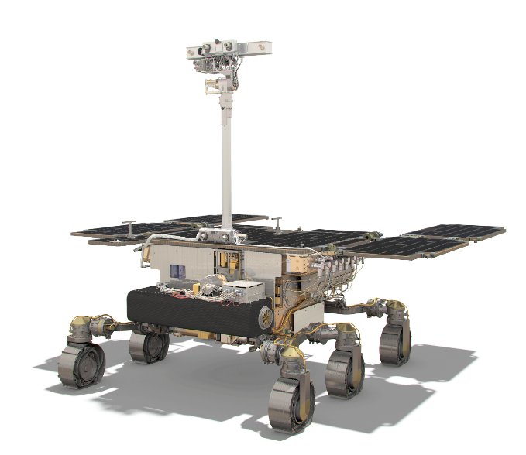
Rosalind Franklin Mission
Collaborating with ESA to ensure RFM has all essential elements for a 2028 Launch
ESA Check Point Review late-November 2023 for mission procurement approval
Continuing MOMA-MS* preparations for launch
PH power card replacement in process for risk reduction
*Mars Organic Molecule Analyser – Mass Spectrometer
Launch Service
Preparing for acquisition of launch vehicle via NLS-II contract action
Lander Descent Engines
Procuring Long Lead Items from Aerojet & MOOG
Radioisotope Heater Units (RHUs)
NASA is working with the Department of Energy to restart production of RHUs that will heat the rover
Credit: ESA

Slide 5
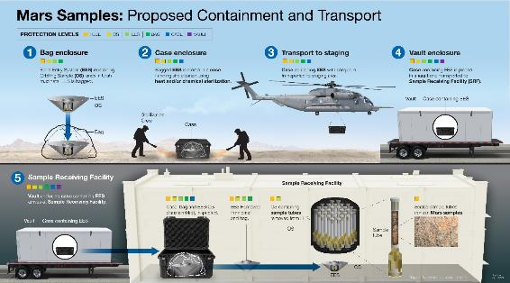
Sample Receiving Project
Measurement Definition Team (MDT)
Developing strawman set of instruments needed within the high-containment facility to accomplish sample safety assessment, curation, and science
23 selected of 147 applicants, plus 6 ex-officio members
Report expected in April 2024
Returned Sample Safety Assessment
Developing protocol to determine if returned samples pose a hazard to Earth’s biosphere and are safe to release from high-containment laboratories
Kick-off meeting held Sept 2023
Coordinating with MDT to ensure alignment with instrument and measurement recommendations
Interim report in Dec 2023; Final report in Mar 2024
Investigating potential partnerships and collaboration opportunities for the Sample Receiving Facility
The SRP is the final element of the MSR Campaign that has a defined mission to recover, contain, transport, assess safety of, curate and scientifically investigate the samples returned to Earth by MSR
Primary Goal: Enable safe and rapid release of the returned samples to world-wide labs for science investigations
Notes:
Karen Gelmis is PE

Slide 6
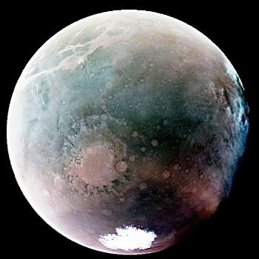
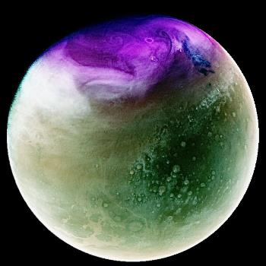
MEP Orbiters
Mars Relay Network (MRN)
MEP successfully managing network activities with aging orbiters that are well into their extended missions
Spacecraft are operating nominally with instruments functioning properly
Projects are managing all consumables to extend science and relay operations
Odyssey
Results of propellant investigation now estimates remaining propellant at 4 kg +/- 2 kg, usage 1 kg/year
Project began its 9th extended mission in October 2022
MAVEN
No safe mode events since Feb 2023
MAVEN operating in all-stellar attitude sensing mode to preserve lifetime of remaining IMU
Project began its 5th extended mission in October 2022
MRO
No safe mode events since Nov 2022
Project began its 6th extended mission in October 2022
ExoMars/TGO
Continuing to support relay operations for MEP; returning >50% relay data of landed assets
MAVEN’s Imaging Ultraviolet spectrograph (IUVS) instrument obtained these infrared views of Mars when the planet was near opposite ends of its elliptical orbit. Credit: NASA/LASP/CU Boulder

Slide 7
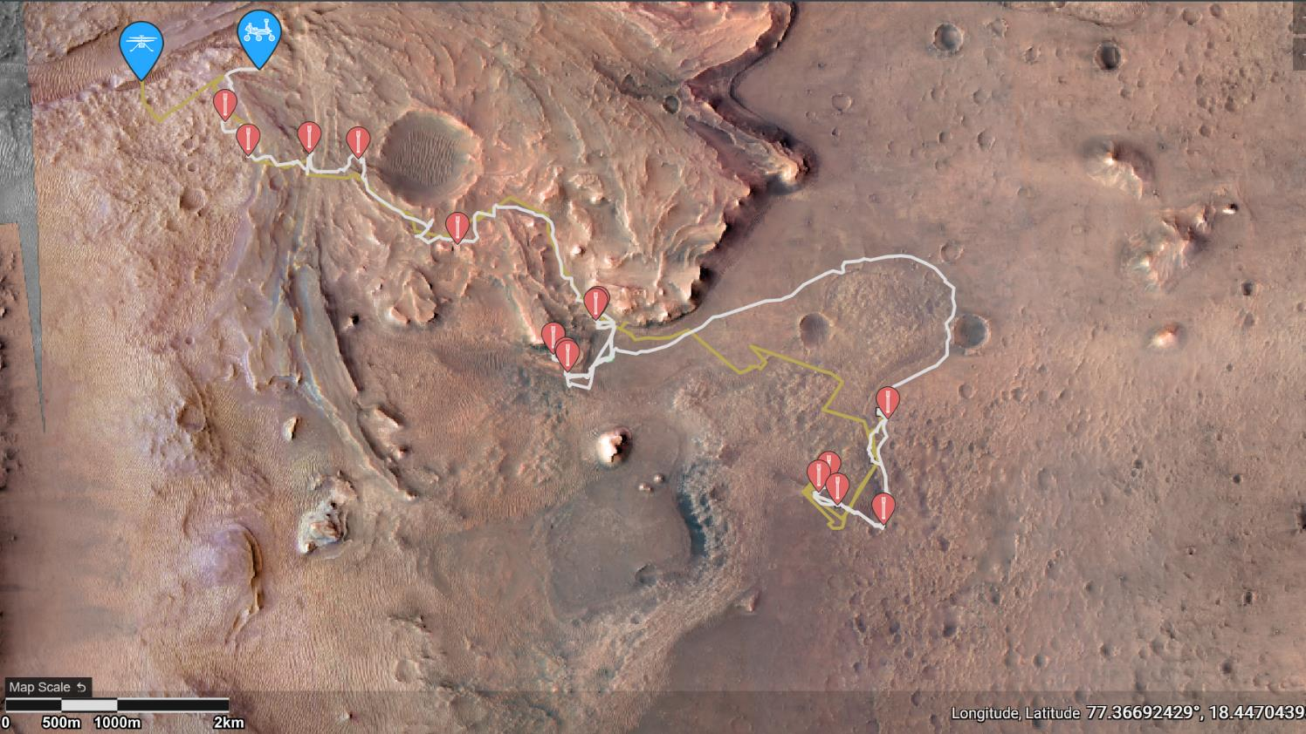
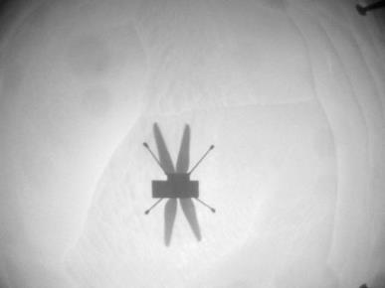
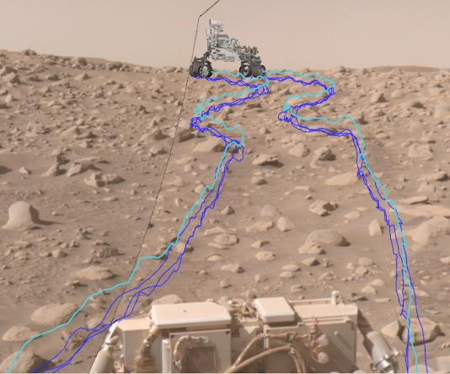
Mars 2020
Margin Campaign
Perseverance Odometer: 22.98 km*
Ingenuity Log: 66 flights, 14.9 km*
* As of November 7, 2023
Delta Top Campaign
Three Forks
Ingenuity Flt 66, NavCam Image Credit: NASA/JPL-Caltech
Annotated composite image shows the path Perseverance took through a dense section of boulders. The pale blue line indicates the course of the center of the rover’s front wheel hubs, while the darker blue lines show the paths taken by the bottom of the rover’s six wheels. Credit: NASA/JPL-Caltech
Notes:
Margin Campaign Activity
Perseverance has passed Jurabi Point, a “triple junction” where the boulder-rich unit, upper fan sedimentary rock, and margin unit intersect. The rover entered Gnaraloo Bay, where it will reside for Mars solar conjunction.
Samples from this campaign are expected to contain carbonates that could give us insight into atmospheric conditions during the rocks’ formation. On Earth, carbonates are an excellent medium for biosignature preservation.
This annotated composite image shows the path Perseverance took through a dense section of boulders. It was acquired on June 29, the 838th day, or sol, of the mission, by one of the rover’s navigation cameras and was annotated using the Robot Sequencing and Visualization Program. Perseverance completed this traverse across “Snowdrift Peak” in about a third of the time it would have taken other NASA Mars rovers. The pale blue line indicates the course of the center of the rover’s front wheel hubs, while the darker blue lines show the paths taken by the bottom of the rover’s six wheels. Credit: NASA/JPL-Caltech

Slide 8
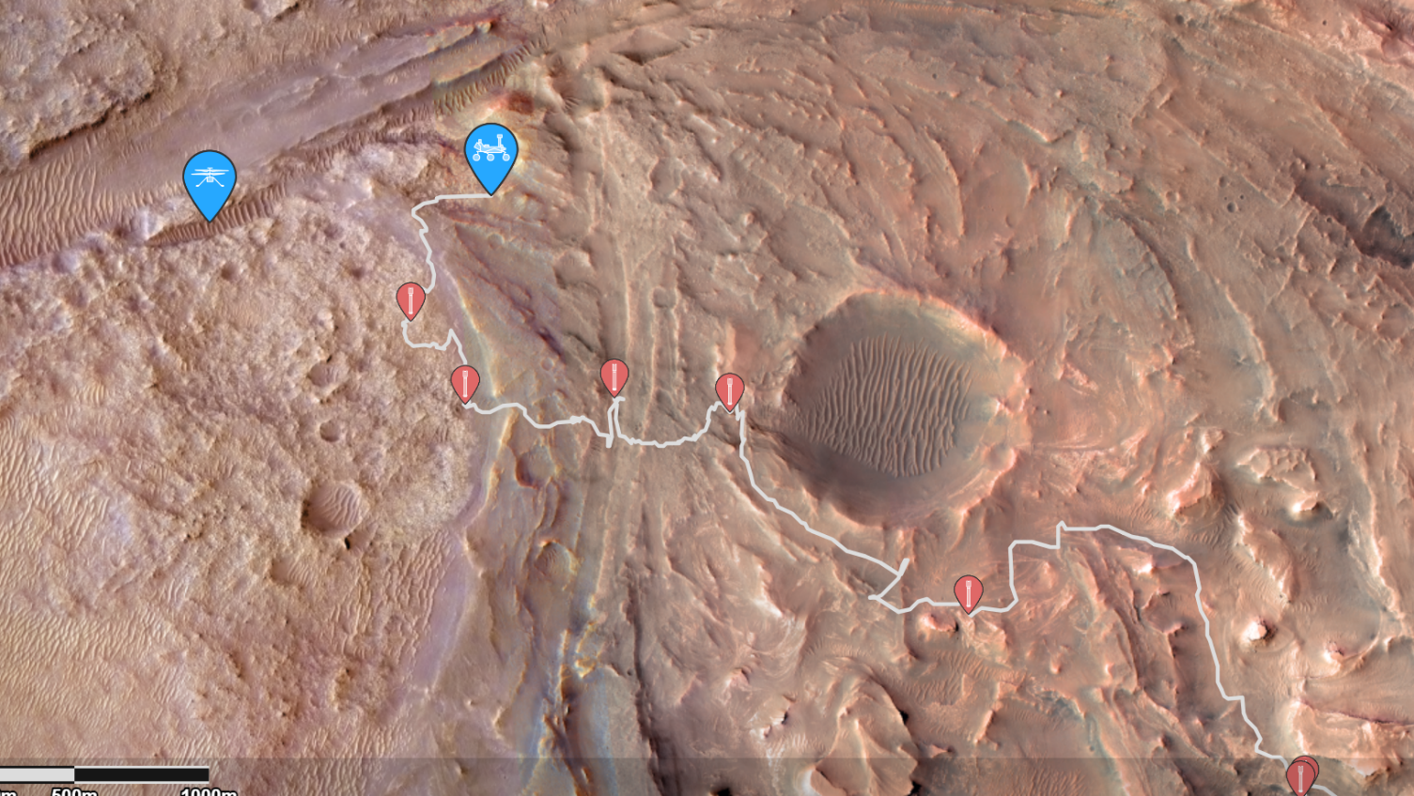
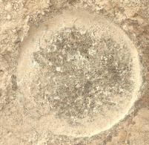
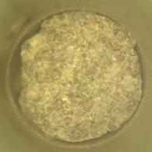
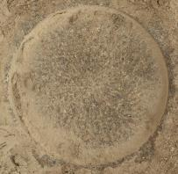
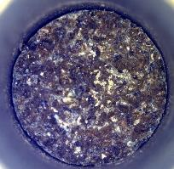
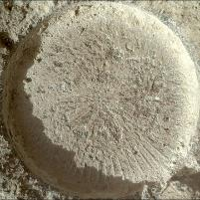
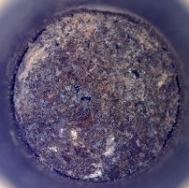
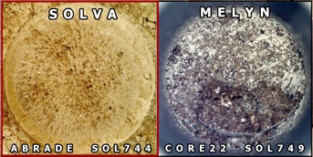
Upper Fan & Margin Unit Campaigns: Tubes 22-26
As of Nov 2, 2023
METERS
200
17
DREAM
LAKE
EMERALD
LAKE
BILLS BAY
ABRADE SOL935
LEFROY BAY
CORE20 SOL942
AMHERST
POINT
ABRADE SOL915
PELICAN
POINT
CORE19 SOL923
GABLETOP MOUNTAIN
ABRADE SOL877
PILOT MOUNTAIN
CORE18 SOL882
TENBY
16

Slide 9
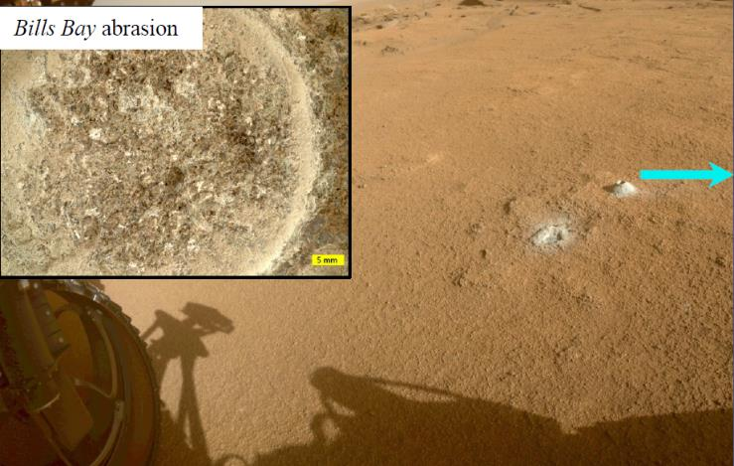
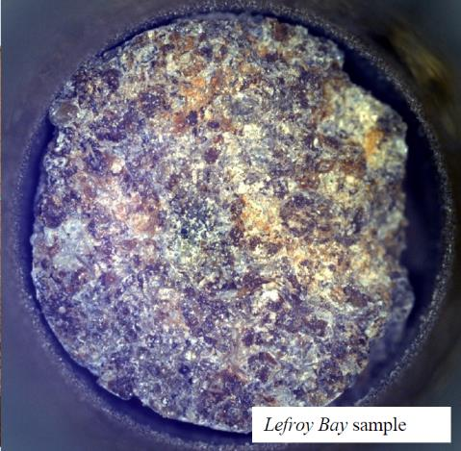
Latest Perseverance Sample: Lefroy Bay
Contains 1st confirmed presence of hydrated silica cement & hydrated carbonates
Potential good preservation media for biosignatures
Possible unique hydrated Mg sulfate and candidate phosphate or perchlorate detection
Record of a distinct habitable environment different from the delta front and upper fan
Opportunity to ground truth high-carbonate “hot spot” that led us to this outcrop by the CRISM data

Slide 10
MSR Campaign Science Organization
Current community science team
Dual Agency Leadership
MSR Campaign Science Executive Group
MSR Science Leadership
MSR Campaign Science Group (MSCG)
MSR Lead Scientist
Michael Meyer
MSR Lead Scientist
Gerhard Kminek
Current internal SRP science team
M2020 PS
Ken Farley
MSR PS
Mini Wadwha
NASA SRP PS
Dave Beaty
ESA SRP PS
Elliot Sefton-Nash
Joint Science Office (JPL/ESA/JSC)
NASA & ESA Project Scientist (PS)
Deputy Project Scientists
Staff
M2020 Science Office/Team
MSR Program Science Office
NASA/ESA Jointly Managed
NASA Appointed
ESA Appointed
Subject Specific Working Groups (e.g., SRF Contamination Panel, Rock Team, Gas Team)
Externally Selected
Programmatic Relationship
Direct Reporting Relationship
Notes:
Currently, SRP has both internal and external science teams to speak for the samples in various different ways. Point out the elements in the orange boxes and maybe explain role of the Joint Science Office. More will be said about the MCSG later.
MCSG = MSR Campaign Science Group. Competed group of international scientists that serves as a proxy for a typical PSG until such time as PIs are selected
Competitively selected group of community experts that can be drawn upon by the MSR Campaign for scientific assessment, input, and recommendations
Represents the scientific interests of the broad international science community who are stakeholders in the scientific planning for MSR, until such time as investigation PIs & MSR Sample Science Team (MSST) are selected
Not empowered with decisional authority on agency matters; they provide the highest-level expert assessment available
MCSG Reports to the MSR Campaign Lead Scientists, while the Joint Science Office (JSO) coordinates and supports MCSG activities

Slide 11
Notional Plan for SRP Science Team
Regardless of phase, a science group will always be in place to participate in relevant activities
AO 1 will cover large instruments that need to be installed in the SRF during construction. AO 2 includes all other instruments both inside and outside the SRF.
PSG is sourced from SRP science team alongside project scientists
Until AO-2, the community is represented by the MCSG
FY24 | FY25 | FY26 | FY27 | FY28 | FY29 | FY30 | FY31 | FY32 | FY33 | FY34 | FY35 | FY36
MCSG1
SRP Science Team (Draft name: MSST)
R&A Activities
Sample Science
Community sourced science teams
Sample Arrival
MDT-1
AO 1
AO 2
Key milestones
MDT-2
SRP Joint Science Office
Science management
SRP PSG (Draft name: MCSG2)
Notes:
Notes from Dave/Brandi: MCSG to be recompeted periodically (thus the difference between MCSG1/2/3)
AO1 is for just a few instrument/Pis for large instruments that need to be installed in the SRF during construction
AO2 includes all other instruments/Pis both inside and outside the SRF. Once selections for AOs, this group constitutes the PSG (on contract in FY31-2 years before sample receipt)
Until AO-2, the community is represented by MCSG and successors
MDT1 informs measurements needed inside the SRF, MDT2 informs measurements outside SRF. These 2 reports will form the basis for the AOs for the science team/PSG
PSG is sourced from SRP science team alongside project scientists
Joint Science Office is analogous to project science office
MSST and MCSG2 terminology sourced from JSMP. MSST= MSR Sample Science Team

Slide 12
Mars Science Laboratory (MSL) Curiosity
Curiosity arrived at Gediz Vallis ridge August 14th!
“After three years, we finally found a spot where Mars allowed Curiosity to safely access the steep ridge,” Ashwin Vasavada (Project Scientist) commenting on reaching the ridge after previous attempts were thwarted by gator-back rocks and steep slopes
Curiosity acquired a drilled sample from light-toned bedrock found in the dark-light interlayered bands of the magnesium sulfate-bearing unit. This is the 3rd drill sample since encountering the unit ~115 vertical meters below, and 39th drill sample overall.
Layered Magnesium Sulfate-Bearing Unit
Gediz Vallis Ridge
NASA’s Curiosity captured this panorama while parked below Gediz Vallis Ridge (seen at right), a formation that preserves a record of one of the last wet periods seen on this part of Mars. After previous attempts, the rover finally reached the ridge on its fourth try. Credits: NASA/JPL-Caltech/MSSS
Notes:
Curiosity recently reached Gediz Vallis Ridge and drilled its 39th core in the sulfate-bearing unit there, sixty meters higher in elevation than the previous drilling location.
The ridge is scattered with rocks that were likely carried down Mount Sharp by powerful debris flows three billion years ago, presenting a selection of otherwise unreachable targets that record one of the last wet periods on Mars.
The sulfate bearing unit likely appeared during a time when Mars was drying out, providing a record of when the planet was becoming the cold-dry Mars of today
Curiosity’s science team has completed its investigation of the Gediz Vallis Ridge, the erosional remnant of a massive debris flow deposit transported from higher on Mount Sharp. The flow, which included car-sized boulders, was likely lubricated by liquid water and occurred late in the history of the mountain. (the implication is that the sulfate unit is at least 115m thick).

Slide 13
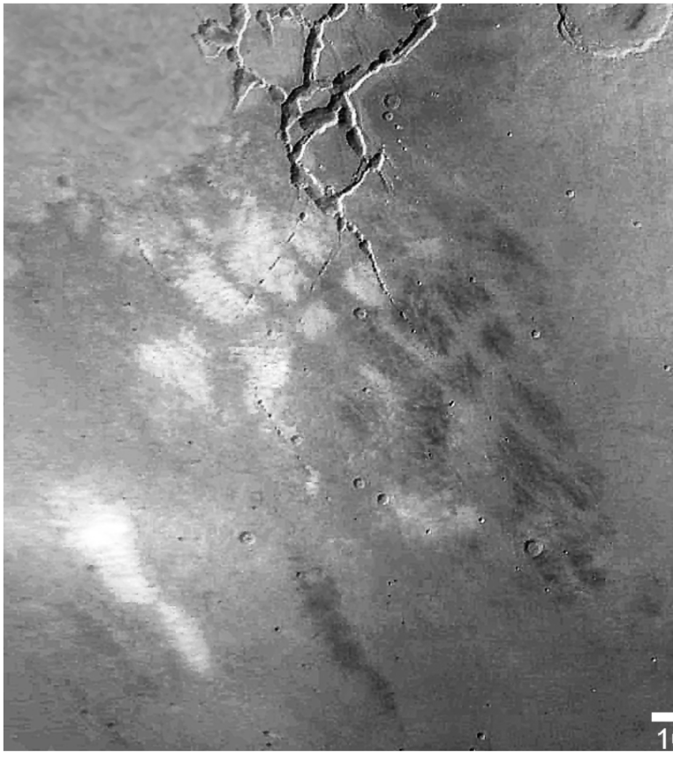
MRO MARCI Clouds
The MRO MARs Color Imager (MARCI) observes Mars to build a global picture of the weather on Mars each day
Condensate clouds play an important role in Mars’ energy balance, both reflecting incident solar radiation and trapping heat emitted by the surface
Active local, deep vertical transport in the Mars atmosphere is shown in this image as afternoon mesospheric condensate clouds above Sinai Planum in the Southern Tropics
This autumn cloud phenomena reached heights greater than 50 km as determined from shadow length measurements
The checkerboard cloud pattern is indicative of organized thermal convection.
The location of the clouds on the southern boundary of the Noctis Labyrinthus valley and canyon network suggests that upslope flow is working in conjunction with thermal convection to explain how the pattern formed at altitude.

Slide 14
with us

Slide 15
Inputs into MSR Sample Science Planning
Science Objectives
Contamination Control
Site Selection
Curation
Sample Selection
Collection
Analysis
Management
The darkness of the blue indicates extent of coverage for that category. Unless noted, all categories refer to the samples, e.g., Sample Management.
Notes:
The community has been involved in the science planning of MSR for quite a while across the different phases of sample’s lifecycle. Many of these reports themselves build on each other, and provide a rich background and context upon which today’s planning occurs.

