Slide 1
The Role of Mental Health in Affecting High Quality Research in Planetary Science
David Trang^{1,2}, Christina E. M. Swafford³, Tamar A. Kreps⁴, Steve D. Vance⁵, Jemma Davidson⁶, Justin Filiberto⁷, Lillian R. Ostrach⁸, Christina R. Richey⁵
¹Hawai‘i Institute of Geophysics and Planetology/University of Hawai‘i at Mānoa, ²Space Science Institute, ³Hawai‘i Pacific University, ⁴Shidler College of Business/University of Hawai‘i at Mānoa, ⁵Jet Propulsion Laboratory/California Institute of Technology, ⁶Buseck Center for Meteorites Studies/Arizona State University, ⁷ARES Division/Johnson Space Center, ⁸Astrogeology Science Center/USGS

Slide 2
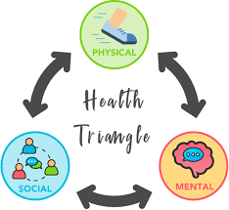
A Quick Overview of Mental Health
When is mental health a concern: Behavioral, emotional, and/or cognitive factors causes distress to a person’s home, work, and social life.
Poor mental health can adversely affect research quality and production as well as physical and social health
Mental health issues in academia have been noted (e.g., Evans et al., 2018; Levecque et al., 2017; Vance et al., 2021)

Slide 3
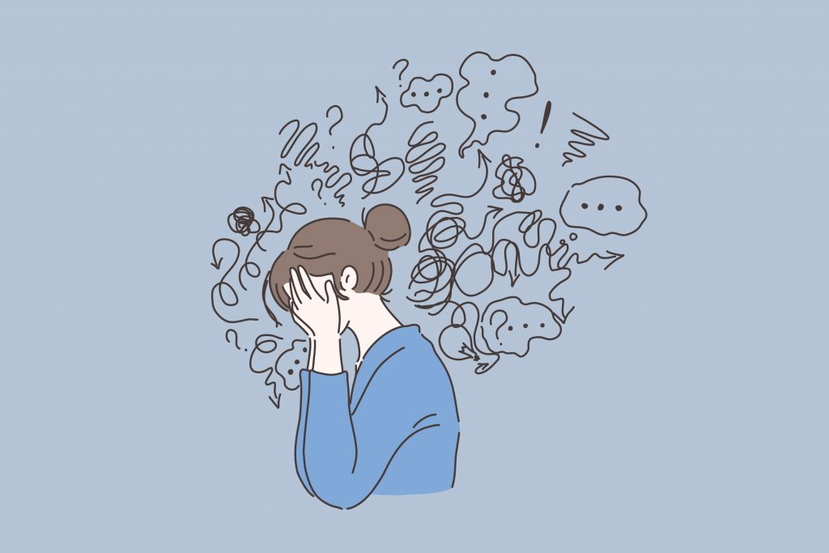
IRB-Approved Mental Health Survey
GOAL: Broad spectrum look at mental health (anxiety, depression, stress) in planetary science (i.e., is there a problem?)
We used three assessments: to measure depression, anxiety, and stress (DASS-42, PHQ-9, GAD-7; Lovibond and Lovibond, 1996; Spitzer et al., 2006; Kroenke et al., 2001)
Commonly used to help screen for depressive, anxiety, and trauma/stress-related disorders
The results are NOT a diagnosis

Slide 4
IRB-Approved Mental Health Survey
Other (5%)
September 14, 2022 to November 21, 2022
307 total participants
Survey included demographic questions (e.g., ethnicity, LGBTQ+, gender, career stage)
Survey demographic has higher proportion of participants that are early career, identify as female, and LGBTQ+ than the overall planetary science community (Porter et al., 2020; Vander Kaaden et al., 2020)
Grad Students (26%)
Established Career (35%)
Early Career (35%)
Non-Binary (7%)
Other (2%)
Male (35%)
Female (58%)

Slide 5
Prevalence of Clinically Significant Anxiety
Moderate and above severity is considered clinically significant
Compare prevalence of clinically significant anxiety between general US population (during the pandemic) and different career stages.
Use $χ2$ test of independence to look for statistical significance ($α$<0.05)
The prevalence of clinically significant anxiety is greater for all groups except government workers.
(Warren et al., 2021)
Indicates statistically significant differences between general US population and career stage

Slide 6
Prevalence of Clinically Significant Depression
Compare prevalence of clinically significant depression between general US population (during the pandemic) and different career stages.
Use $χ2$ test of independence to look for statistical significance ($α$<0.05)
The prevalence of clinically significant depression is greater for graduate students, postdocs, tenure-track faculty, and the overall planetary science community.
(Ettman et al., 2020)
Indicates statistically significant differences between general US population and career stage

Slide 7
Severity of Anxiety, Depressive, Stress Symptoms: Gender
Anxiety
Depression
Stress
Compare anxiety, depression, and stress severity between gender within our samples
Used a student t-test ($α$<0.05)
Female participants experience greater severity of anxiety and stress than male participants.
No statistical difference for depression.
Indicates statistically significant differences between the two groups, color indicates higher for that group

Slide 8
Severity of Anxiety, Depressive, Stress Symptoms: Ethnicity
Anxiety
Depression
Stress
Compare anxiety, depression, and stress severity between ethnicity within our samples
Used a student t-test ($α$<0.05)
People of color and mixed-race participants experience greater severity of anxiety in one measure than male participants.
No statistical difference for stress, depression, and one of the anxiety assessments.
Indicates statistically significant differences between the two groups, color indicates higher for that group

Slide 9
Severity of Anxiety, Depressive, Stress Symptoms: LGBTQ+ Identity
Anxiety
Depression
Stress
Compare anxiety, depression, and stress severity between those who identify with LGBTQ+ and those who do not within our samples
Used a student t-test ($α$<0.05)
Participants who identify with LGBTQ+ experience greater severity of anxiety, depression, and stress.
Indicates statistically significant differences between the two groups, color indicates higher for that group

Slide 10
Mental Health Impact on Research
Work values based reasons to care about mental health:
76% of our respondents said that their anxiety and depressive symptoms are making it somewhat/very/extremely difficult to attend to their work, home, and/or social lives
Poor mental health degrades research as the mind is distracted or focused on navigating symptoms (analogy: grieving scientist)
Mind cannot fully commit all mental resources to making the best interpretation or idea due to worry, stress, and/or hopelessness, hurting research quality and productivity (analogy: limited perspective taking in young children due to developing brain)
Not everyone is affected by mental health concerns, but mental health concerns in the community affects everyone
Notes:
Use sports analogy for second reason
Use health issues/grief analogy or computer model analogy for the third reason
Regardless of source, DEIA promotes recruitment and retention of diverse backgrounds who bring in diverse experiences and thoughts that will help expand potential interpretation of data.

Slide 11
Summary
There is a mental health problem in planetary science
These mental health concerns impact research production and quality

Slide 12
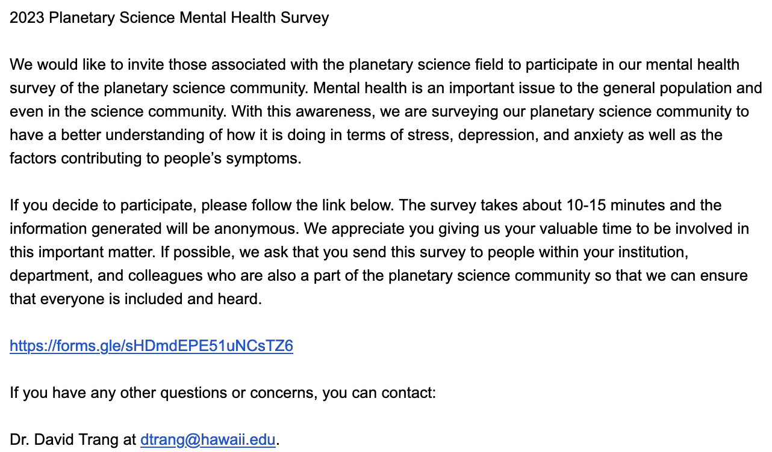
2023 Mental Health Survey Ad
We are running an IRB-approved mental health survey again! Please share with colleagues and students!
The Link: https://forms.gle/sHDmdEPE51uNCsTZ6

Slide 13
Extra Slides

Slide 14
Demographic
Other (2%)
Other (5%)
Non-Binary (7%)
POC and Mixed Race (19%)
Male (35%)
Female (58%)
White (76%)

Slide 15
Demographic
Other (3%)
Other (5%)
Grad Students (26%)
LGBTQ+ (25%)
Established Career (35%)
Maybe/Questioning (7%)
Non-LGBTQ+ (65%)
Early Career (35%)

Slide 16
Who is Leaving Planetary Science?
Comparison between those who plan to stay in planetary science in the next two years and those who are considering or planning to leave.
Respondents who are considering or planning to leave planetary science show statistically significant greater anxiety, stress, and depression (t-test) than those who plan to stay.
$χ2$ test of independence show that LGBTQ+ respondents have a statistically significant greater likelihood of leaving. No difference is shown for ethnicity and gender.

Slide 17
Who is Leaving Planetary Science?
Looking at mental health may have exposed other diversity, equity, and inclusion issues
Institutions focused on diversity, equity, and inclusion need to think about retention, rather than just recruitment of marginalized groups
Diversity, equity, inclusion is important to research production and quality. Without it, we may be turning away some of our greatest minds

Slide 18
Things to Think About or Just Try
For students/postdocs (lessons learned from the history of children)
There should be mentor/advisor training before having students
Cultural shift: Graduate students are not little senior scientists, focus should be on training, rather increasing production.
For post training career stages
Improved division of labor (e.g., teaching, mentoring, and research requires different personalities).
Improved allocation of tasks/work to reinforce people’s enjoyment of research.
Cultural shift: For a scientist to win a competitive opportunity, they need to outperform everyone else. The only way to do this is to spend more hours working, which causes poor work/life balance

Slide 19
Summary
There is a mental health problem in planetary science
These mental health concerns impact research production and quality
Be courageous and try new ideas and adapt new cultural changes
Planetary science has always been more than exploring what’s out there, but who we are and how to better ourselves and humanity

