Slide 1
NASA Astrobiology Program Update
David Grinspoon
Senior Scientist for Astrobiology Strategy
Lindsay Hays
Program Scientist for Astrobiology
PAC Meeting
November 13, 2023

Slide 2
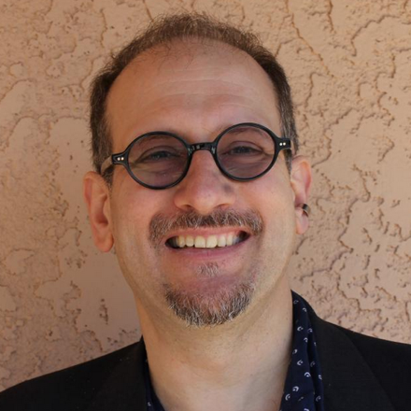
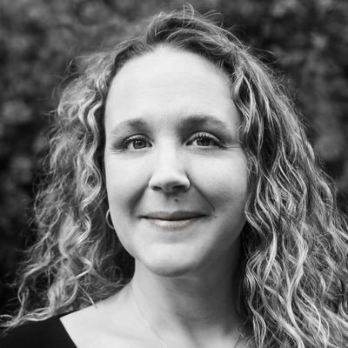

New AB program leadership
Senior Scientist for Astrobiology Strategy
(David Grinspoon):
“Up and out”
Expand the astrobiology program within NASA and beyond.
Program Scientist for Astrobiology
(Lindsay Hays)
“Down and in”
Manage existing research programs.
Deputy Program Scientist for Astrobiology
(Becky McCauley Rench)

Slide 3
New NASA Astrobiology Org Chart

Slide 4
Astrobiology Research Programs
C.5 Exobiology (PO: Lindsay Hays)
  Aim is to understand the origin, evolution, distribution, and future of life in the Universe. Research is centered on the origin and early evolution of life, the potential of life to adapt to different environments, and the implications for life elsewhere.
C.14 Planetary Science and Technology Through Analog Research (PSTAR) (PO: Becky McCauley Rench)
  This program solicits proposals for investigations focused on exploring the relevant environments on Earth in order to develop a sound technical and scientific basis to conduct astrobiological research on other Solar System bodies.
C.20 Interdisciplinary Consortia for Astrobiology Research (ICAR) (PO: Lindsay Hays)
  Proposals that describe a multi-million dollar, five-year project with an interdisciplinary approach to a single, compelling question in astrobiology. For projects larger than the scope of the individual research programs, but within the scope of the Research Coordination Networks.
F.4 Habitable Worlds (HW) (PO: Becky McCauley Rench)
  Aim is to use knowledge of the history of the Earth and the life upon it as a guide for determining the processes and conditions that create and maintain habitable environments and to search for ancient and contemporary habitable environments and explore the possibility of extant life beyond the Earth.
Notes:
Additionally contribute to and overlap with:
PICASSO/MatISSE (instrument development)
FINESST (Graduate Student Grants)
ISFM (NASA Civil Servant research)
TWSC (workshop/conference)
Planetary Protection Research
Exoplanets Research Program

Slide 5
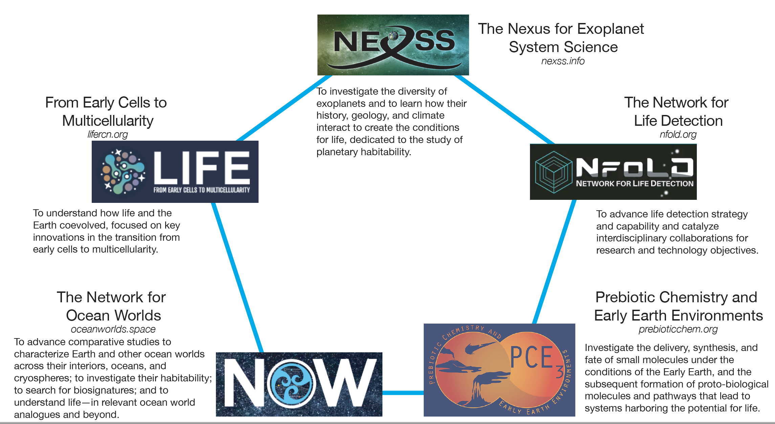
Research
Coordination
Networks
Notes:
Remember – not a funding mechanism; co-leads and steering committees are comprised of folks who receive NASA funding (including ICARs – all of which are part of an RCN), but there are affiliates who may or may not have NASA funding, and the whole RCN is charged with coordinating activities on behalf of the whole research community

Slide 6
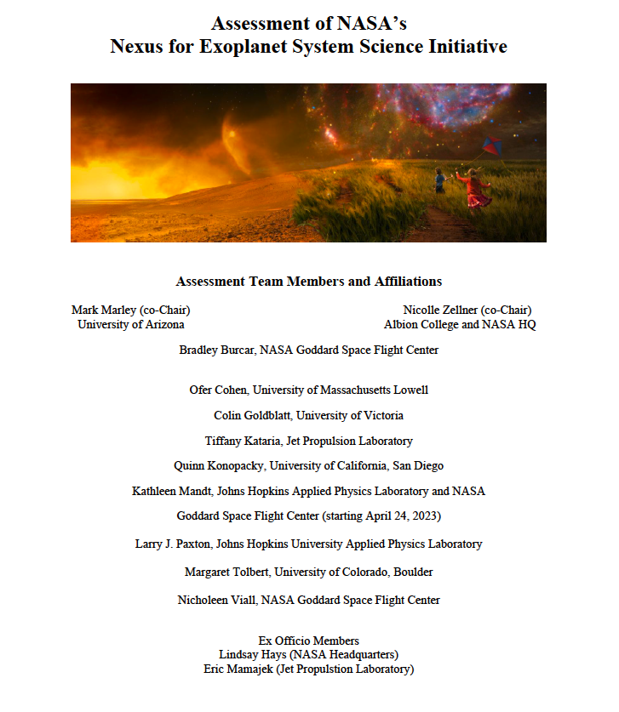

Slide 7
NExSS Assessment
Assessment undertaken early 2023, cross-divisional review panel
Intended to:
  assess the overall success of NExSS with regards to the progress on its stated goals
  gather lessons learned from the first six years of operation of NExSS
  collect information regarding the challenges NExSS has faced
Findings:
  Positives:
    ﻿﻿NEXSS has demonstrably catalyzed interdisciplinary, community interactions in ways that have benefited the community, including observing campaigns, modeling, input to decadals
    ﻿﻿NExSS is of high value for early career researchers involved in the NESS program
  Areas for improvement:
    ﻿﻿NASA Division representation
    ﻿﻿Leadership structure and selection process
    Financial and logistical support to the Co-Leads
    ﻿﻿Mission statement clarity and goal prioritization
Report and NASA response released soon

Slide 8
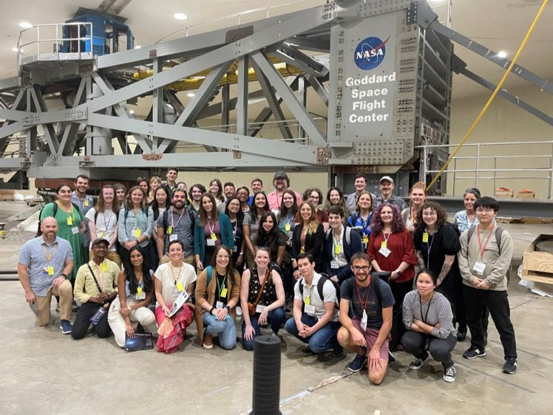
2023 Astrobiology Mission Ideation Factory​
Search for Life at Mars​
NASA Goddard Space Flight Center, August 21-25​
Contracted with KnowInnovation​
32 participants, U.S and international, first year graduate student to early career faculty, as many institutions, cross-disciplinary​
6 mission ideas presented at end of week by teams off 3-7 individuals​
7 mentors from variety of backgrounds​
Planning follow-up activity (Phase 2) to work on mock data from mission ideas and how they could be used to detect life​

Slide 9
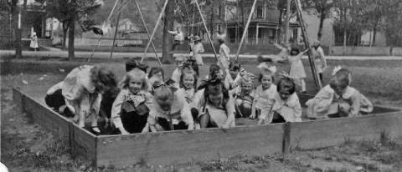
UPCOMING: Biosignature IDEAS Lab
Inputs: Grand Challenge Topic, Creative People, Money
Creative Environment: “Ideas Lab”
Outputs: Potentially Transformative, Novel, Adventurous, Innovative, Interdisciplinary Ideas “Wow Factor”

Slide 10
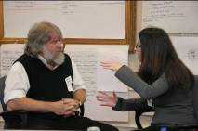
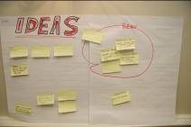
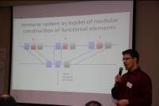
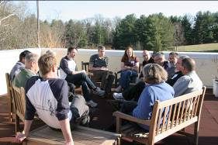

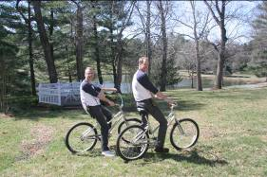
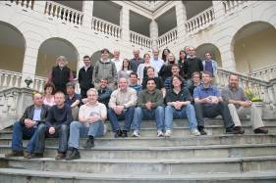
UPCOMING: Biosignature IDEAS Lab
Who is involved?
Mentors
  focus on the topic
Facilitators
  focus on the process
Participants
Interact
Clarify
Ideate
Develop
Implement
Real time peer review
2 months
Submit full
proposals
Three-day residential sandpit
Three virtual meeting days
Select project ideas
Notes:
More details coming this fall
To take place early in 2024

Slide 11
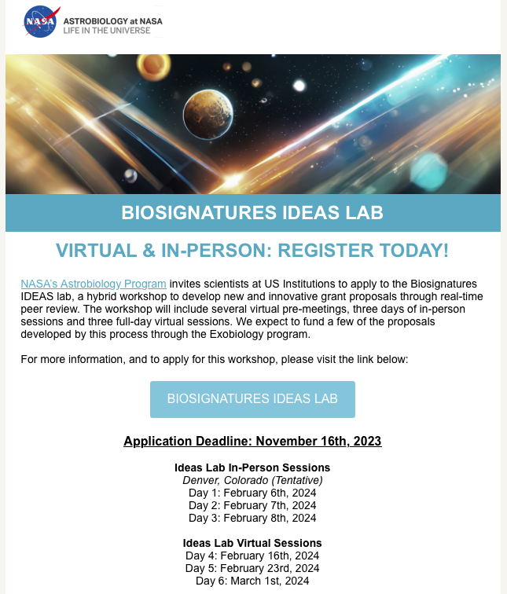
https://apply.knowinnovation.com/ nasabiosignatures/

Slide 12

Future Directions :
(1/2)
Increased cross-divisional & cross-directorate activity in Astrobiology at NASA.
Interagency programs (NSF, USGS, NIH…).
Revitalized international connections & collaborations.
Public/private partnerships.
The current divisional structure within the Science Mission Directorate largely predates the discovery of exoplanets and significant placement of the search for life as a cross-cutting theme for NASA science.
Goal: Raise visibility of astrobio program, increase connectivity. Look to bolster existing activities with new models for support of interdisciplinary, cross-divisional research projects.

Slide 13

Future Directions :
(2/2)
Post discovery planning/imagining
– communication.
-- science.
Astrobiology & global sustainability/Anthropocene/
  future of life/technosignatures
Transformative potential of new technologies: AI,
machine learning, networked smallsats…
Ethical issues in fieldwork, exploration
If we succeed in “finding life” that is not the end but a new beginning for Astrobiology.
Comparative planetology -> comparative biospheres, biochemistries, etc.
What would that science look like?

Slide 14
Strategic input into existing programs:
Additional models of support and structure for RCNs: Are we maximizing openness, transparency, regular processes?
NExSS Review.
How does RCN structure affect overall cohesiveness of larger community?
Relationship with Astrobiology at NASA Centers.
Astrobiology input to missions.
Communications/Engagement,
within NASA
within our scientific community
with the public(s)
Community building.

Slide 15
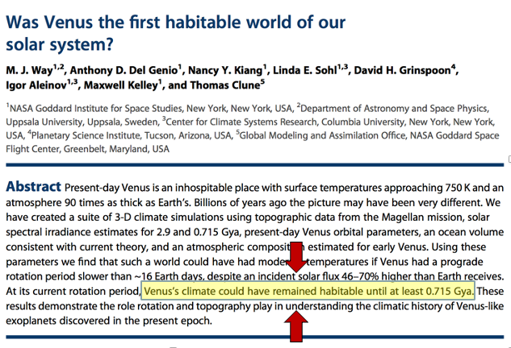
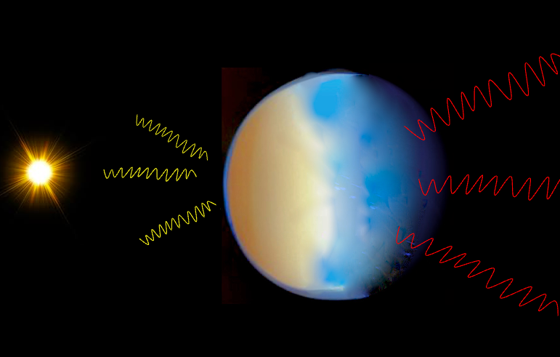
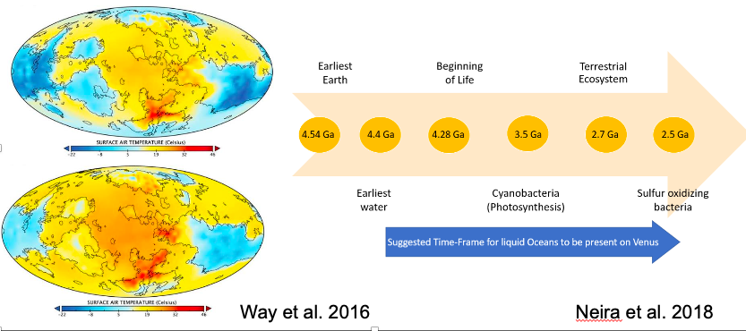
Example of Inter-Divisional Research Potential:
Tools from Earth Science
Data from Planetary & Helio
Tested with future planetary missions
Results relevant for Exoplanets, future space telescopes, etc.

Slide 16
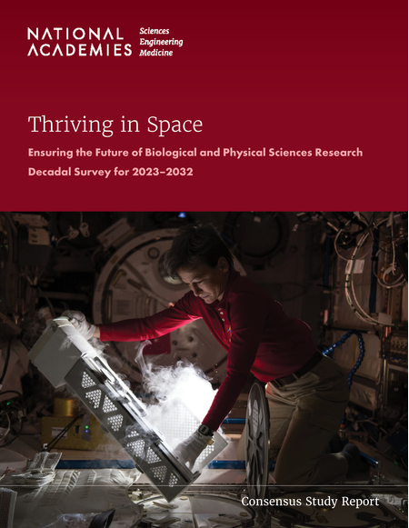
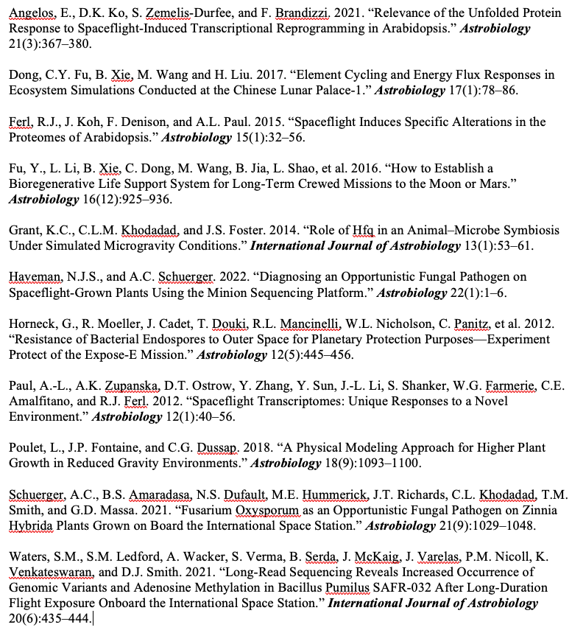

Slide 17
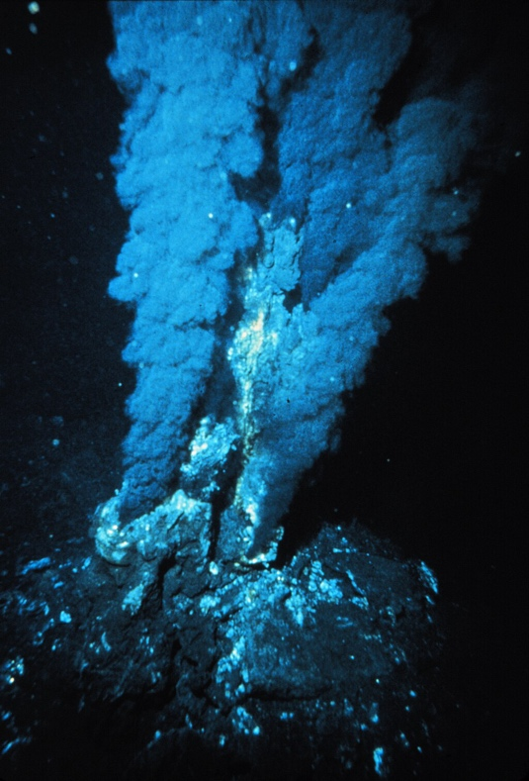
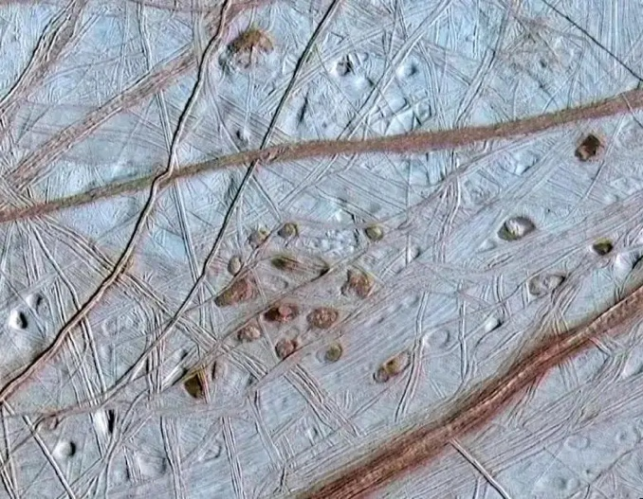
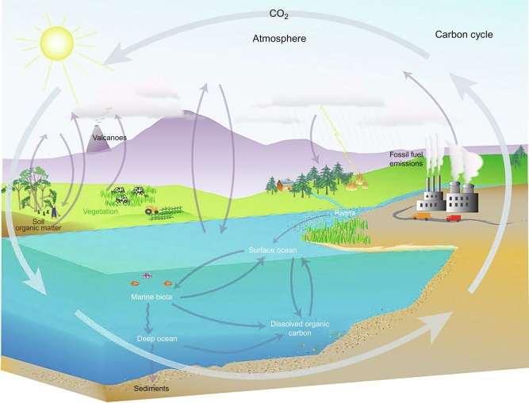
Earth Science Connections
Ocean Worlds
Hydrothermal Vents
Ocean Drilling (joint workshop with NSF ?)
Cryospheres
Biogeochemical Cycles
Climate Science

Slide 18
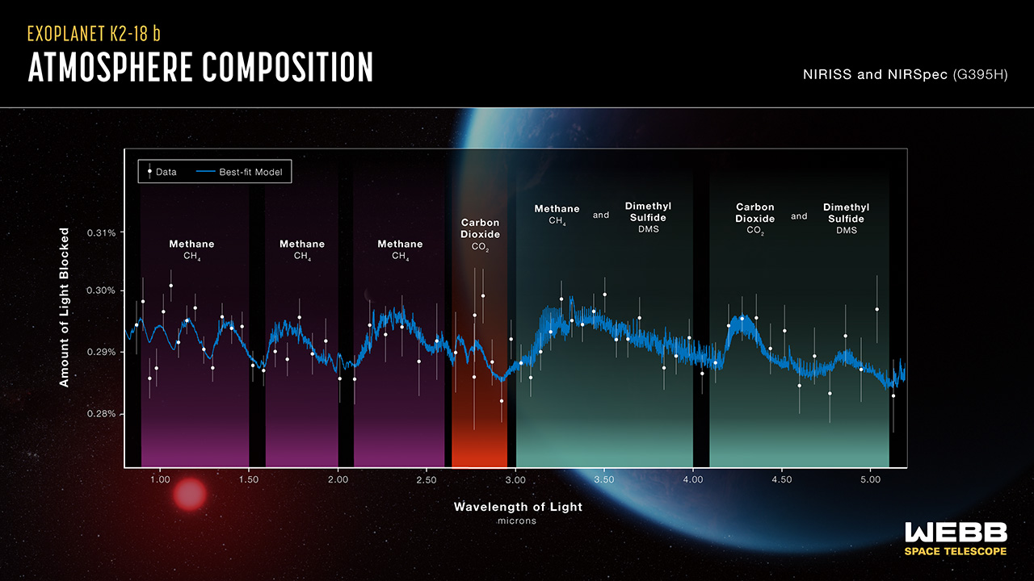
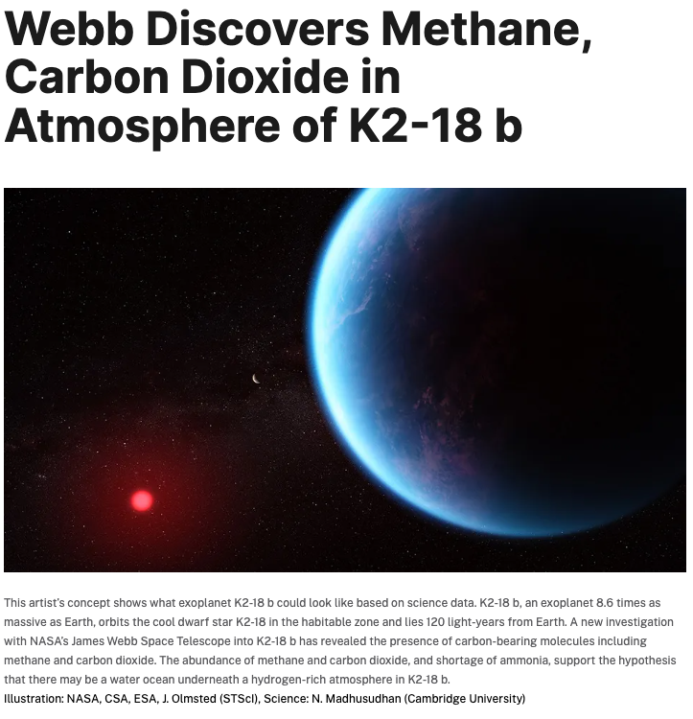
Communication Challenges

Slide 19
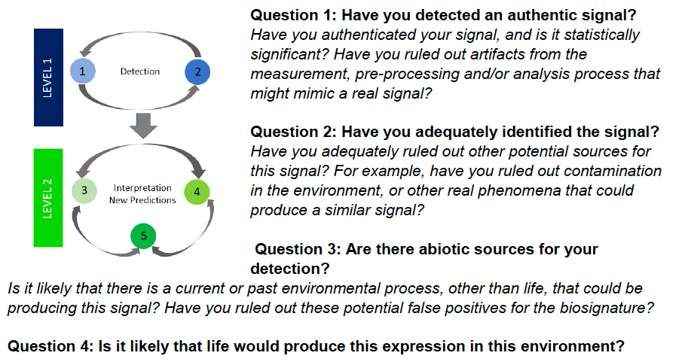

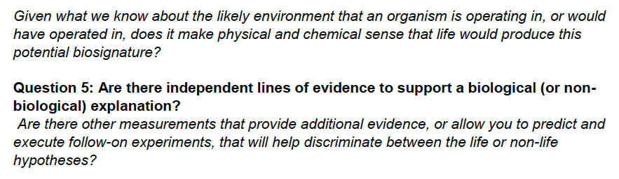
Standards of Evidence

Slide 20
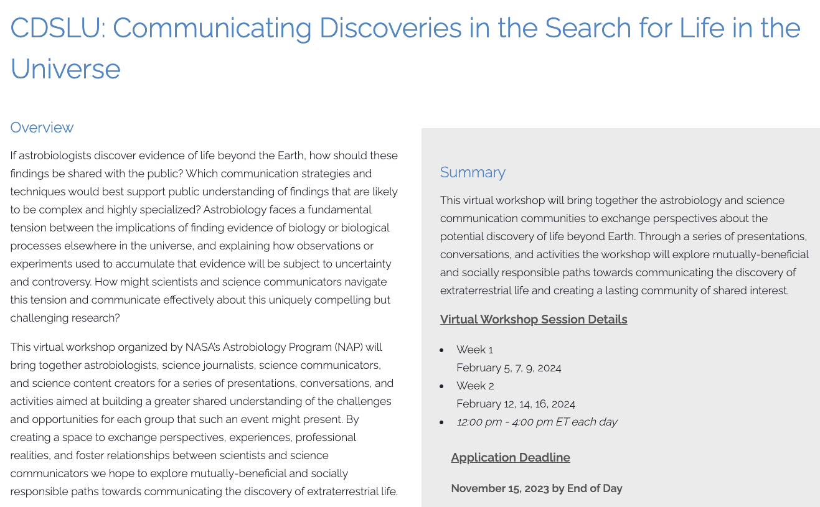

Slide 21
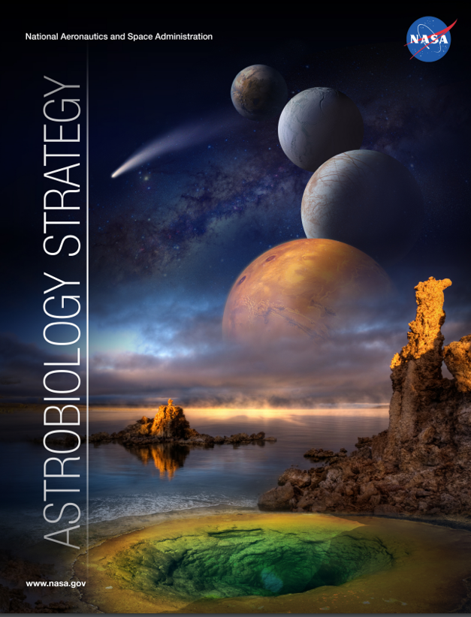
Astrobiology Strategy 2025
We are starting to plan an activity to formulate a new Astrobiology Strategy
A decade since the previous one.
Much has happened:
-New Decadal Survey.
-Concrete evidence of habitable early environments on Mars.
-Dragonfly selection.
-Exoplanets (discovery that Trappist-1 has multiple planets in potentially HZ).
-Tremendous progress in understanding biology and environmental evolution
of early Earth.
Include post-discovery science strategy?
Worth looking more than 10 years ahead?
20 years from now: Hopefully, samples back from many targets, HWO will be operating,
perhaps we’ll be planning a fleet of next generation telescopes, perhaps we’ll have
found multiple biosignatures (or not).
What laboratory & analytical techniques might we have access to?
What will our science look like?

Slide 22
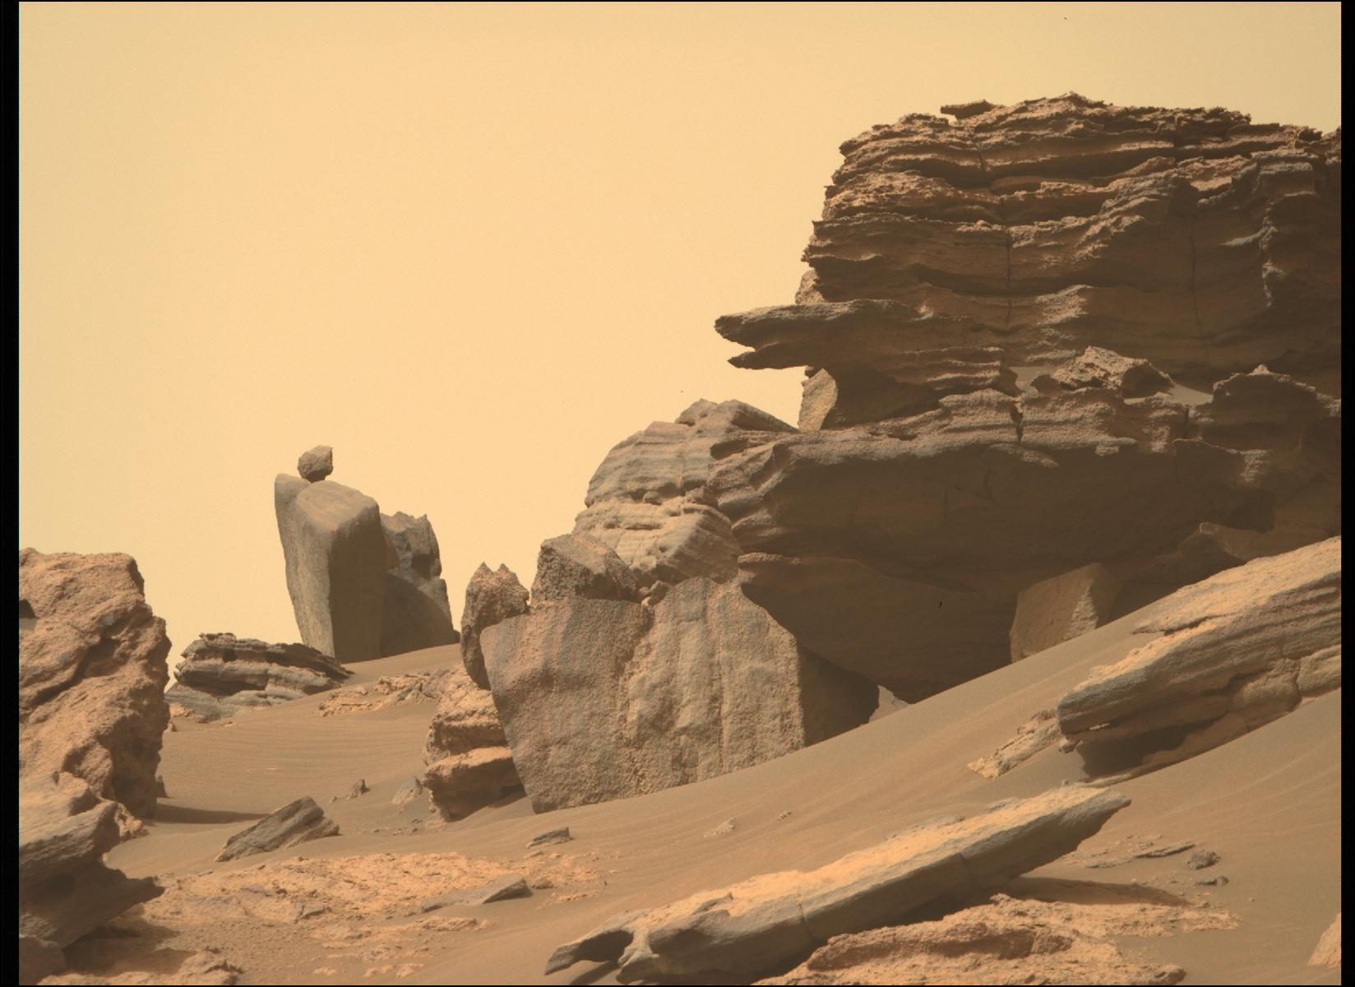
Questions?

