Slide 2
Who are we?
What are our goals?
A community dedicated to understanding life-planet co-evolution recorded in the rock record, in biodiversity, in genome databases, and modeled in silico or by lab proxy studies.
To understand how major biological innovations shaped the evolutionary path of our integrated life-planet system.
To discern the rules of co-evolution so as to predict how life could evolve on worlds other than our own and inform how we search for it.
A community that will develop a science of living worlds by viewing life-planet co-evolution through one lens asking: What environmental pressures, biological mechanisms, and evolutionary opportunities:
gave rise to cellular life?
caused life to expand to planetary scale?
led to the emergence of eukaryotes?
favored the transition from single cells to multicellularity?

Slide 3
Who are we?
co-Leads:
Ariel Anbar, Arizona State
Mary Droser, UC-Riverside
Betül Kaçar, UW-Madison
Frank Rosenzweig, Georgia Tech
NASA Point of contact:
Becky McCauley-Rench
Steering committee
Don Burke-Aguero, U Missouri
Shelley Copley, CU Boulder
Mark Ditzler, NASA Ames
Ben Gill, Virginia Polytechnic
Trinity Hamilton, U Minnesota
Tim Lyons, UC Riverside
Niki Parenteau, NASA Ames
Cynthia Silveira, Univ Miami
Daniel Stolper, UC Berkeley
Steve Vance, JPL
Early career investigator committee, 2023
Christina Buffo, Gatech
Jaime Cordova, UW-Madison
Bruno Cuevas, UW-Madison
Ethan Edmans, ASU
Brandon Hasty, ASU
Adam Hoffman, UCR
Charles Ross Lindsey, Gatech
Kathryn Rico, ASU
Rachel Surprenant , UCRr
Notes:
NOTE #1 Steering Committee Animation #1. Please add names, affiliation, email of newest folks
NOTE #2 We also wanted to engage the FUTURE by involving Early Career investigators, and empowering them to take charge of key RCN activities
Our 2023 committee is composed of Animation #2.

Slide 4
What are we doing to reach our goals?
From our Charter
Outreach
LIFE will bring together paleontologists and geobiologists, geochemists and biochemists, molecular biologists, and evolutionary biologists in an intellectual environment that is collegial and scientifically rigorous.
We welcome theoreticians and experimentalists investigating evolution of catalysts, pathways, networks, and compartments across scales from macromolecules to ecosystems in ways that inform the search for past and presently inhabited worlds and their biosignatures.
Presence at AbGradCon 2023
6 Session Proposals to AbSciCon 2024
Seminar series

Slide 5
What are we doing to reach our goals?
LIFE RCN Speaker series
Led by Early Career Committee
Showcases research by leaders and emerging leaders in Astrobiology.
1st Monday of the month,1-2 pm EST, live-streamed 30-40 min talks followed by moderated Q&A.
Open to all who share an interest in Earth-life co-evolution from early cells to multicellularity.
Date | Speaker | Field
5 June | Maria Rebolleda Gomez, UC Irvine | Microbial Communities
10 July | Paula Welander, Stanford | Archaea
18 Sept. | Steve Vance, JPL | Ocean Worlds
2 Oct. | Patricia Sanchez-Baracaldo, University of Bristol | Origins of Photosynthesis
6 Nov. | Galen Halverson, McGill | Geochemistry
4 Dec. | Chinmayee Govinda Raj, NASA Ames | Instr. Dev. & Space Biol.
Notes:
PLEASE INSERT SPEAKER LIST

Slide 6
What are we doing to reach our goals?
Outreach
LIFE member leadership at GRC, SMBE, AGU et al.
Presence at AbGradCon 2023
6 Session Proposals to AbSciCon 2024
LIFE member leadership of local symposia, e.g., Spring 24 Suddath Symposium at Georgia Tech
Evolution of Multicellularity & Cellular Differentiation

Slide 7
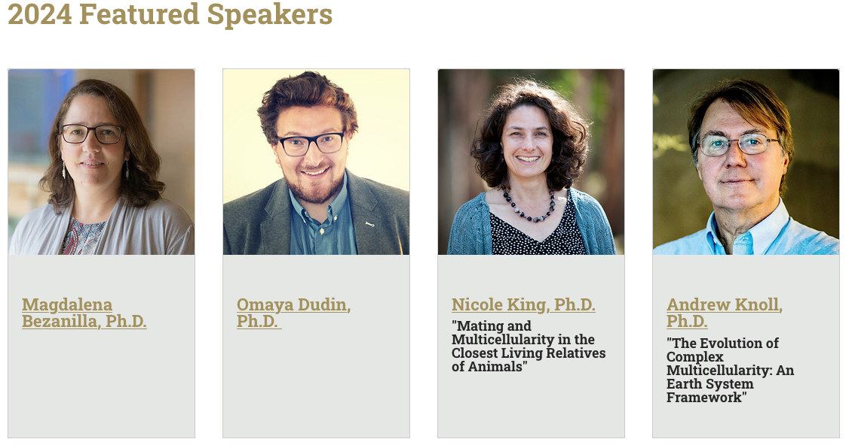

Slide 8
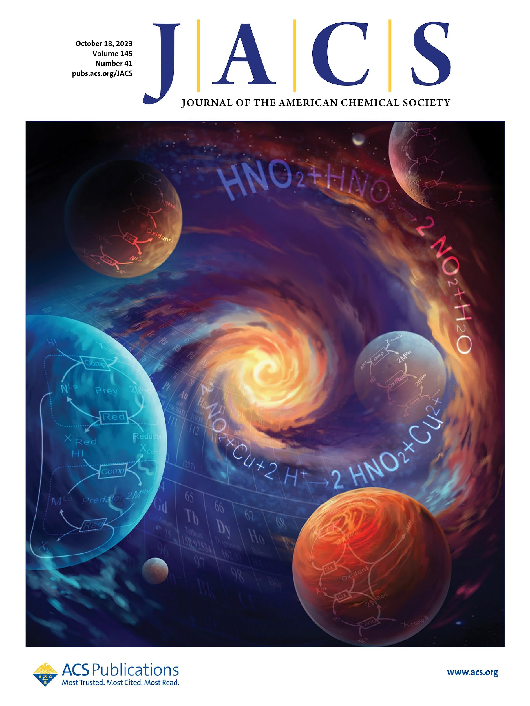
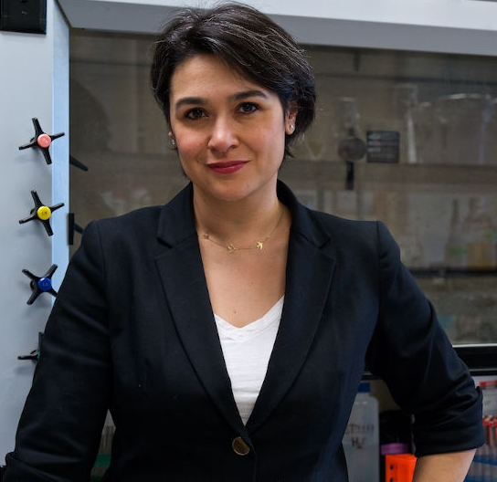
What are we doing to reach our goals?
Outreach
LIFE member leadership at GRC, SMBE, AGU et al.
Presence at AbGradCon 2023
Session Proposals to AbSciCon 2024
LIFE member leadership of local symposia, e.g., Spring 24 Suddath Symposium at Georgia Tech
Evolution of Multicellularity & Cellular Differentiation
LIFE member leadership at NAS CAPS
Ancient Life on Earth as a Guide for Alien Earths
Prof. Betül Kaçar, UWisconsin-Madison
24 October 2023
Beckman Center, Irvine, CA
Image: Peng, Adams, Fahrenbach, Kaçar. 2023. 145: 22483-22493.

Slide 9
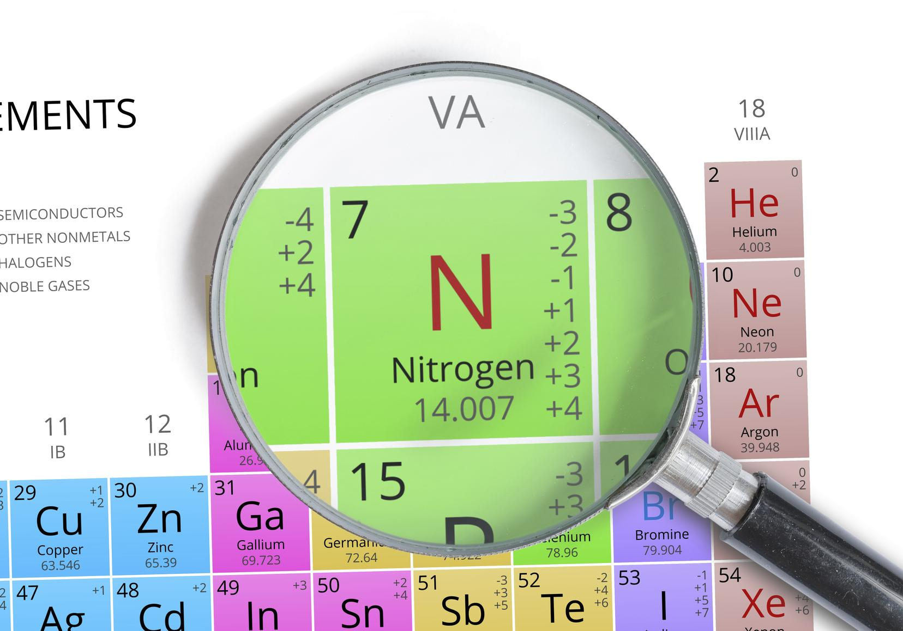
What are we doing to reach our goals?
Fall 2023 Virtual Workshop
Nitrogen Cycling Across Planetary Scales
October 18 and 20, 2023
Lead Organizers: Ben Johnson (Iowa State),
Eva Stueeken (St. Andrews Univ)
Synopsis: Life as we know it requires nitrogen, but how does our understanding of the N cycle inform our search for life in the universe? The goal of this workshop was to define key questions that should focus research in anticipation of the next generation of astrobiology exploration.
Presentations covered planetary origins and formation, terrestrial planets, icy worlds, and evolution
Attendees: 100 (day 1); 70 (day 2)
Manuscript in preparation

Slide 10
What are we doing to reach our goals?
Research
ICAR 2021, PI: Betül Kaçar, UW-Madison
Metal Utilization across Eons (MUSE) https://museastrobiology.org/
Ariel Anbar¹ (DPI), Anne Dekas², Betsy Swanner³, Amanda Garcia⁴, Lance Seefeldt⁵, Bill Seyfried⁶, Kurt Konhauser⁷
¹ Arizona State University, ² Stanford University, ³ Iowa State University, ⁴ UW-Madison, ⁵ Utah State University, ⁶University of Minnessota,⁷ University of Alberta

Slide 11
What are we doing to reach our goals?
Research
ICAR 2021, PI: Betül Kaçar, UW-Madison
Metal Utilization across Eons (MUSE)
MUSE focuses on the evolution of metal use on Earth - specifically, the biochemistry of carbon and nitrogen acquisition throughout time. MUSE conducts geochemical and biological investigations that involve ancient materials, modern experiments, and exploration of past and present natural systems.

Slide 12
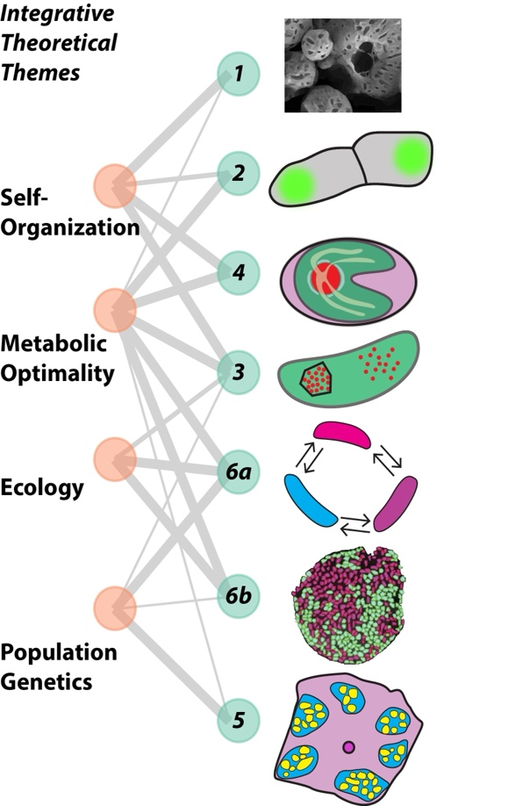
What are we doing to reach our goals?
Research
ICAR 2023
Engine of Innovation:
How compartmentalization drives evolution of novelty and efficiency across scales
Jeff Cameron¹, Shelley Copley¹, Joshua Goldford^{2,5}, Chris Kempes³, John McCutcheon⁴, Victoria Orphan⁵, Frank Rosenzweig⁶ (PI), Alexis Templeton¹, Boz Wing¹
¹CU-Boulder, ²Blue Marble SSI, ³Santa Fe Institute, ⁴Arizona State Univ, ⁵Caltech, ⁶Georgia Tech
We define a compartment as a structure in which exchange of components with the surrounding milieu is restricted, often but not always, by a membrane or a protein shell. We hypothesize that compartmentalization increases flexibility and/or efficiency in acquiring, processing and conserving resources across scales from the molecular to the ecological. To test this hypothesis we will use theory and experiment to study an increasingly complex hierarchy of compartmentalized structures:
prebiotic aggregates,
problematic metabolites,
bacterial micro-compartments,
nested metabolic compartments
serial endo-symbioses,
microbial consortia.
Notes:
EXECUTIVE SUMMARY (1st Paragraphs) A turning point in the history of life occurred when populations of self-replicating molecules crossed the Darwinian Threshold to cellularity. This most consequential of evolutionary transitions opened the door to the evolution of biocomplexity at all scales, from molecules to ecosystems. The hallmark feature of this transition was the enclosure of self-replicating molecular systems within a boundary. Thus confined, the living world began a process of diversification, driven by biochemical and morphological innovation within compartments. Compartmentalization is a principle by which living systems are organized today, whether that means colocalizing proteins and small molecules into separate phases or dividing labor within and among cells. Members of this interdisciplinary research consortium are motivated to answer the overarching question: How does compartmentalization drive evolution of novelty and efficiency across scales?
We define a compartment as a structure in which exchange of components with the surrounding milieu is restricted, often but not always by a membrane or a protein shell. We hypothesize that compartmentalization increases flexibility and/or efficiency in acquiring, processing and conserving resources across scales from the molecular to the ecological. We will explore the evolution and functional consequences of compartmentalization across scales that span four levels of complexity: 1) encapsulation of reactive organic and inorganic constituents in a primordial membrane; 2) protected environments within cells created by protein-protein interactions that enhance the efficiency of critical reactions; 3) compartmentalization of genomes within cells created by successive rounds of endosymbiosis; and 4) compartmentalization of metabolic processes among cells created by syntrophic interactions.
We contend that compartmentalization not only brought life across the Darwinian Threshold, but that it also set the stage for every type of cooperative interaction from metabolism to ecosystems. We further contend that, in order to trace the evolutionary path from earliest cells to multicellularity, astrobiologists need to consider not just the rock record and the genomes of extant species, but also those structures in extant living systems that enable different functions to be hosted and regulated within and between cells. These structures are emergent properties of genomes, produced by complex interactions among many genes, and most are too fragile to be preserved in the rock record. Thus, the best way to understand the evolution and consequences of compartmentalization is to discover how it works across scales in protobiological and extant biological systems. From this fresh perspective, our conceptually and theoretically integrated themes will generate fundamental new insights into the environmental pressures and evolutionary opportunities that brought about the first cells, the diversification of those cells, the emergence of eukaryotes and the emergence of cooperating societies of cells.

Slide 13
Online community seminars and workshops!
lifercn.org
@LIFE_RCN
youtube.com/@LIFE-RCN

Slide 14
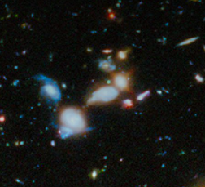
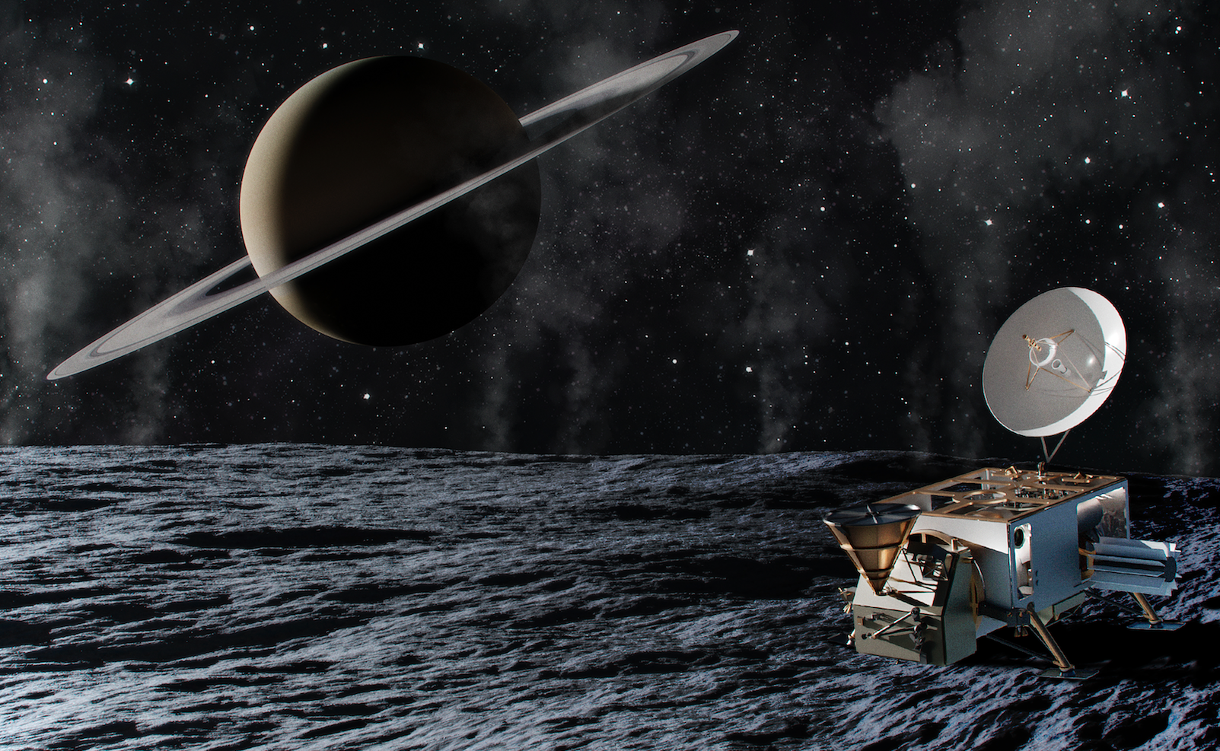
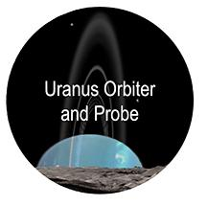
A connected network of networks – supporting current NASA Mission Science
Prebiotic Chemistry and Early Earth Environments
PCE3
NASA Astrophysics Division
NASA APD
JWST
Luvoir/HabEx
Perseverance
Mars Sample
Return
OSIRIS REx
LIFE: Early Cells to Multicellularity
ECM
The Nexus for Exoplanet System Science
NExSS
Enceladus Orbilander
Europa Clipper
Europa Lander
Dragonfly
NASA Earth Sciences Division
NASA ESD
Network for Life Detection
NFOLD
Network for Ocean Worlds
NOW

