Slide 1
Deep Space Network Updates
Presented to: ​
Planetary Sciences Advisory Committee
Presented by:​
Dr. Jeffrey Hayes
Discipline Scientist, Science Mission Directorate On Detail to the Space Communications and Navigation (SCaN) organization
Space Operations Mission Directorate
National Aeronautics and Space Administration
November 14, 2023​

Slide 2
Outline
1
About SCaN
DSN Status, Challenges, and Plans
2
2

Slide 3
Enabling Human Space Exploration and Science
Develop, operate and manage all NASA space communications capabilities
Develop technologies to enable and enhance future mission experience
Manage NASA spectrum; represent NASA on
national and international spectrum management forums
Develop space communication standards as well as positioning, navigation, and timing policies
Represent and negotiate on behalf of NASA on all matters related to space communications and navigation

Slide 4
Deep Space Network (DSN)
DSN’s Role and Structure
DSN is the only US network dedicated to providing telecommunications services for missions beyond LEO
DSN also supports international spacecraft and scientific investigations (radar, radio astronomy and radio science)
DSN has three complexes, spread across the world to ensure 24/7 coverage
The NASA Jet Propulsion Laboratory (JPL) develops, operates, and manages DSN

Slide 5
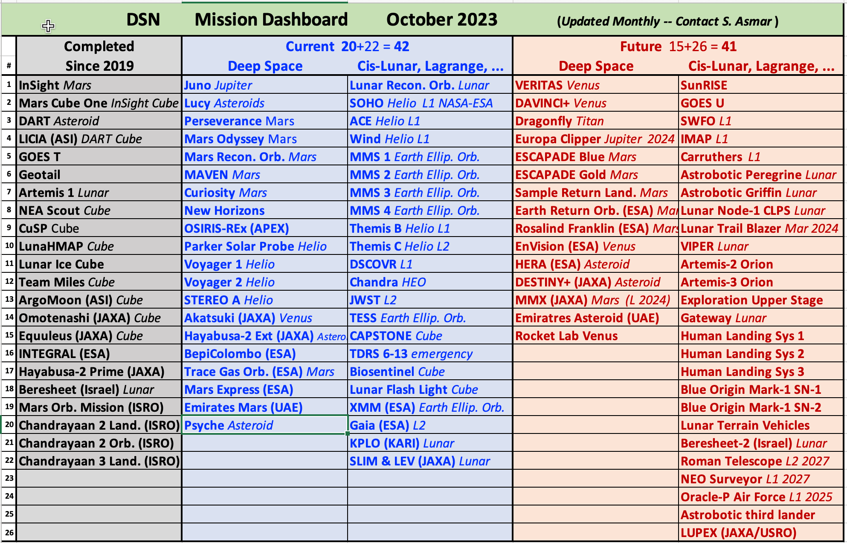
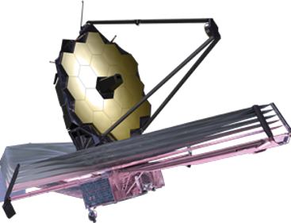
Deep Space Communications are Key to Agency Priorities
Notes:
Current and Future projected mission list represents a real challenge
Focus remains on:
Maintaining infrastructure to meet operational needs → “Road to Green”
Adding capacity where budget supports it
Looking for practical ways to improve beyond the higher-cost infrastructure items
Encouraging good stewardship of the assets by the mission community

Slide 6
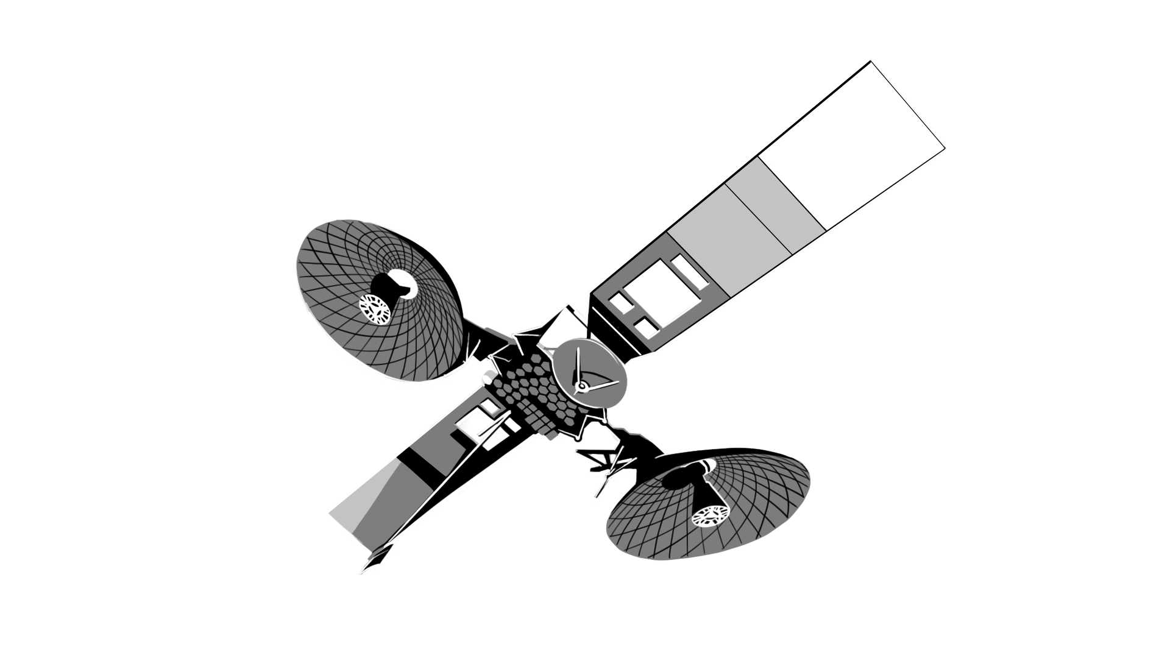
NASA’s Communications Networks
NASA Near Space Network (NSN)
NASA Deep Space Network (DSN)
Commercial Stations Supporting NSN
Near Space Network: Tracking and Data Relay Satellites (TDRS)
Lunar Exploration Ground Sites (LEGS)
F13
F7
Optical
F8
Future Upgrades
F12
Ka-band upgrade
Svalbard, Norway
KSAT, Norway
F10
F6
SSC Kiruna, Sweden
F11
Madrid, Spain
Sardinia, Italy
- DAEP Ka-band Upgrade
White Sands Complex, New Mexico
Blossom Point, Maryland
Wallops Island, Virginia
ASF, Alaska
NOAA, Alaska
North Pole, Alaska
Launch Range, Florida
LEGS 1, White Sands
Goldstone, California
White Sands, New Mexico
KSAT
Singapore
- Ka-band Upgrade
LEGS 2, Matjiesfontein,
South Africa
- Table Mtn, California
NSN Station, SSC
Hartebeesthoek, Africa
- Ka-band Upgrade Alaska
LEGS 3, Australia
Ka-band
Commercial Upgrade Punta Arenas, Chile
Guam Remote Ground Terminal
SSC
Dongara, Australia
Canberra, Australia
SSC Hawaii
DAEP Ka-band Upgrade
Canberra, Australia
Hawaii
KSAT
TrollSat, Antarctica
McMurdo, Antarctica
6

Slide 7
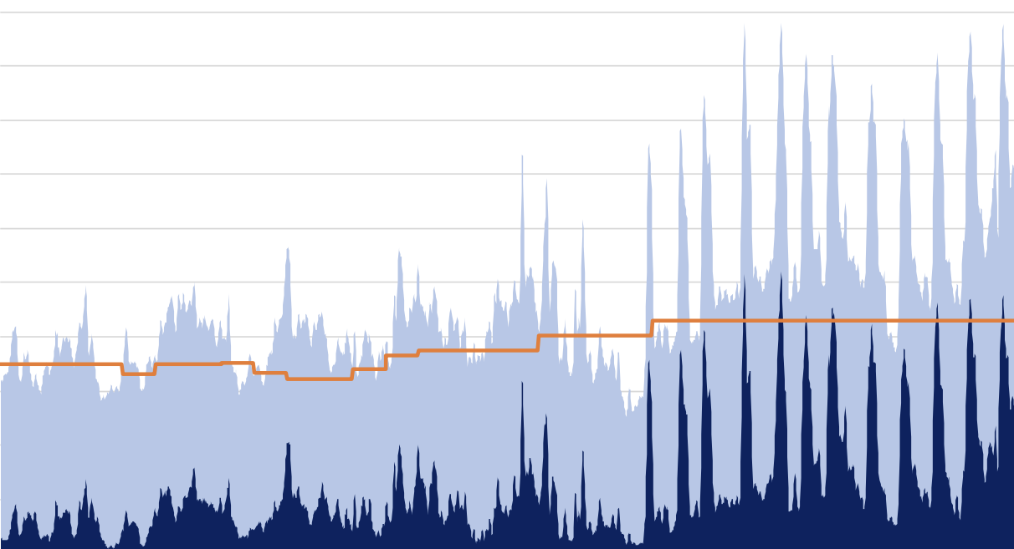
The DSN Challenge: Rapidly Growing User Needs
Cadence and complexity of cis-lunar and SMD missions are creating a new level of network demand not seen in decades
New technologies to achieve Decadal Survey priorities are ever more data hungry
JWST alone uses 10% of DSN capacity; sending back 25x the data of Hubble
Infrastructure support has not kept up
Hours (Per 28-day Interval)
Equivalent Antennas
20,000
18,000
16,000
14,000
12,000
10,000
8,000
6,000
4,000
2,000
0
Demand Hours
Today
33.5
29.8
26.0
22.3
18.6
14.9
11.2
7.4
3.7
0.0
Excess Demand
Capacity of the DSN
2010 | 2015 | 2020 | 2025 | 2030 | 2035 | 2040
NASA Office of the Inspector General, 7/12/23
7

Slide 8
DSN Challenge: Demand Spikes During Artemis
© 2023 California Institute of Technology. Government sponsorship acknowledged.
8

Slide 9
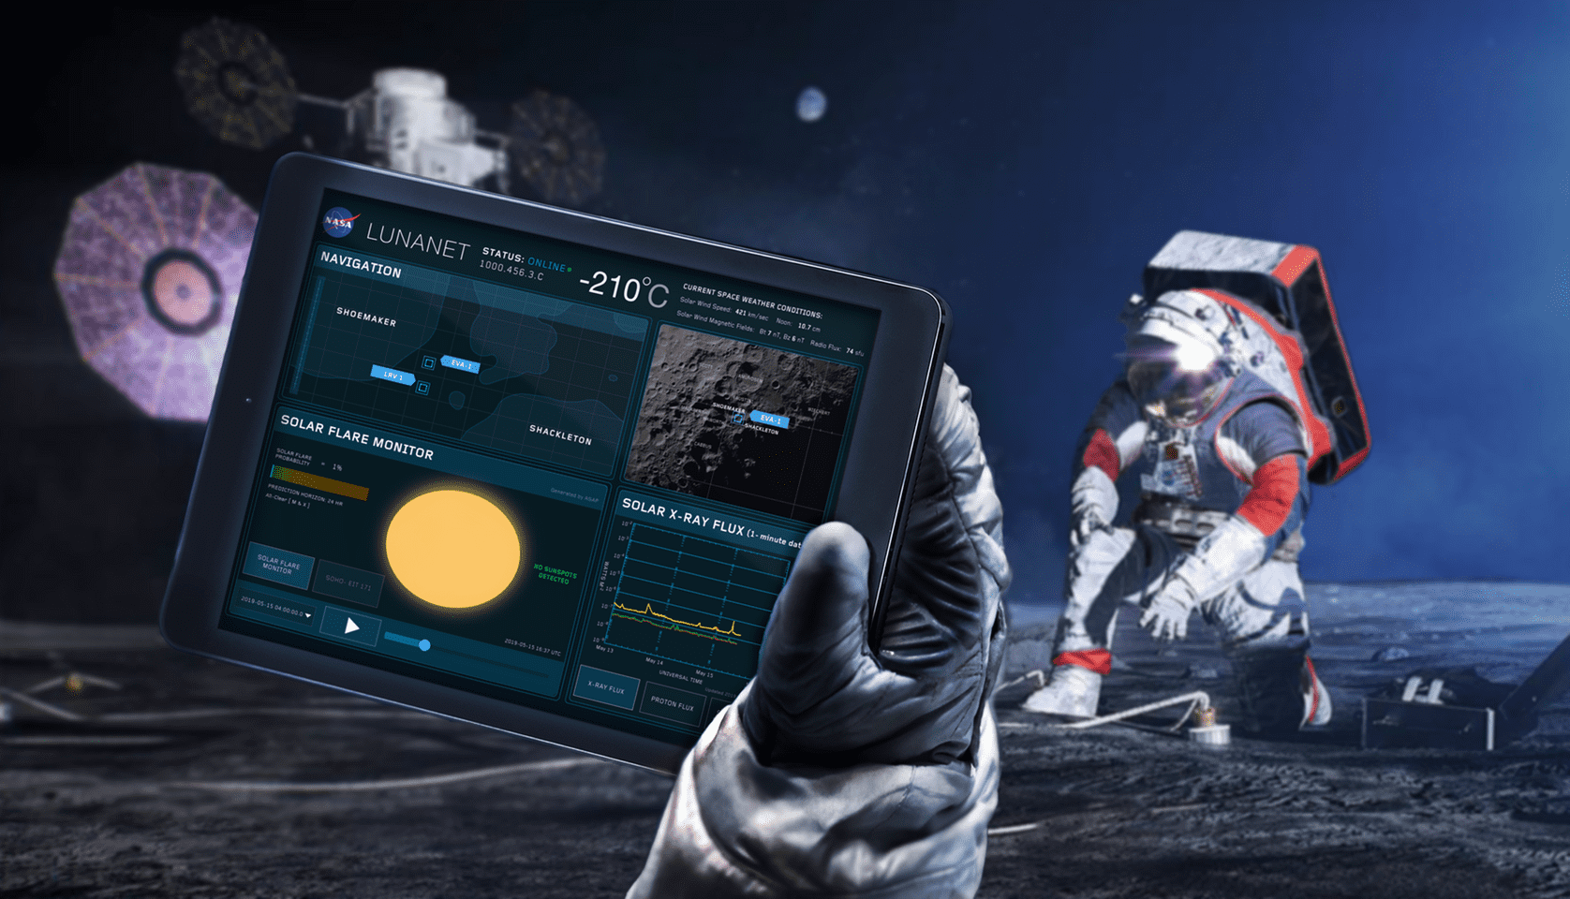
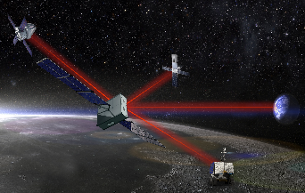
How SCaN Plans to Support DSN Users
New Deep Space Network (DSN) Capacity & Upgrades
Building six 34m antennas across all three DSN complexes
Upgrading two DSN antennas at each complex to enable simultaneous operations, enhance uplinks, and increase data rates
1
Network of new 18-meter class antennas to support lunar missions
Starting with three government owned, commercial operated sites around the Earth, offering continuous coverage
Commercial LEGS will add additional capacity as demand grows
Lunar Exploration Ground Segment (LEGS)
2
3
Further drawing upon commercial service procurement to devlelop lunar relays to reduce user PNT burden and remove DTE line-of-sight constraints (enabling South Pole and Far-Side operations)
Seeking additional commercial and international contributions for both Earth based and Lunar C&N assets
Commercial and International Partners
4
Optical will reduce burden on DSN alongside other technologies
Priority 1: Direct-to-Earth assets that meet or exceed LEGS performance
Priority 2: Lunar relay comm and PNT services
Priority 3: Lunar surface comm and PNT capabilities
Optical and other New Technologies

Slide 10
DSN Upgrades: The Road to Green (R2G)
Holography
Antenna Spares
Shaped Surface Sub-reflector
34meter Surface Reflector
R2G examined DSN’s state of health starting in 2020 R2G determined concreate steps to improve network reliability and robustness
Quadripod
Beam Waveguide Shroud
Azimuth Track
Micro
wave Controller
Water main and sewers
Subterranean Pedestal Room
Transmitter
34 Meter Antenna
Power Plant
Fire Suppression
Underground fuel and oil tank (move to above ground)
Operations Center Concept
Generators
Uninterruptible Power Supply
Funds prioritized to address:
Health and safety
IT security
Facility infrastructure
Vulnerable antenna components
General Cyber Security
Transformers and Switchgear
OS Upg
rades

Slide 11
DSN Upgrades: DSN Aperture Enhancement Project (DAEP)
DAEP is building six 34m Beam Wave Guide (BWG) antennas across all three DSN complexes to provide additional capacity
FY2024 DAEP STATUS SNAPSHOT:
Four 34m BWG deliveries completed (Two in Canberra and two in Madrid)
One 34m BWG in process in Goldstone; Delivery to service April 2026
One 34m BWG in the future at Canberra; Delivery to service expected October 2029
Further expansion after FY30 will be based on a DSN Futures Study, Agency requirements, and available support
May include higher power transmitters, HEF antenna refurbishments, and site diversity measures
Post-FY30 development work is funding dependent
GDSCC – Goldstone, California
CDSCC – Canberra, Australia
DSS-15
HEF
DSS-24
BWG-1
DSS-25
BWG-2
DSS-24
BWG-3
DSS-33
BWG-4
DSS-45
HEF
DSS-34
BWG-1
DSS-35
BWG-2
DSS-36
BWG-3
DSS-33
BWG-4
Signal Processing Center SPC-10
Signal Processing Center SPC-40
DSS-14
70m
DSS-13
R&D
DSS_28
GAVRT
DSS-43
70m
MDSCC – Madrid, Spain
Legend
DSS-65
HEF
DSS-54
BWG-1
DSS_55
BWG-2
DSS-56
BWG-3
DSS_53
BWG-4
Decommissioned
Delivered DAEP
Futured DAEP
Signal Processing Center SPC-60
DSS-63
70m

Slide 12
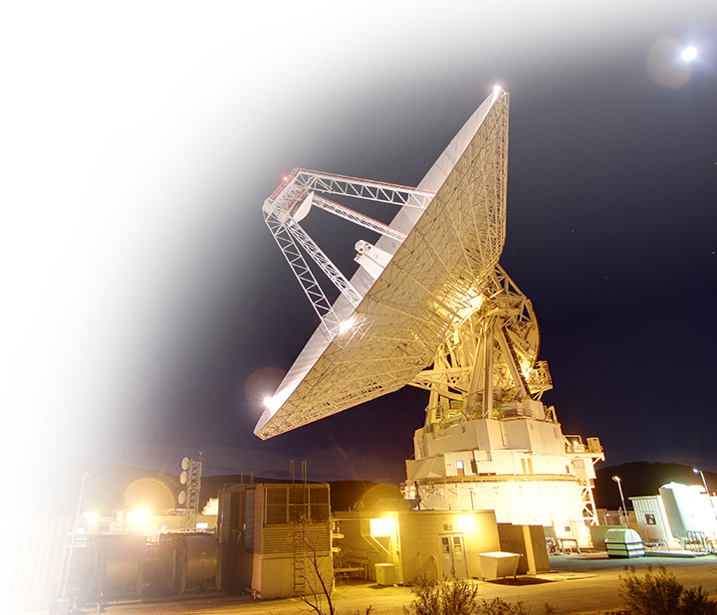
DSN Upgrades: DSN Lunar Exploration Upgrades (DLEU)
Upgrading six DSN antennas (two at each of the three complexes)
Adds capability for near-earth K-band uplink, uplink encoding, and increased data rates (100Mbps+ in Ka)
Provides simultaneous operations across frequency bands – S+Ka-band, X+Ka-band, or simultaneous Ka
Two upgrades completed (Goldstone and Canberra)
Estimated completion dates for additional upgrades:
Goldstone: December 2023
Canberra: July 2024
Spain (DSS-56): April 2025
Spain (DSS-54): March 2028

Slide 13
Lunar Exploration Ground Segment (LEGS)
Representative/ potential commercial locations that may be proposed in response to the NSN procurement to add LEGS capability with S, X, Ka band services
LEGS is a new network of DTE antennas that reduce contention for DSN by absorbing new Artemis demands
LEGS 1 to 3:
Cover three geographically diverse sites, offering continuous lunar coverage
18-meter class performance in X and Ka
Government-owned / contractor operated
LEGS 4+:
Locations TBD
18-meter class performance in X, Ka and S
Being pursued under full commercial services procurement
LEGS Site #1: White Sands Complex (WSC)
Government: NASA/GSFC
Target Readiness Date: Gateway Launch
Single X/Ka Transmit/Receive Antenna
LEGS Site #2: MTJ, South Africa
Government: SANSA
Target Readiness Date: Gateway Launch
Single X/Ka Transmit/Receive Antenna
LEGS Site #3: Geraldton, Australia
Government: ASA, ASD
Target Readiness Date: Gateway Launch
Single X/Ka Transmit/Receive Antenna

Slide 14
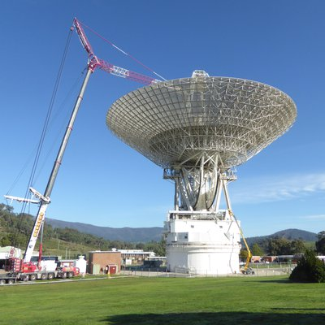
DSN Futures Study
DSN Futures Study objectives:
Look at near-term issues (network scheduling efficiency, network and element brittleness, and fragility), and projected capability needs though 2050
Understand what probable technology will be available, when it could be infused into the DSN, and the required costs
Incorporating SMD (Decadals) and ESDMD (Lunar and Mars architectures) as long-term planning inputs
Study Team members include NASA stakeholders from ESDMD, SMD, and SOMD that are asked to review study progress on a quarterly basis
Plan is to bring the final report to this board for review

Slide 15
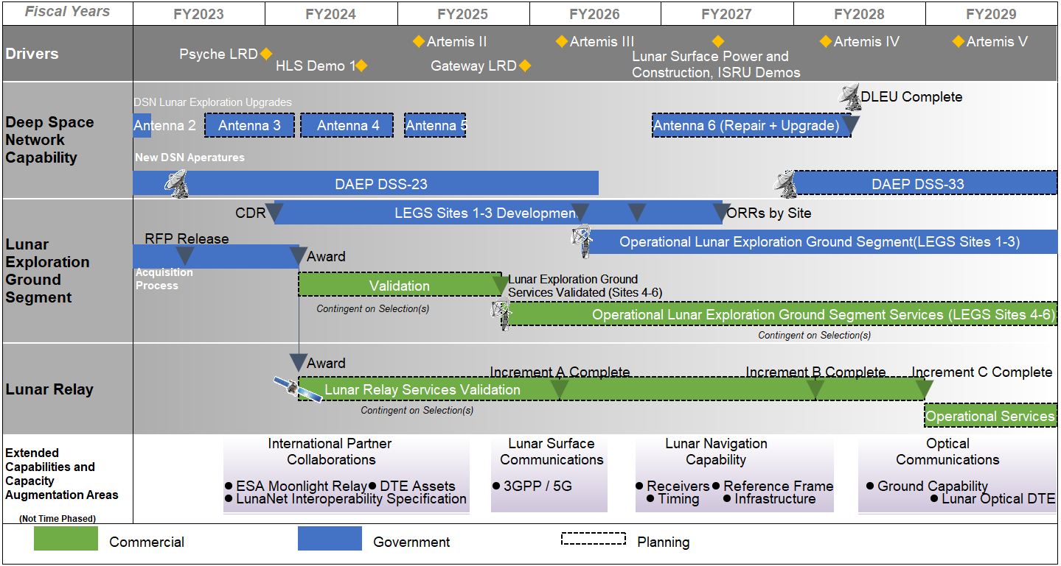
Orchestration of Supply
Examples only… critical event list is significant
VIPER
Dragonfly
Roman
Mars Sample Return
Veritas
O&M and sustainment must be orchestrated around mission demands and capability variance is 1:1 with funding variance

Slide 16
Synopsis: The Future of SCaN
New Challenges and New Opportunities
Growing DSN demand is putting flagship SMD and SOMD missions at risk
Investment in reliability, robustness, and capacity will be necessary to secure DSN’s future
LEGS government and commercial investments can also offload some Artemis and CLPS requirements from DSN, alongside international partnerships
16

Slide 17
Mr. Jeffrey Volosin
Acting Deputy Associate Administrator
Space Communications and Navigation (SCaN) Office
Follow us at: https://www.nasa.gov/scan Facebook: NASASCaN Twitter: @NASASCaN

