Slide 1
Dr. Delia Santiago-Materese
Director, Planetary Research Programs
PAC Meeting
November 14, 2023

Slide 2
Overview
Planetary Research Staffing Update
Research & Analysis (R & A) by the Numbers
R & A General Updates
Data Tidbits
Upcoming ROSES-2024 changes, then Discussion

Slide 3
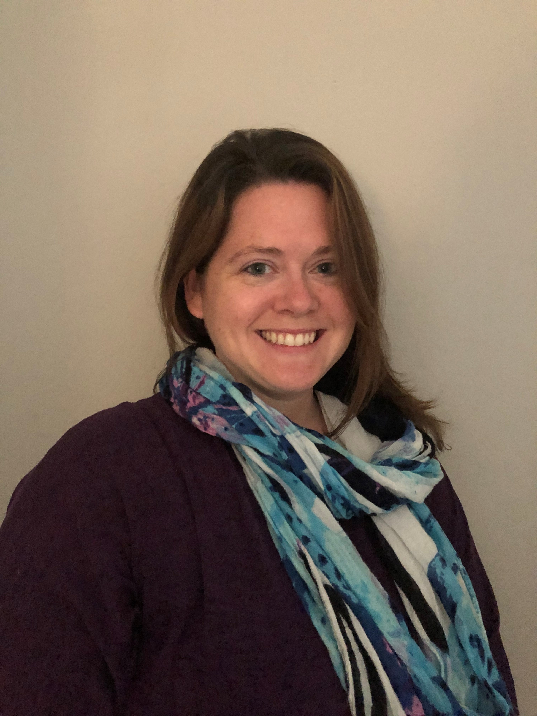
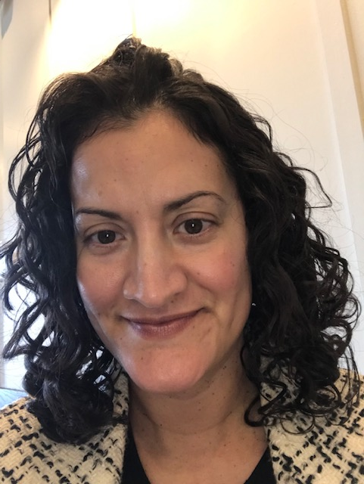
Planetary Research Leadership Changes
Stephen Rinehart is on a one-year detail to the White House Office of the National Cyber Director.
Delia Santiago-Materese and Kathleen Vander Kaaden will serve as Director and Deputy Director of Planetary Research, respectively, for the first six months and then swap roles for the next six months.
Meagan Thompson continues as the Program Executive and manages the budgetary aspect of the portfolio as well as serving in the PDE and on PSD's DEIA initiatives.
Director: Leads selection meetings, R & A general leadership, public-facing R & A representative.
Deputy: Supports Director efforts, leading ROSES-2024 development.

Slide 4
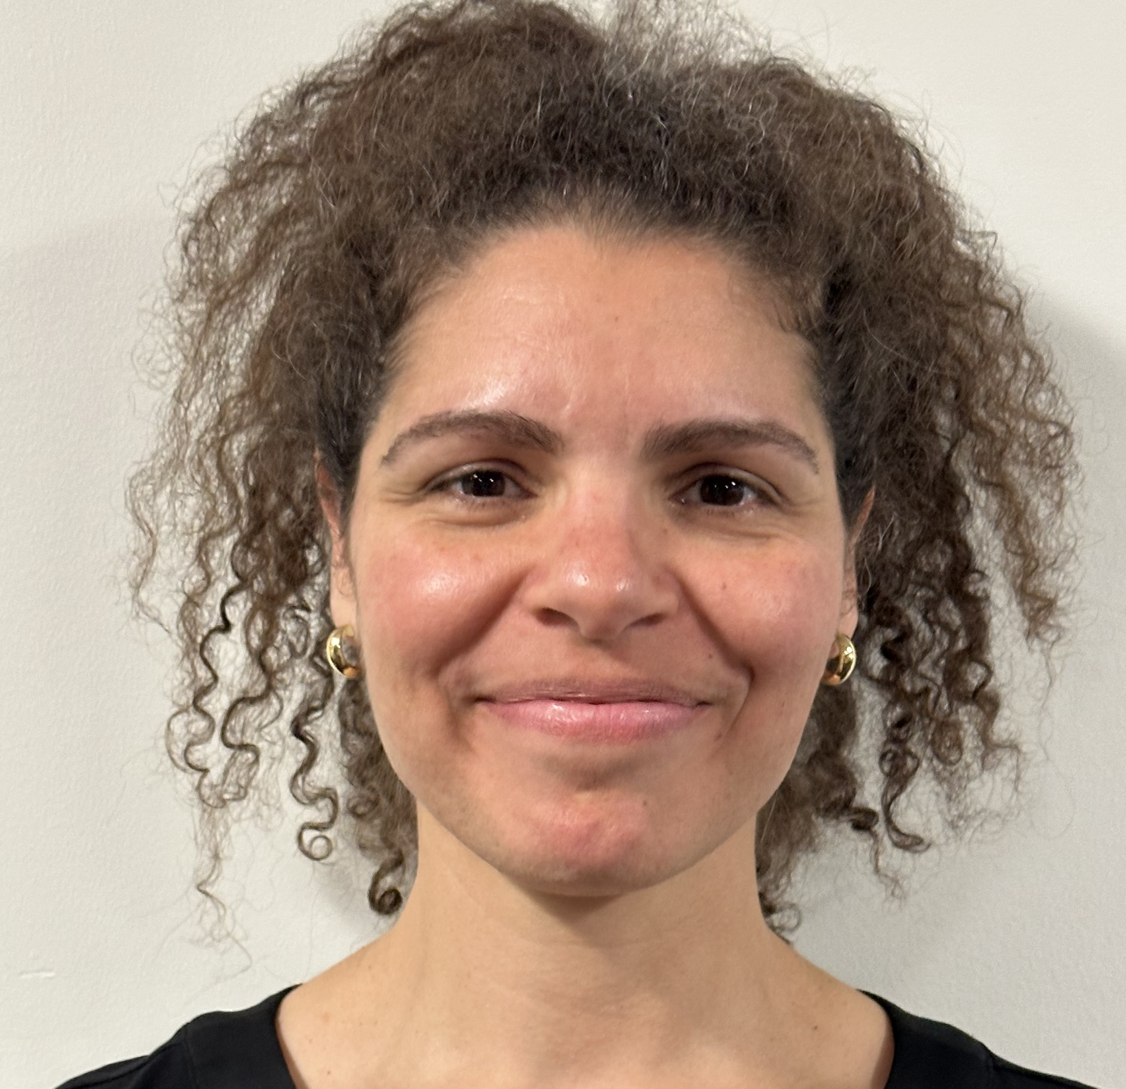
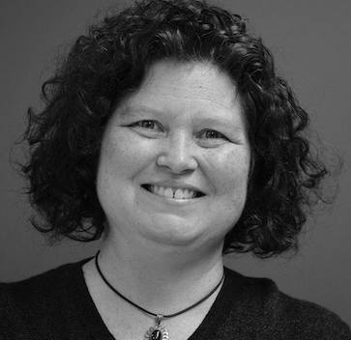
Welcome to new PSD R & A team members
Majd Mayyasi, IPA
Boston University
Julie Ziffer, IPA
University of Southern Maine

Slide 5
R & A by the Numbers

Slide 6
PSD ROSES-2022 Programs with Due Dates
Highlighted in Yellow = Cross-Divisional
PROGRAM | Step-1 Due Date | Step-2 Due Date | Panels Held | Selections/ Proposals | Selection Dates | Days from Step-2 to Select
Exoplanets Research Program | 03/31/2022 | 05/26/2022 | Yes | 30/173 (17%) | 08/30/22 | 96
Maturation of Instruments for Solar System Exploration | 04/06/2022 | 07/14/2022 | Yes | 5/37 (14%) | 10/20/22 | 98
Planetary Science Enabling Facilities | 04/08/2022 | 06/03/2022 | Yes | 10/25 (40%) | 10/31/22 | 150
Development and Advancement of Lunar Instrumentation | 04/13/2022 | 06/15/2022 | Yes | 5/33 (15%) | 2/28/23 | 258
Yearly Opportunities for Research in Planetary Defense | 04/21/2022 | 06/16/2022 | Yes | 8/17 (47%) | 12/2/22 | 169
Cassini Data Analysis Program | 05/05/2022 | 07/07/2022 | Yes | 8/27 (30%) | 0/26/22 | 81
Martian Moons eXploration Participating Scientist Program | 06/16/2022 | 08/16/2022 | Yes | 10/49 (20%) | 4/12/23 | 239
Planetary Protection Research | 06/21/2022 | 07/20/2022 | Yes | 5/15 (33%) | 12/20/22 | 153
Discovery Data Analysis | 09/06/2022 | 11/01/2022 | Yes | 9/16 (56%) | 5/22/23 | 202
New Frontiers Data Analysis Program | 09/07/22 | 11/3/2022 | Yes | 9/22 (41%) | 2/13/23 | 102
Mars Data Analysis | 09/07/2022 | 11/15/2022 | Yes | 15/55 (27%) | 5/9/23 | 175
Analog Activities to Support Artemis Lunar Operations | N/A | 12/06/2022 | Yes | 13/33 (39%) | 2/24/23 | 80
Planetary Science Early Career Award | N/A | 12/08/2022 | Yes | 5/33 (15%) | 5/16/23 | 159
Apollo Next Generation Sample Analysis Program | 10/17/2022 | 01/19/2023 | Yes | 3/7 (43%) | 5/23/23 | 124
Precursor Science Investigations for Europa | 11/01/2022 | 12/16/2022 | Yes | 5/28 (18%) | 7/14/2023 | 210
Interdisciplinary Consortia for Astrobiology Research | 09/15/2022 | 01/20/2023 | Yes | 9/28 (32%) | 7/11/2023 | 182
Habitable Worlds | 11/08/2022 | 02/03/2023 | Yes | 11/39 (28%) | 7/26/2023 | 173
Lunar Data Analysis | 12/1/2022 | 02/23/2023 | Yes | 8/34 (24%) | 7/7/2023 | 134
Artemis III Geology Team | 2/24/23 | 4/25/23 | Yes | 1/9 (11%) | 9/6/2023 | 134
Future Investigators in NASA Earth and Space Science and Technology | N/A | 2/21/23 | Yes | 39/216 (18%) | 7/13/2023 | 142
PSTAR | Not solicited this year

Slide 7
PSD ROSES-2023 Programs with Due Dates
PROGRAM | Step-1 Due Date | Step-2 Due Date | Panels Held | Selections/ Proposals | Selection Dates | Days from Step-2 to Select
Exoplanets Research | 3/28/2023 | 6/1/2023 | Yes | 26/116 (24%) | 8/14/2023 | 74
Yearly Opportunities for Research in Planetary Defense | 4/20/2023 | 6/14/2023 | Yes | 11/34 (32%) | 11/3/2023 | 142
Development and Advancement of Lunar Instrumentation | 4/13/2023 | 6/22/2023 | Yes | xx/32 | TBD | TBD
Cassini Data Analysis Program | 5/4/2023 | 7/13/2023 | Yes | xx/44 | TBD | TBD
Planetary Protection Research | 6/21/2023 | 7/20/2023 | Yes | 4/8 (50%) | 11/6/2023 | 110
Planetary Science and Technology Through Analog Research | 8/16/2023 | 10/24/2023 | No | xx/45 | TBD | TBD
Discovery Data Analysis | 9/6/2023 | 11/2/2023 | No | xx/21 | TBD | TBD
New Frontiers Data Analysis Program | 9/14/2023 | 11/9/2023 | No | TBD | TBD | TBD
Mars Data Analysis | 9/7/2023 | 11/16/2023
Hera Participating Scientist Program | 10/3/2023 | 11/30/2023
Planetary Science Early Career Award | N/A | 12/7/2023
Habitable Worlds | 11/8/2023 | 2/1/2024
Lunar Data Analysis | 3/1/2024 | 4/30/2024
Future Investigators in NASA Earth and Space Science and Technology | N/A | 2/6/2024
Maturation of Instruments for Solar System Exploration | Not Solicited This Year
Planetary Science Enabling Facilities | Not Solicited This Year
Interdisciplinary Consortia for Astrobiology Research | Not Solicited This Year
Precursor Science Investigations for Europa | Not Solicited This Year
Analog Activities to Support Artemis Lunar Operations | Not Solicited This Year

Slide 8
The No Due Date, or "NoDD" trial period continues
Year 1: ROSES-2021 was the first year of NoDD (complete)
Year 2: ROSES-2022 (complete)
Year 3: ROSES-2023 reviews are on-going, with proposals eligible for submission until March 29, 2024
The full extent of the three-year trial period will not be complete until Fall 2024
Proposal pressure continues to be down
This is not unique to Planetary Science
This is not unique to NoDD, though more apparent with NoDD

Slide 9
NoDD programs
We will be reporting NoDD statistics, in general, for the year ending 6 months ago (the last year to pass the nominal notification goal of 180 days)
Data for proposals submitted 5/1/2022 – 4/30/2023
 | Program | Submitted | Pending | Declined | Selected | Selectable | Selection Rate | Still Pending
C.2 | EW | 33 | 0 | 16 | 17 | 0 | 52% | 0%
C.3 | SSW | 82 | 4 | 42 | 36 | 0 | 44% | 5%
C.4 | PDAR(T) | 28 | 0 | 20 | 8 | 0 | 29% | 0%
C.5 | EXO | 64 | 1 | 48 | 15 | 0 | 23% | 2%
C.6 | SSO | 20 | 0 | 12 | 8 | 0 | 40% | 0%
C.12 | PICASSO | 17 | 0 | 9 | 8 | 0 | 47% | 0%
C.16 | LARS | 10 | 0 | 4 | 6 | 0 | 60% | 0%
These numbers will change as any pending proposals get reviewed.

Slide 10
Change in Proposal Pressure from 2014-2018 average

Slide 11
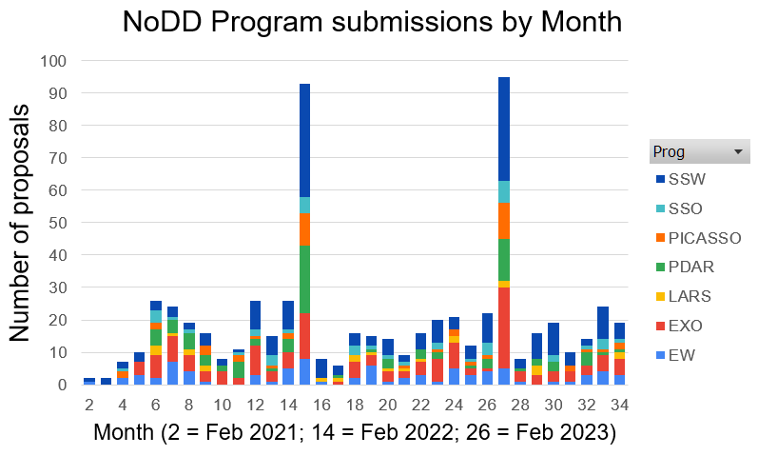
NoDD Proposal Submissions by Month
ROSES 2021
ROSES 2022
ROSES 2023
F M A M J J A S O N D J
F M A M J J A S O N D J
F M A M J J A S O

Slide 12
NoDD Submission rates – all programs

Slide 13
Metric: 80% of Proposals will have a notification time of 180 days or less
Proposal
submitted after
this date
cannot
yet be assessed
for 80% notification

Slide 14
Career stage of proposers (decade past terminal degree) – all NoDD programs
Normalized to 100%. ROSES 2023 data as of 1 Nov 2023
(e.g., D3= third decade, or 21-30 years past terminal degree)

Slide 15
Institution type of proposers – all NoDD programs
Normalized to 100%. ROSES 2023 data as of 1 Nov 2023

Slide 16
Internal Scientist Funding Model (ISFM) Work Packages
Center | ISFM | FY23 ($) | FY24 ($) | Duration | Last Review | Next Review | Other Div
ARC | Mars Climate Modeling Center (MCMC) | 1,280,000 | 1,280,000 | 10/21-9/24 | 6/23 | 9/24
ARC | Habitable Environments and Biosignatures / Center for Life Detection (HEB/CLD) | 1,602,303 | 1,599,780 | 10/21-9/24 | 6/23 | 9/24 | BPSD
ARC | Evolutionary Processes that Drove the Emergence and Early Distribution of Life (EPDEL) | 782,000 | 782,000 | 10/21-9/24 | 6/23 | 9/24 | BPSD
ARC | NASA Center for Optical Constants (NCOC) | 297,200 | 297,200 | 10/21-9/24 | 6/23 | 9/24
ARC | Astrobiologically Important Organics during Early Planetary System Formation and Evolution | 300,000 | 300,000 | 10/21-9/24 | 6/23 | 9/24
GSFC | Planetary Geodesy | 545,000 | 545,000 | 10/21-9/26 | 9/22 | 4/24
GSFC | Fundamental Laboratory Research (FLaRe) | 4,100,000 | 4,299,423 | 10/21-9/26 | 9/22 | 4/24
GSFC | The Goddard Instrument Field Team (GIFT) | 778,989 | 778,989 | 10/21-9/26 | 9/22 | 4/24
GSFC | Sellers Exoplanet Environments Collaboration (SEEC) | 2,454,177 | 2,458,000 | 10/21-9/26 | 9/22 | 4/24 | APD/HSD
GSFC | Exosphere-Ionosphere-Magnetosphere Modeling (EIMM) | 1,125,000 | 1,125,000 | 10/21-9/26 | 9/22 | 4/24 | HSD
GSFC | (R3D) Resolving Orbital and Climate Keys of Earth and Extraterrestrial Environments with Dynamics | 199,423 | N/A | 10/21-9/23 | 9/22 | N/A
JSC | Coordinated Analysis (CA) | 1,950,000 | 1,950,000 | 10/21-9/25 | 11/23 | 9/25
JSC | Geo-Cosmochemistry (GC) | 2,199,938 | 2,199,938 | 10/21-9/25 | 11/23 | 9/25
JSC | Planetary Process Simulation (PPS) | 1,320,657 | 1,320,657 | 10/21-9/25 | 11/23 | 9/25
JSC | Organic Geochemistry (OG) | 500,862 | 500,862 | 10/21-9/25 | 11/23 | 9/25
JSC | Mission Enabling (ME) | 1,092,143 | 1,092,143 | 10/21-9/25 | 11/23 | 9/25
MSFC | Marshall Interdisciplinary Planetary Science (MIPS) | 630,000 | 630,000 | 10/21-9/25 | 11/23 | 9/25

Slide 17
R & A General Updates

Slide 18
Reminders to the community
Remember rules on duplicate and resubmitted proposals (see C.1).
Compliance checking scripts are now available to all at: https://github.com/nasa/ROSES-Compliance-Checking-Tools/blob/main/README.md
The scripts come with no guarantee!
Please turn in your progress reports.
Reviewers wanted!
https://science.nasa.gov/researchers/volunteer-review-panels

Slide 19
Effective immediately: New TWSC solicitation
Topical Workshops, Symposiums, and Conferences (TWSC-24) in Space and Earth Sciences and Technology
TWSC is no longer in ROSES!
Listed in the ROSES-2023 Appendix tables, and will be for future ROSES years as well.
3-year open period reduces the administrative burden both for internally for SMD and for the public
TWSC does not change year-to-year
As its own, stand-alone NRA, all the information for proposers can be put into one place
Reduces the burden on repeat proposers as well as the SMD staff managing the elements

Slide 20
FYI: Research Initiation Awards (RIA)
Debuted in ROSES-2023 under F.22 Research Initiation Awards
RIA aims to broaden the base of investigators involved in the SMD ecosystem
→ Still under review, but be on the look out for it under ROSES-2024
An RIA award, including indirect costs, must not exceed $300,000 for a duration of 24 months.
Funding for undergraduate students is a required element of the proposed project.
RIA awardees may in the future propose for an additional two-year RIA award for a total of four years of support. No further proposals will be accepted.
Institutional teaching and service commitments at non-R1s may be high, and therefore RIA program encourages proposers to include requests for funding for teaching buy-outs (to include sabbaticals) and/or summer salary.
Proposals are short (6 pages) and contain two sections: a high-level Research Description and a Statement of the Impacts of the RIA.

Slide 21
Updates on New Programs presented at last PAC
As previously discussed, the growth in R & A is an opportunity to broaden participation and create a more diverse and inclusive community.
Proposed New Programs:
Mission Concept Studies FY25 Delayed 1-2 years
Postdoctoral Fellowship Program FY25 Delayed indefinitely
Mission: IDEA (next slide) FY25

Slide 22
Mission: IDEA update
Goal: Create conditions necessary for effecting cultural change and developing the vibrant, equitable, inclusive community we seek.
Achievements to date: NASA began a partnership with the National Science Foundation (NSF) exploring an Ideas Lab to enhance collaborative discussions and broaden participation in achieving common research goals. We have a small, cross-agency working group identified.
Plans for the next year: NASA and NSF kick off the collaboration in early 2024 (calendar) and develop an Ideas Lab solicitation and a communication plan for making sure the solicitation is communicated widely. Solicitation anticipated late Spring/early Summer.
NASA has previously collaborated with the NSF on Ideas Labs

Slide 23
Data Tidbits
23

Slide 24
SMD Yearbook
Yearbook release pending! Yearbook will contain demographic and programmatic information about the R & A Programs (both Directorate- and Division-level).
24

Slide 25
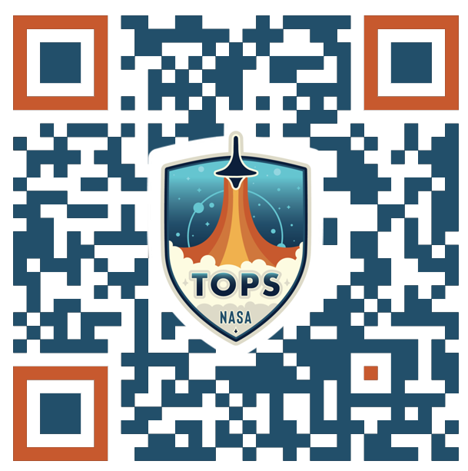
NASA Open-Source Science Initiative
Complete NASA’s open science course!
Open Science 101: A community-developed introduction to core open science skills
Know how to write a NASA open science and data management plan
Learn about tools and best practices
Increase the impact & visibility of your science
Earn your digital NASA open science badge
Enroll now!
Self-Paced Online Course
Online & In-person Workshops
Images by Freepik

Slide 26
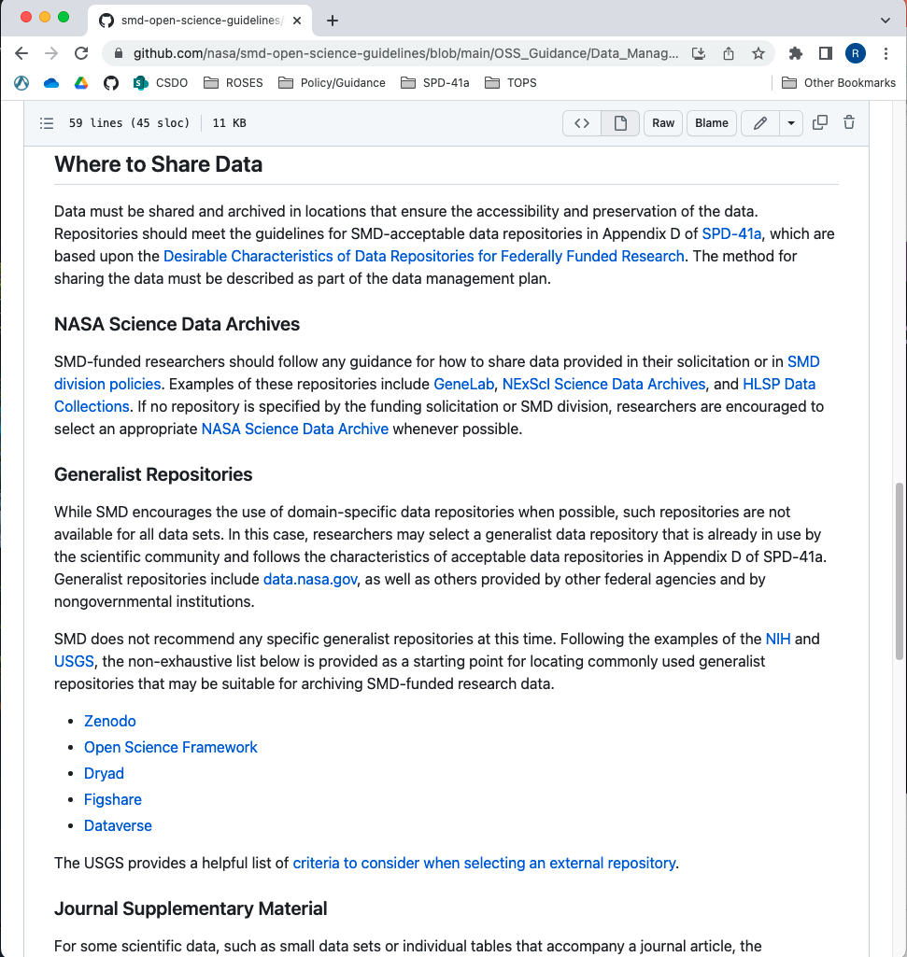
Additional Resources
SMD Open-Source Science Guidance
Narrative guidance for researchers on SPD-41a
Includes:
Open Science and Data Management Plan
Sharing Publications
Data Management and Sharing
Software Management and Sharing
Persistent Identifiers for Investigators
Sharing Materials for Science Events
Glossary
Available on GitHub and in PDF; all versions linked on Scientific Information Policy Website
See also:
SPD-41a FAQ and the ROSES OSDMP page
26

Slide 27
Planetary Science Open Science Highlights
Open Science Community Shout-out! - https://moonlidar.com/
USGS Astrogeology Science Center and Hobu team completed a beta release (with the AWS Registry of Open Data) of a cloud native, streamable LOLA point cloud. Product is freely and publicly available.
A browser visualization of the entire NASA LOLA LiDAR data archive that utilizes the Hobu Eptium application to visualize a single Cloud Optimized Point Cloud.
Discussions within NASA (ESDMD, SOMD, ESSIO, SMD) and with NGA regarding Lunar reference frames to support a sustained human presence on the moon. This is a long-term effort.
ExMAG-LEAG Specific Action Team is being formed to examine 3 main topics: (1) Volatile Samples and Cold Curation, (2) Nominal Samples, and (3) Sample Data Infrastructure.
Community applications to serve on the SAT have been accepted and are being reviewed.

Slide 28
Upcoming Changes for ROSES-2024

Slide 29
PSD R&A ROSES-2024 Overview
Maintain same programs reviewed under DAPR and NoDD
DAPR: CDAP, DDAP, LDAP, MDAP, "NFDAP", PPR, PSIE
Also HW, XRP
Reminder: DAPR will be the default under ROSES-2025
NoDD: EW/SSW/SSO, Exobiology, PDART, PICASSO, LARS, H2O
Removed substantial duplicate information from individual program elements into C.1, including information on DAPR submission process. Added this text to the top of each individual program element:
In an effort to increase the clarity and accessibility of information for programs within Appendix C, we have moved information that pertains to the majority of the programs into Appendix C.1 Planetary Science Research Program Overview. Proposers are advised to read C.1 in its entirety to ensure that they have the necessary information to be compliant with their proposal submission.
All C appendices (except for C.01) have been restructured to include the following sections:
1. Scope of Program
2. Program Specific Information
3. Proposal Submission (and Evaluation) Process
4. Summary of Key Information

Slide 30
PSD R&A ROSES-2024 Changes (1/2)
For ROSES-2024, we will be merging C.02 EW, C.03 SSW, and C.06 SSO into a single program element (Solar System Science). (see additional slides)
C.20 ICAR will be solicited in ROSES-24. However, a full program element will not be available with the full ROSES roll out so a placeholder will be added and likely updated in Summer of 2024.
Adding Artemis Geologic Mapping Campaign. This is an ESSIO call but it’s in Appendix C. A placeholder will be added for release of ROSES-2024.
Modifying all DAPR calls under C.1 to also require an anonymized NOI/Step-1.

Slide 31
PSD R&A ROSES-2024 Changes (2/2)
C.4 PDART and C.11 DDAP will pull the OSDMP out of the 15-page STM and will now allot 2 additional pages like other program elements
Pending available funding, C.7 NFDAP may be becoming NFPRDAP: New Frontiers Precursor Research and Data Analysis Program to allow proposers to include tasks that relate to precursor planning, in addition to data analysis. This would include, for instance, ground-based work performed now to study organic chemistry processes on Titan, which would enable rapid science analysis from Dragonfly once mission data is acquired.
Discussions underway for C.12 PICASSO, C.13 MatISSE, C.19 DALI to potentially require OSDMPs for the first time.
Reporting requirements were moved out of several program elements and will be included in award letters instead.

Slide 32
Merging EW-SSW-SSO into single element​
C.2 Emerging Worlds
The Emerging Worlds program solicits research proposals to conduct scientific investigations related to understanding the formation of our Solar System and/or the early evolution of our Solar System
C.3 Solar System Workings
This program seeks to understand processes that occur throughout the Solar System, as well as those specific to individual objects and systems which inform our understanding of the fundamental processes at work.
C.6 Solar System Observations
Solar System Observations (SSO) supports primarily Earth-based observations, including ground-, airborne- and space-based astronomical observations, of bodies in our Solar System.
Concerns:
Have created unnecessary barriers for the community for both proposal submission and reviews
Doesn’t foster ability for interdisciplinary science that spans the formation and evolution of the SS
Low proposal pressure (Total proposals for R-21:136 ; R-22:138)

Slide 33
Merging EW-SSW-SSO into single element​ (cont.)
Solution: C.25 Solar System Science
This program solicits research proposals to conduct scientific investigations that address the formation and evolution of our solar system from the collapse of the molecular cloud, through planetary accretion and differentiation, and up to present day processes.
Rationale:
Decrease barriers for the community for both proposal submission and reviews
Foster the ability for interdisciplinary science that spans the formation and evolution of our solar system
Even if proposal pressure increases, still are not likely to see pre-2020 SSW levels (300+). But even if we do, we know we can handle that number of proposals in a single program
Provides more flexibility in what is funded
Maintaining Clarity of Research being funded for the community
Current funding lines for EW, SSW, and SSO would be maintained
Those funding lines would be maintained at the currently planned levels

Slide 34
Discussion Questions
What metrics would instill community trust in a merger program?
Tracking original funding line data over time
"What programs the proposal would previously have been submitted to?"
Continued assessment of portfolio balance (target? process?)
Any other questions related to the upcoming changes?

Slide 35
Backup Slides

Slide 36
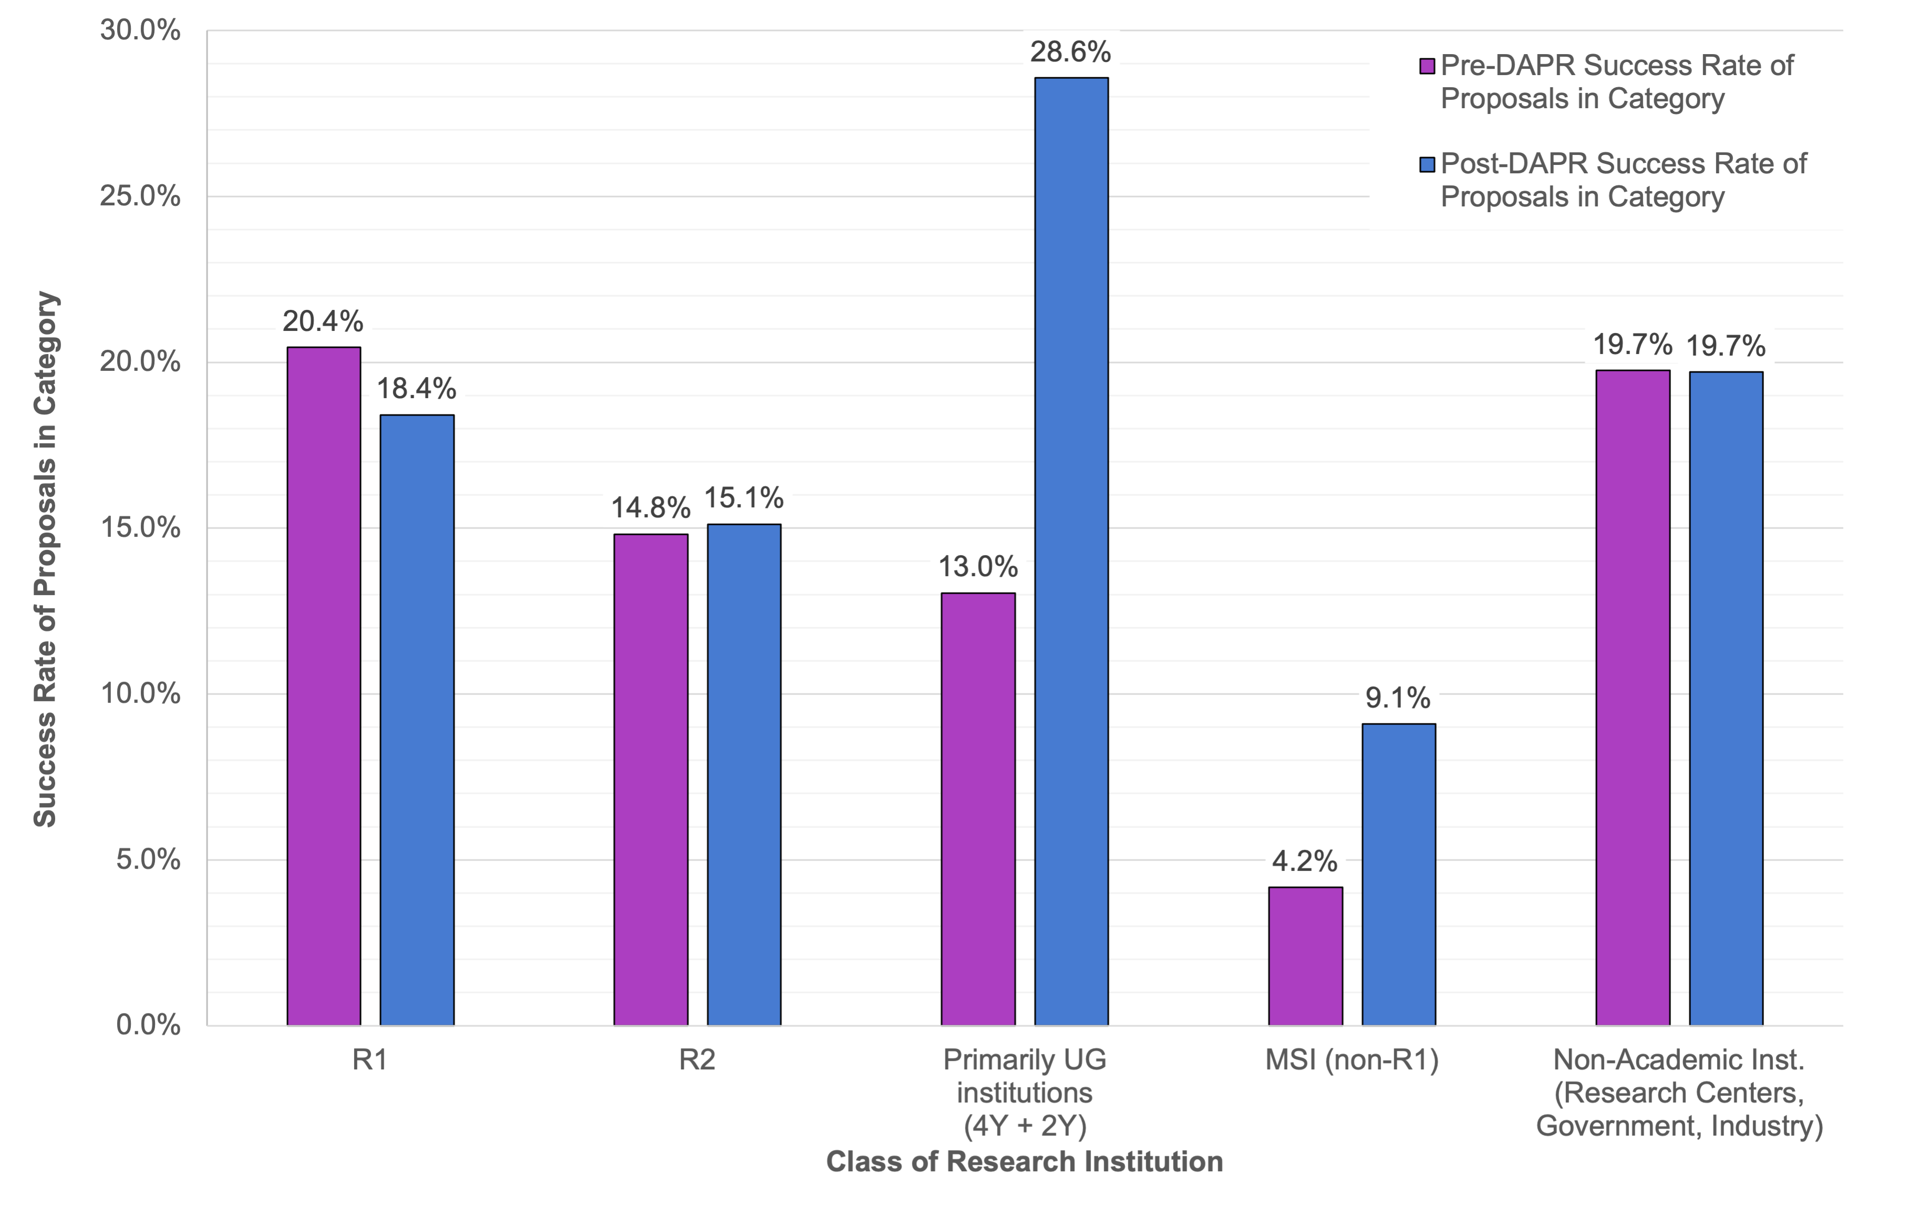
DAPR Updates (SMD)
The data come from the ADAP, ATP, and XRP.
Overall selection rates pre- and post-DAPR are basically the same.
Most of the differences shown may not be significant but the factor of 2 changes in selection rates for Primarily UG and non-R1 MSIs look to be.
These changes are precisely one of the expected benefits of DAPR.

Slide 37
Career stage of proposers (decade past terminal degree) – all NoDD programs
Raw number of proposals. ROSES 2023 data as of 1 Nov 2023
(e.g., D3= third decade, or 21-30 years past terminal degree)

Slide 38
Institution type of proposers – all NoDD programs
Raw number of proposals. ROSES 2023 data as of 1 Nov 2023

