Slide 1
Mapping and Planetary Spatial Infrastructure Team (MAPSIT)
Findings for the Planetary Advisory Committee (PAC), Nov 13–14, 2023 Meeting

Slide 2
MAPSIT Steering Committee
Brad Thomson (Univ. Tenn.), Chair
Julie Stopar (LPI), Vice Chair
Brent Archinal (USGS)
Ross Beyer (SETI/NASA Ames)
Sander Goossens (NASA Goddard)
Justin Hagerty (USGS), Ex Officio
Trent Hare (USGS)
Jay Laura (USGS)
Sam Lawrence (JSC), ESDMD rep, Ex Officio
Myriam Lemelin (Université de Sherbrooke, Canada)
Jeannette Luna (Tennessee Tech Univ.)
Becky McCauley Rench (NASA HQ), Ex Officio
Moses Milazzo (Other Orb), Ex Officio
Jani Radebaugh (Brigham Young Univ.), past Chair
David Williams (Arizona State Univ.)

Slide 3
MAPSIT Findings (1 of 4)
Map source: Fortezzo et al. 2020
Finding: There are insufficient planetary maps to support upcoming missions to high-priority targets such as the Moon and Venus.
MAPSIT suggests that NASA should consider how to fund production of high-priority maps that leverage modern datasets, including geologic maps, hazard maps, and resource maps. In the past, systematic mapping campaigns allowed the community to organize and activate to produce the needed maps.
For the Moon, this follows the recommendations of the Lunar Critical Data Products LEAG/MAPSIT Special Action Team (Stickle et al., 2021; doi:10.5281/zenodo.7236426)
MAPSIT is encouraged by the convening of a Lunar Surface Science Workshop, "Geological Mapping to Support Artemis Strategic Decisions" Aug 16–17, 2023 (Virtual). Organizers: J. Skinner (USGS), A. Huff (ASU), J. Luna (TNTech), R. Watkins (NASA HQ)

Slide 4
MAPSIT Findings (2 of 4)
Source: Brunton.com
Finding: MAPSIT notes that a white paper on lunar coordinate system options has been completed by LEAG (with participation from some members of the MAPSIT steering committee).
Final version posted on LEAG website (Archinal et al., 2023): https://www.lpi.usra.edu/leag/reports/ME-White-Paper_Final.pdf
This white paper advocates for continued use of the Mean Earth (ME) coordinate system for the Moon
The intent is to promote an informed discussion among stakeholders so that the full implications of any potential changes are considered
Notes:
AU Working Group on Cartographic Coordinates and Rotational Elements (WGCCRE), based on the Artemis III SDT and LCDP SAT input, has proposed "refining" the ME lunar reference frame, at about the meter level.
The NGA/GSFC folks seem to want to "change" to a different system (the PA system) for mapping, which is a ~1 km (860 meters) change - something that's hardly a refinement.
Mean Earth/polar axis (ME), or Mean Earth/Rotation (MER)
Principal axis (PA) or axis of figure

Slide 5
MAPSIT Findings (3 of 4)
Finding: MAPSIT sees an urgent community-wide need to discuss and identify critical software gaps for planetary data analysis. MAPSIT suggests a specific action team be formulated and requests direct involvement in this effort.
PESTO (Planetary Exploration Science Technology Office) is interfacing with the NASA Advisory Groups to identify and prioritize technology gaps. While the primary focus of the draft technology gaps identified by PESTO is hardware based, MAPSIT sees a particular need for continued development of software relevant to planetary science and data analysis.
MAPSIT views an assessment of critical software gaps as essential for the long-term planning of infrastructure investments and analyses of planetary data, as well as for upcoming missions (one example, software to visualize data collected on the Moon's surface).
Notes:
The I

Slide 6
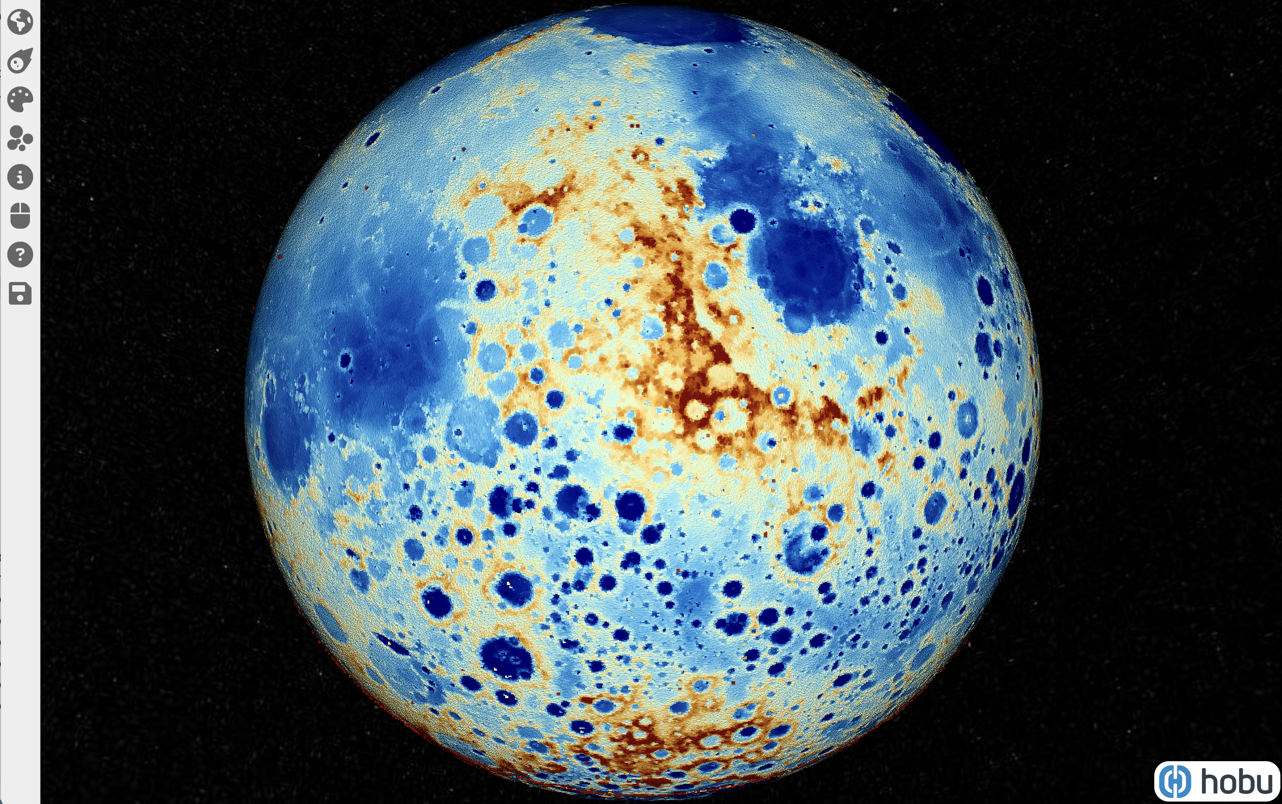
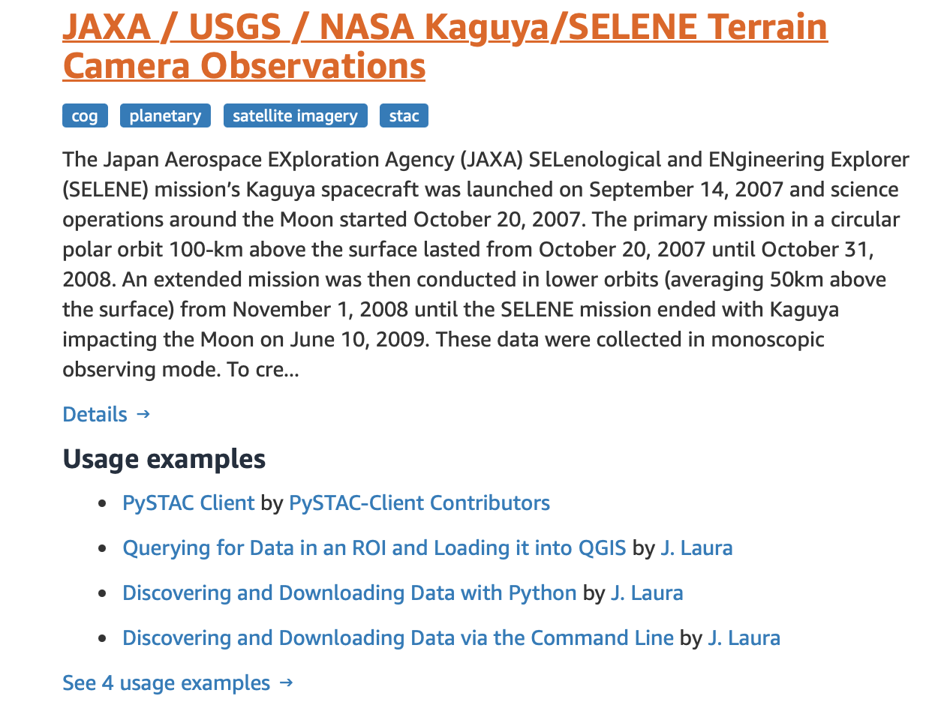
MAPSIT Findings (4 of 4)
Finding: NASA should continue to support efforts to produce analysis-ready data in a platform-agnostic format.
New examples of analysis-ready data since the last meetings are USGS efforts to release > 400,000 Kaguya Terrain Camera images (in partnership with JAXA) and over 1 billion Lunar Orbiter Laser Altimeter shots (in partnership with Hobu)
All data are API accessible and freely available via the Amazon Registry of Open Data.
https://moonlidar.com
https://registry.opendata.aws
Notes:
The I

Slide 7
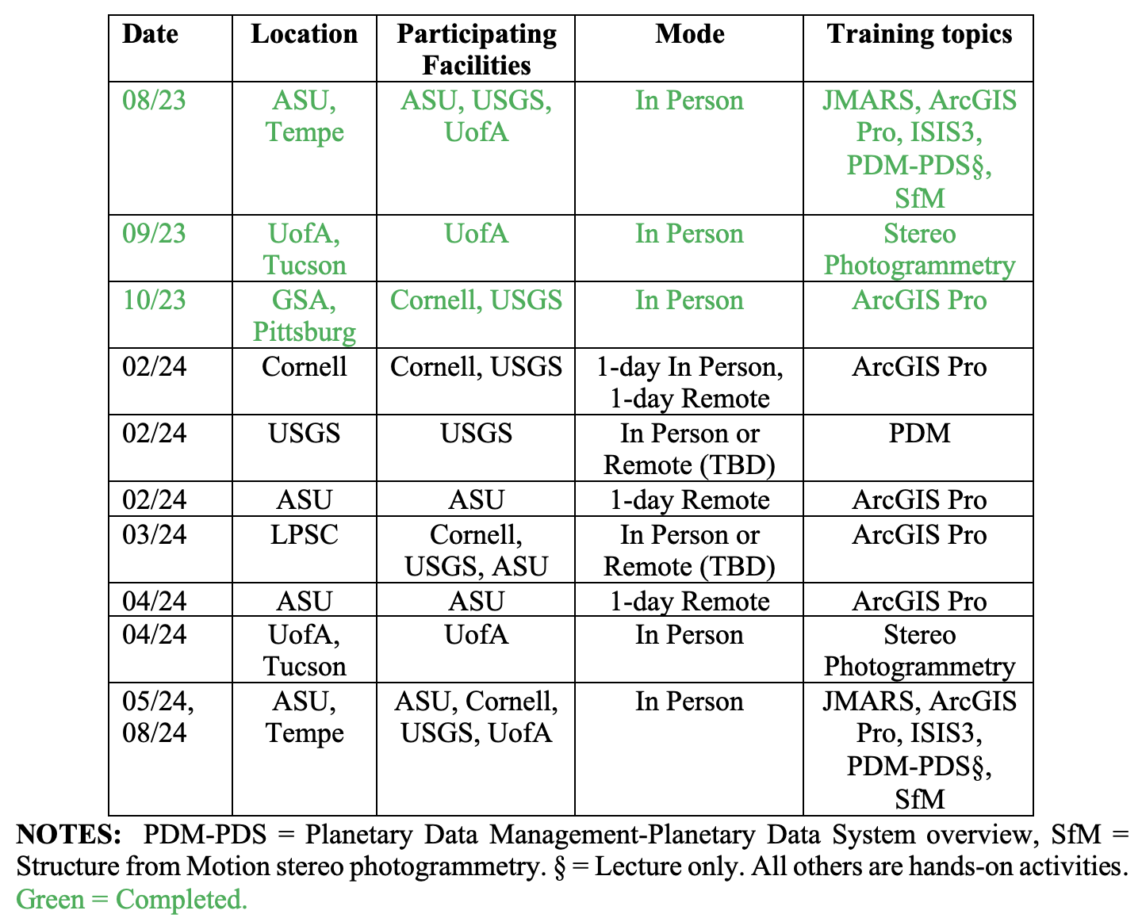
Recent and upcoming activities
Planetary Geology Mappers’ Meeting: Oct 15–18, 2023 as part of GSA Annual Meeting in Pittsburg, PA. Hybrid format.
Organizers: Jeanette Luna (TN Tech) and Jim Skinner (USGS)
Planetary Data Training Workshops, Organizers: David Williams et al.
5 events held in 2023
8 events over 5 dates planned for 2024 (see table & https://rgcps.asu.edu/ > GIS Tab).
MAPSIT Town Hall at LPSC, March 11–15, 2023

