Slide 1
PAC meeting November 14, 2023 VEXAG 2023 Meeting DRAFT 2023 FEQ Venus Exploration Strategy Upcoming Activities
Noam Izenberg Applied Physics Laboratory, Chair
Debra Buczkowski Applied Physics Laboratory, Dpty Chair
Molly McCanta* University of Tennessee
Jason Rabinovich* Stevens Institute of Technology
Siddharth Krishnamoorthy**
Jet Propulsion Laboratory, ECR
Sara Port** Glenn Research Center, ECR
Chuanfei Dong Boston University, ECR
Erika Kohler Goddard Space Flight Center, ECR
Eric Grosfils Pomona College
Daniel Nunes Jet Propulsion Laboratory
Anna Gulcher California Institute of Technology. ECR
Michael Way Goddard Institute for Space Studies
Tracy Gregg University of Buffalo
Alexander Akins Jet Propulsion Laboratory. ECR
Natalie Punt Scribe
Darby Dyar PSI, Mount Holyoke College, Emeritus
Nick Lang NASA HQ, ex officio
*Term ends in January 2024
**Term ends in July 2024
Notes:
Ask members to stand

Slide 2
21ST MEETING OCT 30-31 2023
New Mexico Museum of Natural History and Science, Albuquerque
123 in person registrants
191 virtual
Late breaking numbers put
individual attendance at 400+
Meeting day 2 was haunted
Notes:
THEMES OF VEXAG
Similar to last year. Engage the community. Engage NASA

Slide 3
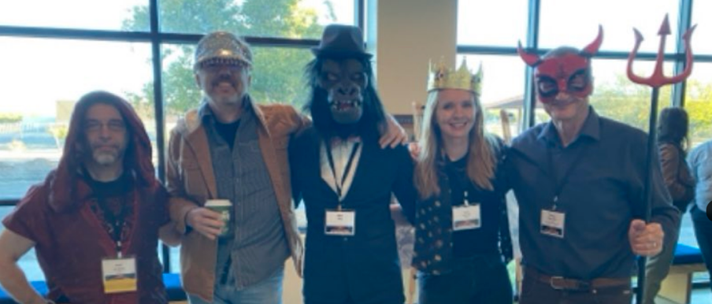
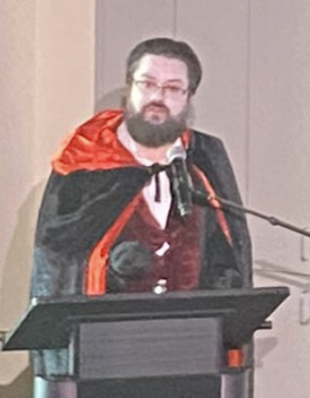
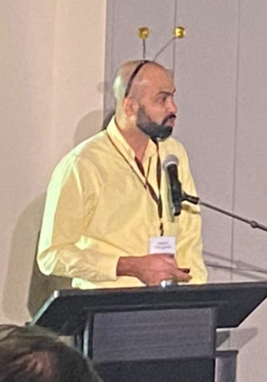
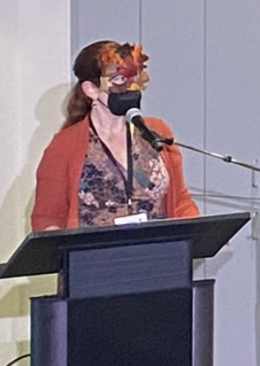
21ST MEETING OCT 30-31 2023
New Mexico Museum of Natural History and Science, Albuquerque
123 in person registrants
191 virtual
Late breaking numbers put
individual attendance at 400+
Meeting day 2 was haunted
Notes:
THEMES OF VEXAG
Similar to last year. Engage the community. Engage NASA

Slide 4
THREE YEAR GOALS 2023-2025
Develop Venus Exploration Strategy for the next decade with NASA
Work with missions and the international Venus community
Nurture the next generation of Venus scientists and engineers
Improve communication within Venus community and among the general public
Revise GOI, Roadmap, Tech Plan

Slide 5
OPPORTUNITIES FOR VENUS EARLY CAREER NETWORKING
140 members and growing
Speed Networking event at VEXAG
EC dinner

Slide 6
FINDINGS ENDORSEMENTS QUESTIONS
Findings
Go to the PAC
2 ONLY
Inter–AG recommendations for action
Endorsements
Go to NASA
Support and information from the community
Questions
Go to SMD director, NASA Liaison, others at HQ
Information the community seeks
Seeking the most effective way to advocate for the Venus community, show support, and get the information we need
Notes:
We expect to generate 2-3 Findings (I had targeted 2, but recent events may warrant a third) intended specifically for discussion/input/action at the PAC.
Other things that used to be listed as findings but are not PAC concerns will be in the same document (which will probably have to be renamed, Perhaps “VEXAG 2022 Report”):
Endorsements - These are statements of community support and desire for programs and other projects at NASA. For example past Findings that would be recategorized this way would be community support for the development and continuation of HEEET and ADEPT EDL systems, or the continuing or RT power systems.
Questions - These are requests for information or communication from the community to NASA that will help us in our strategic thinking and community action. They will be directed to individuals (e.g. the SMD director, the VEXAG liaison, etc.) who can hopefully provide answers in some number of months. These are *not* requests for action. A recent example for VEXAG would be a delve into the R&A history of Venus-related proposals across ROSES that helped us produce a recent community white paper.

Slide 7
DRAFT FINDINGS 2023
R&A Finding: There is an R&A program gap in funding fundamental research that is badly needed to support Venus missions. A Venus Fundamental Research (VFR) program or “Precursor Science Investigations – Discovery” (PSI-D) R&A program could address these needs.
Examples:
The recent Venus Experimental Workshop recommended a round-robin set of experiments in which all facilities would run the same sample and comparisons could be made to ensure consistency across facilities.
Lack of laboratory spectra acquired under Venus conditions.
VERITAS Finding: VERITAS engineering development funds should be reinstated and a launch date be determined ASAP. A launch in FY29 would help retain radar staff and key VERITAS personnel, support the ongoing work of international partners, reduce technical risk and total cost, and deconflict VERITAS and EnVision temporal overlap.
Will be narrowed to 2 most actionable by/with PAC. The rest will become Endorsements
Notes:
R&A Finding Example:

Slide 8
DRAFT FINDINGS 2023
In-Situ Technology Finding: There are multiple technology gaps in in-situ exploration technologies, which are critical follow-ons to the DAVINCI, VERITAS, and EnVision missions as well as throught the solar system. A “CloudTech” program would focus on probes, aerial/airborne technologies, deep atmospehres, and implementations applicable to multiple planetary targets; while a HOTTech 3 program would enable maturing and integrating key technologies into platforms and systems.
Workforce Finding: LPSC and other relevant planetary conferences should rotate to a broader set of locations to increase community access, consistent with the NASA principles of Inclusion, Diversity, Equity, and Accessibility (IDEA). Headquarters and the community are urged to support use of multiple pronouns, both in collecting demographic information and in increasing visibility in postings on official NASA websites.
Will be narrowed to 2 most actionable by/with PAC. The rest will become Endorsements
Notes:
R&A Finding Example:

Slide 9
DRAFT FINDINGS 2023
SIMPLEx Finding: NASA is leaning towards requiring SIMPLEX proposals/payloads to be co-destined with the primary mission that launches them. VEXAG endorses this plan and therefore finds NASA should issue a SIMPLEx AO in FY 2024 or 2025, soliciting rideshare payloads early enough to accompany the launch of DAVINCI in 2029, and/or VERITAS in 2029–2031 (depending on restart date), provided this has no detrimental impact on the primary mission efforts.
SIMPLEx co-destination reduces wasted proposal efforts, but also limits opportunity - an AO for a 2029 launch is a short fuse, but there are many viable candidates from past AOs.
Will be narrowed to 2 most actionable by/with PAC. The rest will become Endorsements
Notes:
R&A Finding Example:

Slide 10
DRAFT ENDORSEMENTS 2023
International Collaboration: VEXAG recognizes the value of NASA’s continued engagement in international missions to Venus. JAXA, ESA, ISRO, more.
New Frontiers: VEXAG endorses the inclusion of the VISE theme (recommended in OWL) to the next New Frontiers competition.
Planetary Mapping: VEXAG endorses the needed completion of Magellan Venus quadrangle geologic mapping and the importance of planetary geologic maps for upcoming missions.
Earth-based Venus Science: VEXAG endorses support of Venus-analog field campaigns in addition to ground-based/balloon/suborbital observations of Venus, including ground-based radar facilities, and leveraging cross-division opportunities that can support Venus and non-Venus communities alike.
Notes:
We expect to generate 2-3 Findings (I had targeted 2, but recent events may warrant a third) intended specifically for discussion/input/action at the PAC.
Other things that used to be listed as findings but are not PAC concerns will be in the same document (which will probably have to be renamed, Perhaps “VEXAG 2022 Report”):
Endorsements - These are statements of community support and desire for programs and other projects at NASA. For example past Findings that would be recategorized this way would be community support for the development and continuation of HEEET and ADEPT EDL systems, or the continuing or RT power systems.
Questions - These are requests for information or communication from the community to NASA that will help us in our strategic thinking and community action. They will be directed to individuals (e.g. the SMD director, the VEXAG liaison, etc.) who can hopefully provide answers in some number of months. These are *not* requests for action. A recent example for VEXAG would be a delve into the R&A history of Venus-related proposals across ROSES that helped us produce a recent community white paper.

Slide 11
DRAFT ENDORSEMENTS 2023
LLISSE Technology: VEXAG endorses the completion of development for the Long Life In-situ Solar System Explorer (LLISSE)
Student and Early Career Support: VEXAG endorses and encourages NASA efforts to engage and train/recruit diverse early-stage scientists and engineers in Venus investigations through R&A programs and mission involvement.
Laboratory Access: VEXAG endorses NASA support of experimental tests to prepare for upcoming missions, enable low costs free access for early career and underrepresented groups, enable further technology maturation. Examples: community test in GEER (GRC)and other dedicated facilities (e.g. JPL Atmposphere chamber)
Notes:
We expect to generate 2-3 Findings (I had targeted 2, but recent events may warrant a third) intended specifically for discussion/input/action at the PAC.
Other things that used to be listed as findings but are not PAC concerns will be in the same document (which will probably have to be renamed, Perhaps “VEXAG 2022 Report”):
Endorsements - These are statements of community support and desire for programs and other projects at NASA. For example past Findings that would be recategorized this way would be community support for the development and continuation of HEEET and ADEPT EDL systems, or the continuing or RT power systems.
Questions - These are requests for information or communication from the community to NASA that will help us in our strategic thinking and community action. They will be directed to individuals (e.g. the SMD director, the VEXAG liaison, etc.) who can hopefully provide answers in some number of months. These are *not* requests for action. A recent example for VEXAG would be a delve into the R&A history of Venus-related proposals across ROSES that helped us produce a recent community white paper.

Slide 12
SAW 4: VENUS EXPLORATION STRATEGY
Goal(s): Develop Venus Exploration Strategy for the 2023-2032 decade with NASA
Products: Strategy statement, document(s)
Members: Paul Byrne, Chuanfei Dong
Timeline:
Draft to community at 2023 VEXAG
Final for NASA at LPSC 2024
Status:
Notes:
Breaking News
HQ updates (CAPS meetings, HQ Liaison report, Decadal or NASA study reports)
Critical Business (SC selection, fast turn-around SC work/community response, meeting preparations)
Guest Reports (Missions/Initiatives)
Science Analysis Workgroup (SAW) Updates
Last Announcements, upcoming events
Around the room (if time)

Slide 13
Upcoming VEXAG events, etc.
Venus at AGU and other meetings
Finalized FEQ Jan-Feb ‘24
Townhall at LPSC
*Release of Exploration Strategy
Update of GOI, Roadmap, Tech Plan documents (Spring-Summer ‘24)
LPI Initiative meeting #4 (Summer ‘24?)
Exoplanets in our Backyard 3 (Nov. ‘24)
22nd VEXAG, November ‘24
Notes:
We expect to generate 2-3 Findings (I had targeted 2, but recent events may warrant a third) intended specifically for discussion/input/action at the PAC.
Other things that used to be listed as findings but are not PAC concerns will be in the same document (which will probably have to be renamed, Perhaps “VEXAG 2022 Report”):
Endorsements - These are statements of community support and desire for programs and other projects at NASA. For example past Findings that would be recategorized this way would be community support for the development and continuation of HEEET and ADEPT EDL systems, or the continuing or RT power systems.
Questions - These are requests for information or communication from the community to NASA that will help us in our strategic thinking and community action. They will be directed to individuals (e.g. the SMD director, the VEXAG liaison, etc.) who can hopefully provide answers in some number of months. These are *not* requests for action. A recent example for VEXAG would be a delve into the R&A history of Venus-related proposals across ROSES that helped us produce a recent community white paper.

