Slide 1
Mercury Exploration Assessment Group (MExAG)
November 14, 2023
Carolyn Ernst, MExAG Chair
Johns Hopkins Applied Physics Laboratory

Slide 2
Ongoing Findings and Notes
BepiColombo IDS/GI Programs
MExAG encourages NASA to work with its international partners to secure the opportunity for U.S. participation in any future BepiColombo IDS/GI calls run by ESA and/or JAXA. In particular, MExAG would welcome an increase in the number of NASA-supported scientists who can participate, especially given the high-level of Mercury-science interest and expertise in the U.S.
Discovery
Note: MExAG is the sole AG community for which Discovery is the only potential avenue for exploration in the next decade. This fact, compounded by the long cruise times for missions to Mercury, means that any delays or reductions in the Discovery AO cadence will disproportionately impact opportunities for exploration of the innermost planet and the health of the Mercury community.
Complete Findings are in the additional slides

Slide 3
Mercury and MExAG Activities
Annual Meeting: Annual MExAG meeting 6–8 Feb 2024 (virtual).
Science Goals Document: Plan to release a complete draft of the first MExAG Science Goals Document for the MExAG meeting, will incorporated community feedback and release.
New Members: Open geochemistry slot now filled, steering committee fully staffed.
Technology: Compiling feedback to PESTO Technology Development Plan Framework.
BepiColombo: Completed Mercury Flyby 3 (of 6) on June 20, next flyby 5 September 2024.

Slide 4
Additional MExAG Materials

Slide 5
Finding: Discovery Program
MExAG is disappointed that problems with the Psyche mission have led to substantial negative consequences for other PI-led missions. The MExAG community supports the principle that each competitively selected, PI-led mission should have the opportunity to proceed through the development process, including reviews and key decision points, on its own merits to achieve the science for which it was selected.
Further, MExAG notes that within the context of the recommended program for missions in the most recent Decadal Survey, Origins, Worlds, and Life, it is the only AG community for which Discovery is the sole potential avenue for exploration in the next decade. This fact, compounded by the long cruise times for missions to Mercury, means that any delays or reductions in the Discovery AO cadence will disproportionately impact opportunities for exploration of the innermost planet and the health of the Mercury community.
MExAG Finding: February 2023

Slide 6
BepiColombo IDS/GI Programs
MExAG thanks NASA for working with ESA to include and support U.S.-based scientists on the BepiColombo team as an Interdisciplinary Scientist (IDS)/Guest Investigators (GIs).
MExAG encourages NASA to work with its international partners to secure the opportunity for U.S. participation in any future BepiColombo IDS/GI calls run by ESA and/or JAXA. In particular, MExAG would welcome an increase in the number of NASA-supported scientists who can participate, especially given the high-level of Mercury-science interest and expertise in the U.S. Such participation would also continue to leverage NASA’s significant investments in building Mercury expertise through the MESSENGER mission and analysis of the data it collected.
In addition, MExAG notes that the previous call for BepiColombo Interdisciplinary Scientists and Guest Investigators stated “The aim of this AO is to appoint up to six IDSs and up to eleven GIs for the BepiColombo mission” without noting how many of those were potentially available to U.S. scientists. MExAG encourages NASA to provide explicit guidance for any future BepiColombo IDS/GI calls regarding the likely number of investigators that would be supported by NASA for this program, i.e., so that potential proposers are fully aware of the programmatic parameters.
MExAG Finding: February 2022

Slide 7
Decadal Survey – Highlighted Recommendations
R&A constitute 10% of PSD budget.
Technology be 6–8 % of PSD budget.
New NF concepts due to new discoveries be evaluated before NF-7.ª
Plutonium-238 needs be evaluated against mission portfolio and increased as needed.ª
Expanding support for ground-based telescope observations and planetary astronomers.ª
Reviewing current radar infrastructure to meet community needs, including replacing capabilities lost with Arecibo.ª
ª MExAG has presented findings to the PAC in 2021 & 2022 consistent with these recommendations.

Slide 8
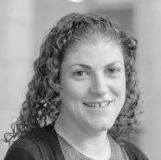
MExAG Steering Committee 2023–2024
Carolyn Ernst
JHU APL
Chair
Stephen Parman
Brown University
Vice-Chair
Steven A. Hauck, II
Case Western Reserve University
Past Chair
Ronald J. Vervack, Jr.
JHU APL
Exosphere Discipline Member
Brendan Anzures
LPI/ NASA Johnson Geochemistry Discipline Member
Mallory Kinczyk
JHU APL
Geology Discipline Member
Catherine L. Johnson
UBC & PSI
Geophysics Discipline Member
Jim Raines
University of Michigan
Magnetosphere Discipline Member
Ryan Dewey
University of Michigan
Early Career Member
Megan Mouser
Carnegie Institute of Washington
Early Career Member
Suzanne Imber
U. of Leicester
International Liaison
Océane Barraud
DLR
International Early Career Member
Shoshana Weider
NASA HQ
NASA Liaison

Slide 9
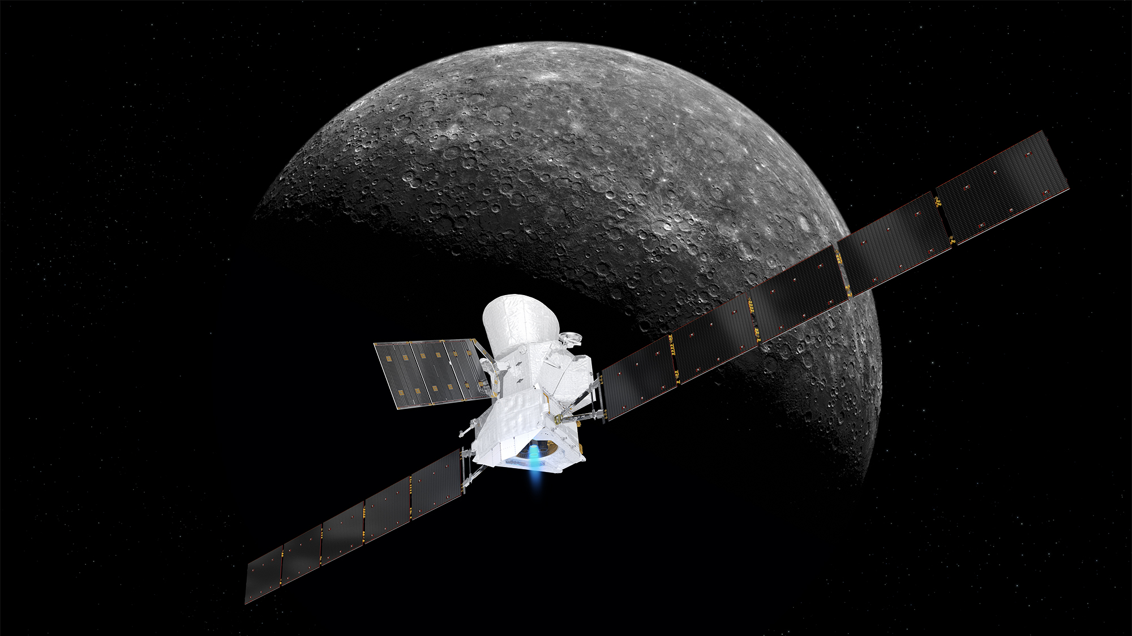
Upcoming Mercury Events
AGU 2023, 11–15 December 2023
MExAG 2024, 6–8 February 2024
LPSC 2024, 11–15 March 2024
Mercury 2024, 4–7 June 2024 in Kyoto, Japan
BepiColombo:
Mercury Flyby 4, 5 September 2024
MExAG: https://www.lpi.usra.edu/mexag
Twitter: @ExploreMercury

