Slide 1
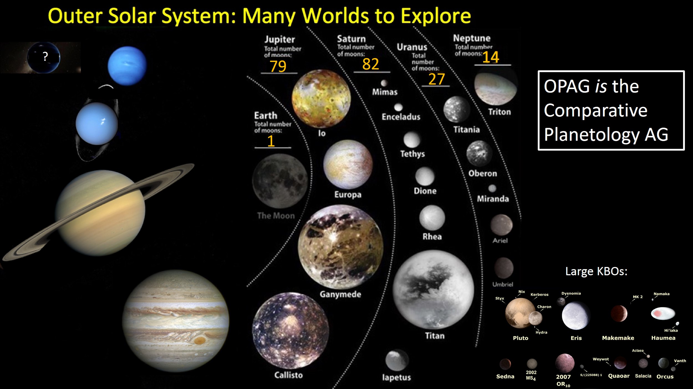
OPAG Update to the Planetary Science Advisory Committee (PAC)
Amanda Hendrix, OPAG Chair, PAC Meeting, 14 November 2023
?
95
83

Slide 2
Some of the Topics at the Upcoming OPAG meeting (Nov 28-29, Boulder)
Dragonfly - awaiting confirmation
OPAG stresses the importance of this mission
OPAG is very concerned about delays in mission calls
PI-led missions are critical for the community and for science
NF-5
If NASA is going to CAPS to re-think mission themes, this process should start immediately
NASA/CAPS should focus on science rather than making the list too prescriptive
OPAG reminds the community that OWL did not recommend moving forward with MSR “at all costs”
Planetary community demographics
See presentation at OPAG meeting!
RPS
Pu-238 & clad production rates should not slow down despite current budget slowdown & mission formulation delays
Clipper!
OPAG fully supports this flagship as it moves toward launch in <1 year
UOP
Has been quite well-studied … #1 priority next flagship in OWL/PSDS

