Slide 1
Cross-AG EDIA Working group
Updated leadership
Co-chairs:
Julie Rathbun – she/hers – PSI/Cornell
Kas Knicely – she/hers – U. Alaska Fairbanks
HQ reps:
Meagan Thompson – she/hers
Julie Ziffer – she/hers
New business
Recommendation for AGs (and PAC) to avoid meeting during religious holidays or at the same time as affinity groups
Working with OPAG (and other AGs) to develop a recommendation(s) on demographic data collection to meet decadal survey recommendations

Slide 2
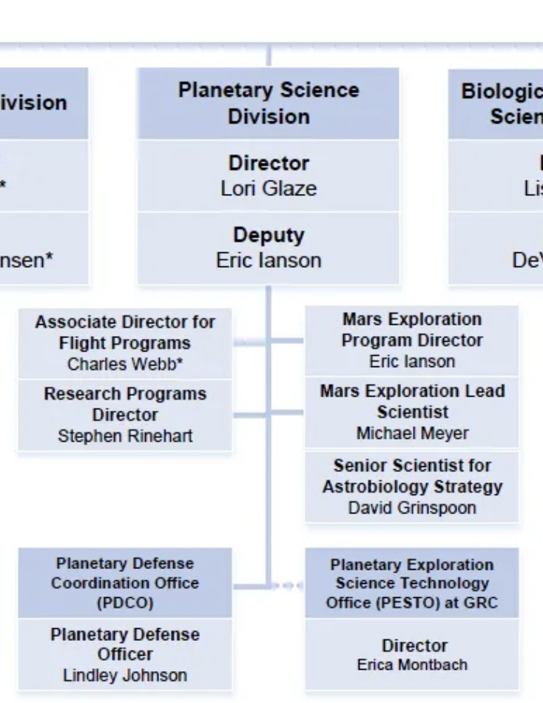
Cross-AG EDIA Working group
Continuing Business
TWSC to fund 2-day AG style meeting
New positions in PSD/SMD leadership
Look forward to a similar EDIA position to help address abysmal demographics

