Slide 1
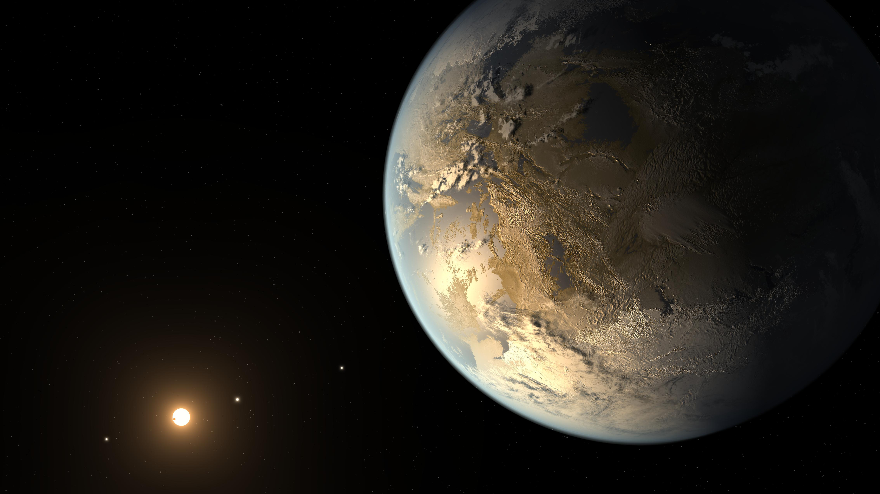
Exoplanet Program Analysis Group (ExoPAG) Report to PAC Natalie Hinkel (LSU) Representative for the ExoPAG Executive Committee Nov 2023
Credit: NASA

Slide 2
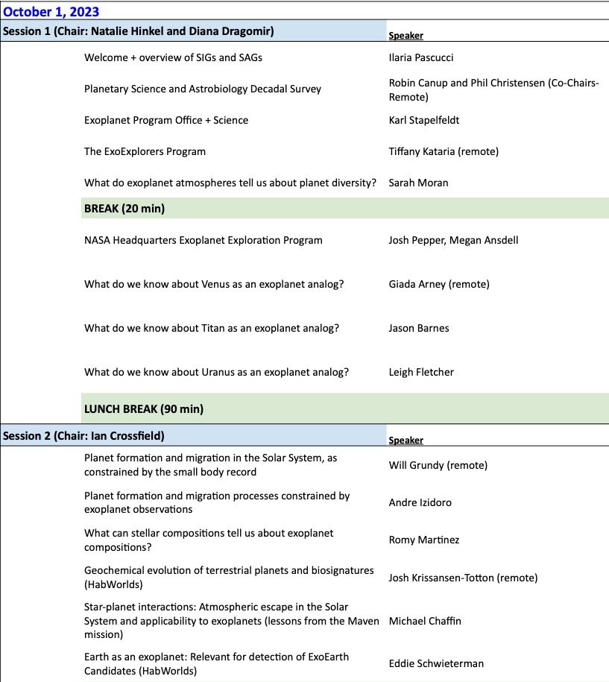
ExoPAG28 Ahead of DPS
Goal: strengthen the connections/collaborations between the astrophysics and planetary science communities in exoplanet science.
Excellent presentations!

Slide 3
In The Future
Interest in having one of the semi-annual ExoPAG meetings in connection with a large planetary science meeting (e.g., DPS, AbSciCon…) Integrate the ExoPAG meeting within the conference program
Advertise meetings earlier, more broadly, acquire travel fundin.g
Targeted funding for cross-disciplinary exoplanet science.

