Slide 1
Lunar Discovery and Exploration Program Update
Joel Kearns
Deputy Associate Administrator for Exploration
Science Mission Directorate
NASA Headquarters
Planetary Science Advisory Committee
November 14, 2023
Notes:
NASA Science and the National Cislunar S&T Policy
Objective 1: Support research and development to enable long-term growth in Cislunar space
- R&D to enable enduring human presence
R&D to best utilize Cislunar space for science
ensure availability and readiness of a skilled workforce
Objective 2: Expand international S&T cooperation in Cislunar space
Develop and lead on a proposal for an International Lunar Year
Develop technical foundations of best practices for safe Cislunar spaceflight operations

Slide 2
Lunar Discovery and Exploration Program (LDEP) Update
November 13, 2023
Plans/Strategies
  Implementation plan for Integrated Lunar Science Strategy (NASA) – will be issued as Community Announcement for comment, revision
  Community Science Definition Team: objectives for Endurance-A Mission (South Pole-Aitken Basin sample return)
  Moon2Mars Architecture Concept Review 23 and Architecture Definition Document (ADD)
  NASEM Studies
Competitive Solicitations
  Artemis III Geology Team selected (A3GT) August 22, 2023
    Earth-based Artemis III Geologists for Lunar Exploration (EAGLE) [Denevi/APL] (Artemis III)
  Artemis III Deployed Instruments call released May 30, 2023 (A3DI); selections spring 2024
  Planning: A4DI
  Planning: A4 Hand-Held Instruments
  Planning: LTV instruments
  Planning: PRISM4 (Stand Alone Site Agnostic (SALSA) instruments call)
Artemis II
  Artemis II Lunar Observation Campaign (ALOC) [Lead: Young/NASA GSFC] (Artemis II)
PRISM1 instrument suites in development:
  Lunar Vertex - Exploring the Intersection of Geoscience and Space Plasma Physics (Lunar Vertex) [Blewett/APL] (CP-11)
  Farside Seismic Suite (FSS) [Panning/JPL] (CP-12)
  Lunar Interior Temperature and Materials Suite (LITMS) [Grimm/SwRI] (CP-12)
PRISM2 instrument suites in development:
  Lunar Vulkan Imaging and Spectroscopy Explorer (LunarVISE) [Donaldson-Hanna/UCF] (CP-21)
  Lunar Explorer Instrument for Space Biology Applications (LEIA) [Settles/NASA ARC] (CP-22)
PRISM3 instrument suite selected:
  Dating an Irregular Mare Patch with a Lunar Explorer (DIMPLE) [Anderson/SwRI] (CP-32)
CLPS delivery competitions
  Next: CP-22 (LEIA + others) to South Pole
    CLPS company proposals received
  Then: CP-21 (LunarVISE + others) to Gruithuisen Domes
VIPER progress through SIR; landing Nov 2024
Lunar Trailblazer to storage; Rideshare on IM-2 [Ehlmann/CalTech]

Slide 3
PRISM 3 Overview
The third PRISM draft solicitation was released in August 2022 for community comment for 30 days. The final announcement was released on Sept. 19, 2022
Step 1s due Oct. 24, 2022
Step 2s due Dec. 20, 2022
Soliciting suites of payloads for one delivery to the lunar surface in mid-2027
Address decadal-level science objectives traceable to Origins, Worlds, and Life
Total mass cap: 50 kg
Budget cap: $50M
PRISM 3 Opportunity Highlights
Delivery to a safe landing destination identified and justified by the proposer
Leverage the following services provided by the CLPS provider:
Survive-the-night services
Mobility services

Slide 4
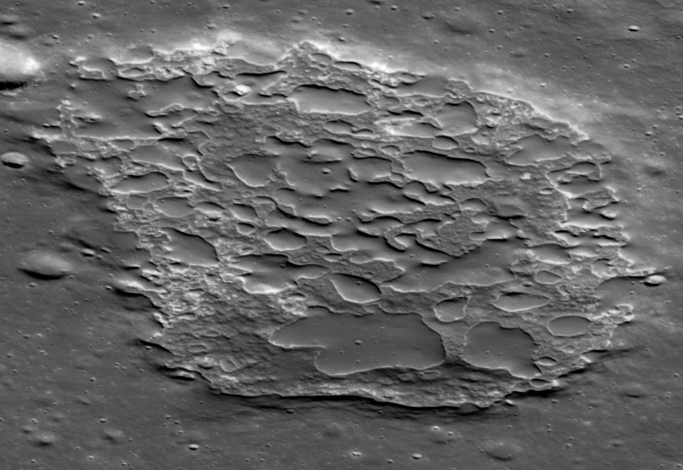
PRISM 3
Dating an Irregular Mare Patch with a Lunar Explorer (DIMPLE)
Establish the age, geochemistry of the Ina Irregular Mare Patch and verify the duration of lunar volcanic activity
(Anderson, SWRI)
Definitively resolve how recently the Moon was volcanically active at an enigmatic site
  Measure age to within 375 Ma using the ⁸⁷Rb-⁸⁷Sr isochron method
Demonstrate geochronometry technology that can be applied to various geologic terrains across the Solar System
Characterize elemental geochemistry: SiO₂, Na₂O/K₂O, Ti, Fe, Mg, Ca, Al, Si, Na, K, Th, and oxides
International contributions from University of Bern and University of Manchester, UK
Ina Irregular
Mare Patch

Slide 5
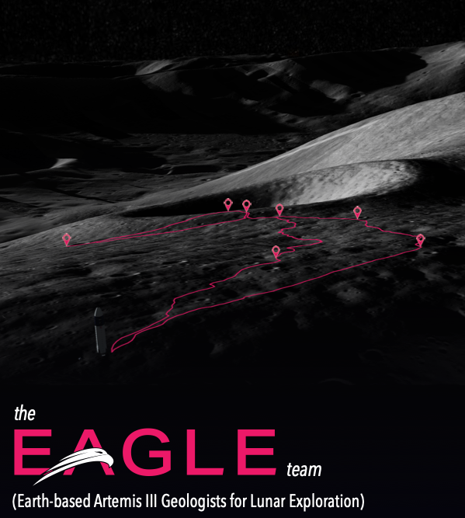
Artemis III Geology Team (A3GT):
EAGLE Team: Earth-based Artemis III Geologists for Lunar Exploration
PI: Brett Denevi, Johns Hopkins Applied Physics Laboratory

Slide 6
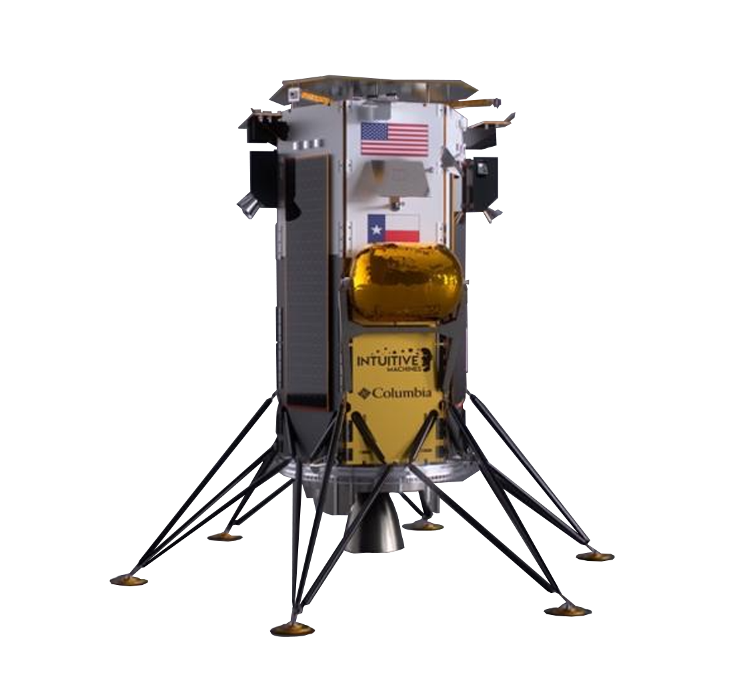
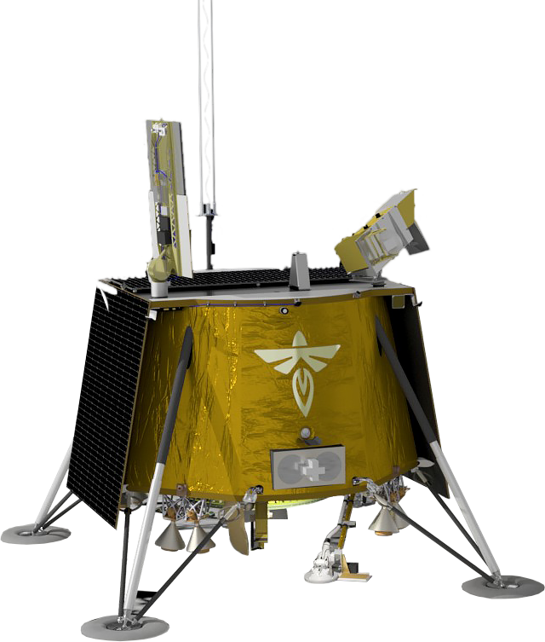
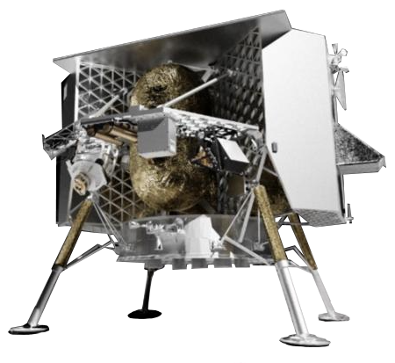
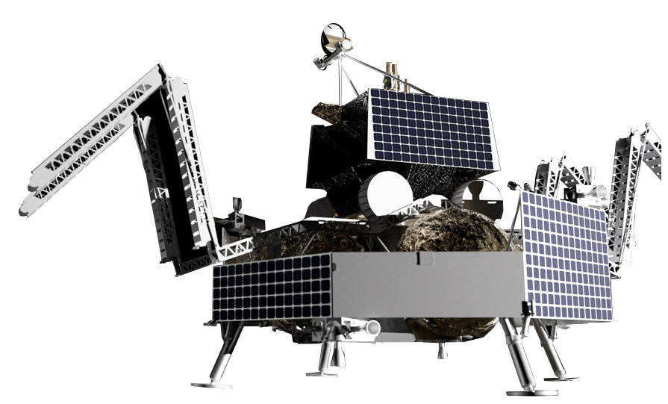


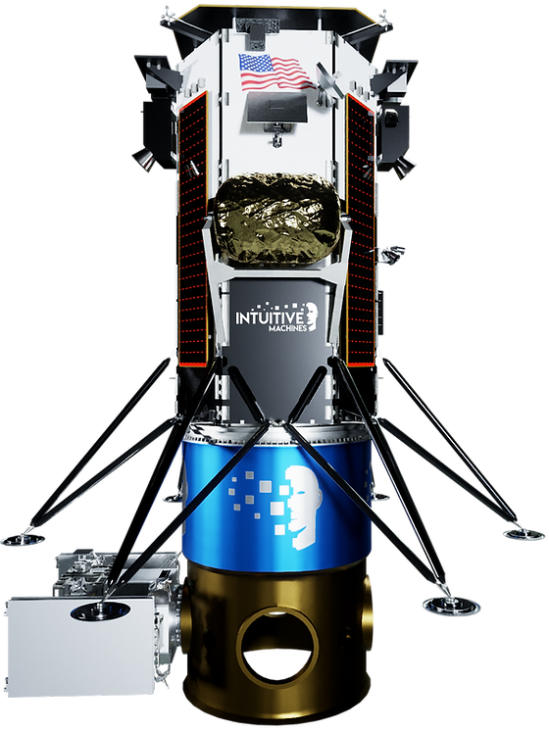
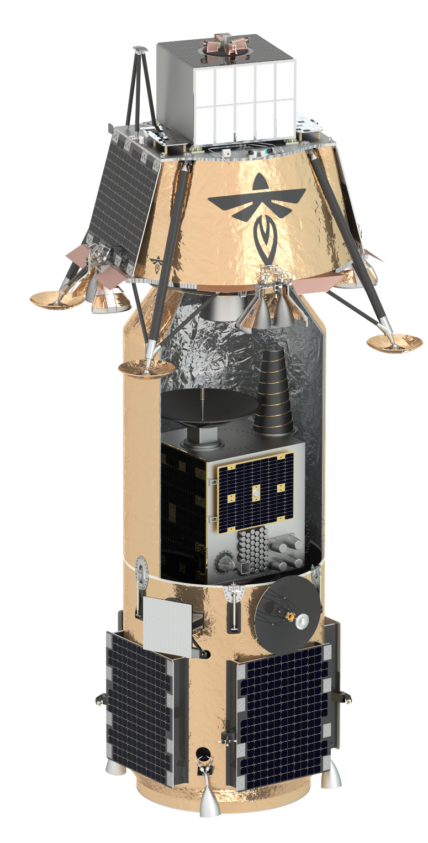
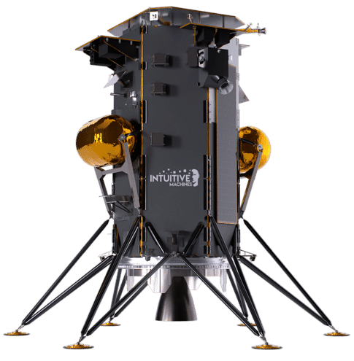
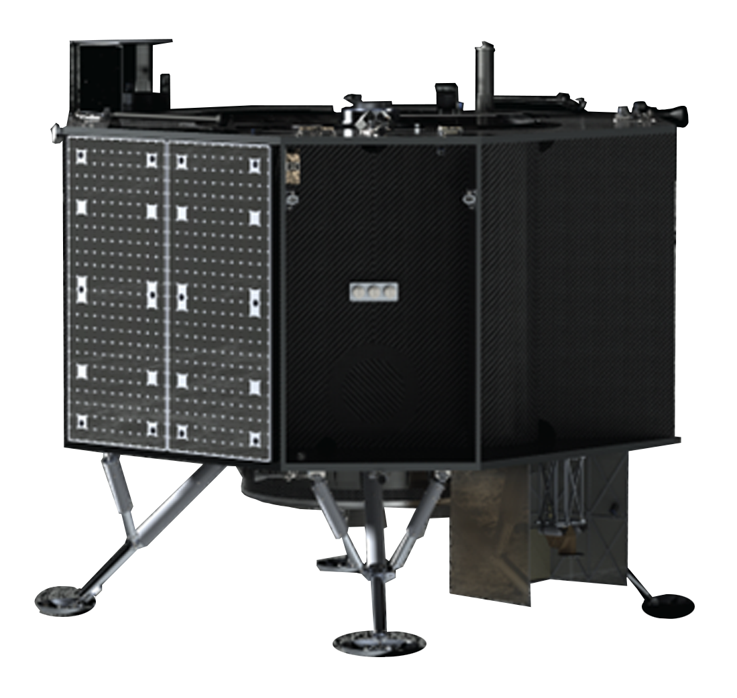

TO2-AB
PM-1
TO2-IM
IM-1
TO19D
Blue
Ghost 1
TO20A – VIPER
GM-1
Peregrine Lander
Nova-C Lander
Blue Ghost lander
Griffin Lander
PRIME-1
IM-2
CP-11
IM-3
CP-12
TBA
CS-3 & CS-4
Blue
Ghost 2
Nova-C Lander
Nova-C Lander
Series-2 Lander
Blue Ghost Lander
06-01-2023
Notes:
Artist’s conceptions of first eight CLPS surface landers

Slide 7


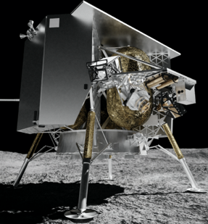
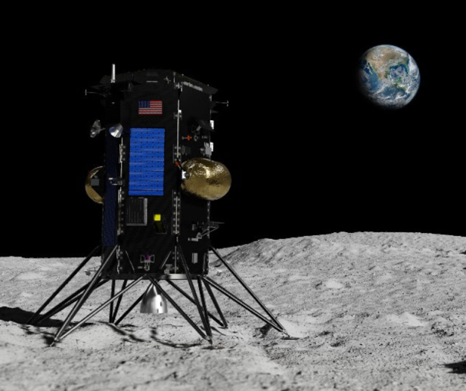
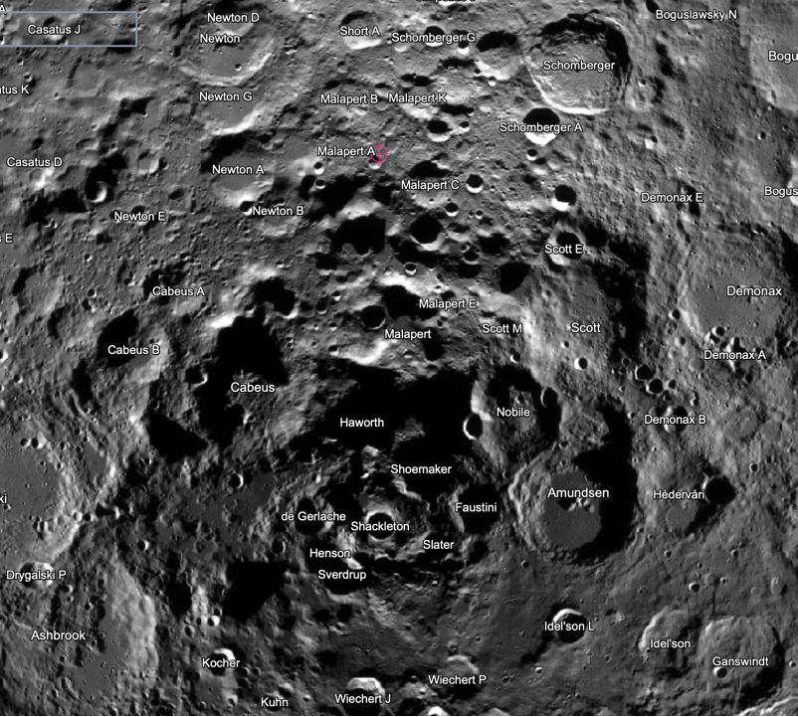
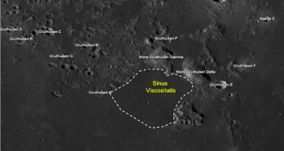
Commercial Lunar Payload Services
First Two Task Orders
Astrobotic Technologies Peregrine Lander
PM-1 Mission
Intuitive Machines
Nova-C Lander
IM-1 Mission
Mission Details
Lander/ Launch Provider: Peregrine / ULA Vulcan-Centaur
Launch Date: December 24-26, 2023
Landing Date: January 25, 2024
Landing Site: Sinus Viscositatis
(35.1°N, 41.8°W)
Surface Ops Duration: ~196 Hours
Mission Details
Lander/ Launch Provider: Nova-C / SpaceX Falcon 9
Launch Window: January 12-16, 2024
Landing Date: January 19 or 21, 2024
Landing Site: South Pole - Malapert A
(80.297°S 1.2613°E)
Surface Ops Duration: ~ 264 Hours
As of November 12, 2023
Notes:
Innovative, service-based, competitive acquisition approach that enables rapid, affordable, and frequent access to the Lunar surface via American commercial providers.
Service task orders are firm fixed price (FFP) for the full scope of delivery.
CLPS deliveries are CLPS Provider missions (not NASA missions).
CLPS Project Goals:
Do science at, and of, the moon using low- to mid-size commercial landers
Address “Decadal Survey” level science questions
2 awards/year leading to 2 landings/year
Enable NASA’s Space Technology, Exploration Systems Development and Space Operations Mission Directorates to advance technologies and systems on lunar surface
In doing so, develop a commercial community of service providers for Artemis

Slide 8
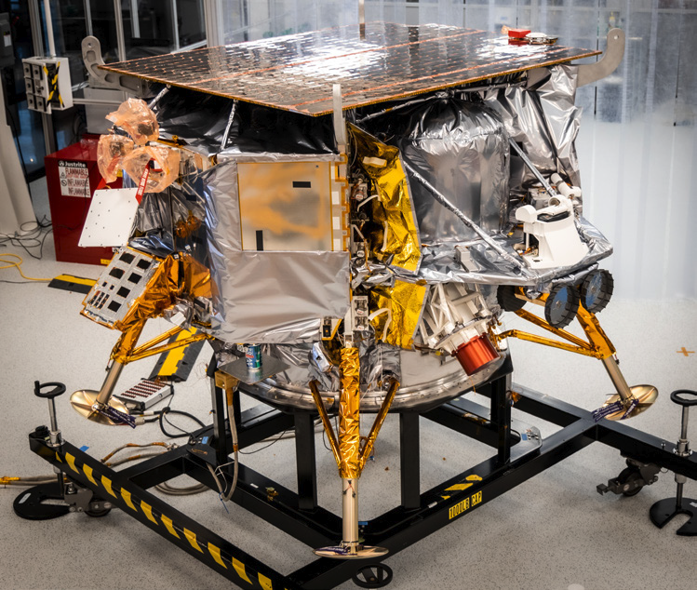
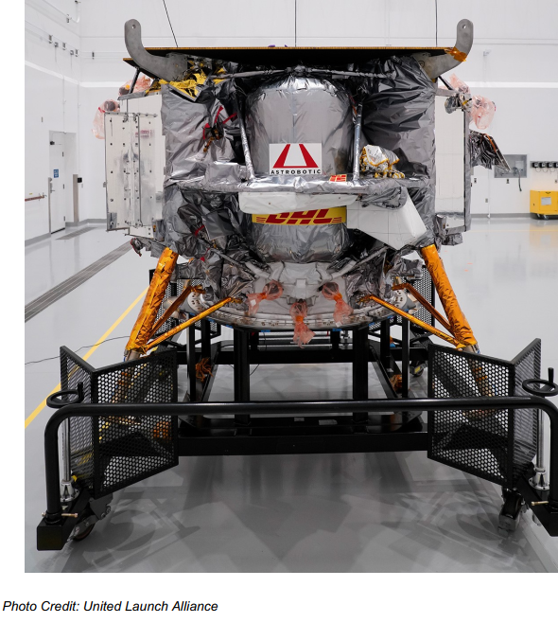
Astrobotic’s Peregrine Mission-1
Astrobotic PM-1 Launch windows open
12/24: 6:49am UTC
12/25: 6:53am UTC
12/26: 7:08am UTC
Astrobotic PM-1 Landing window
1/25: 8:30am UTC

Slide 9
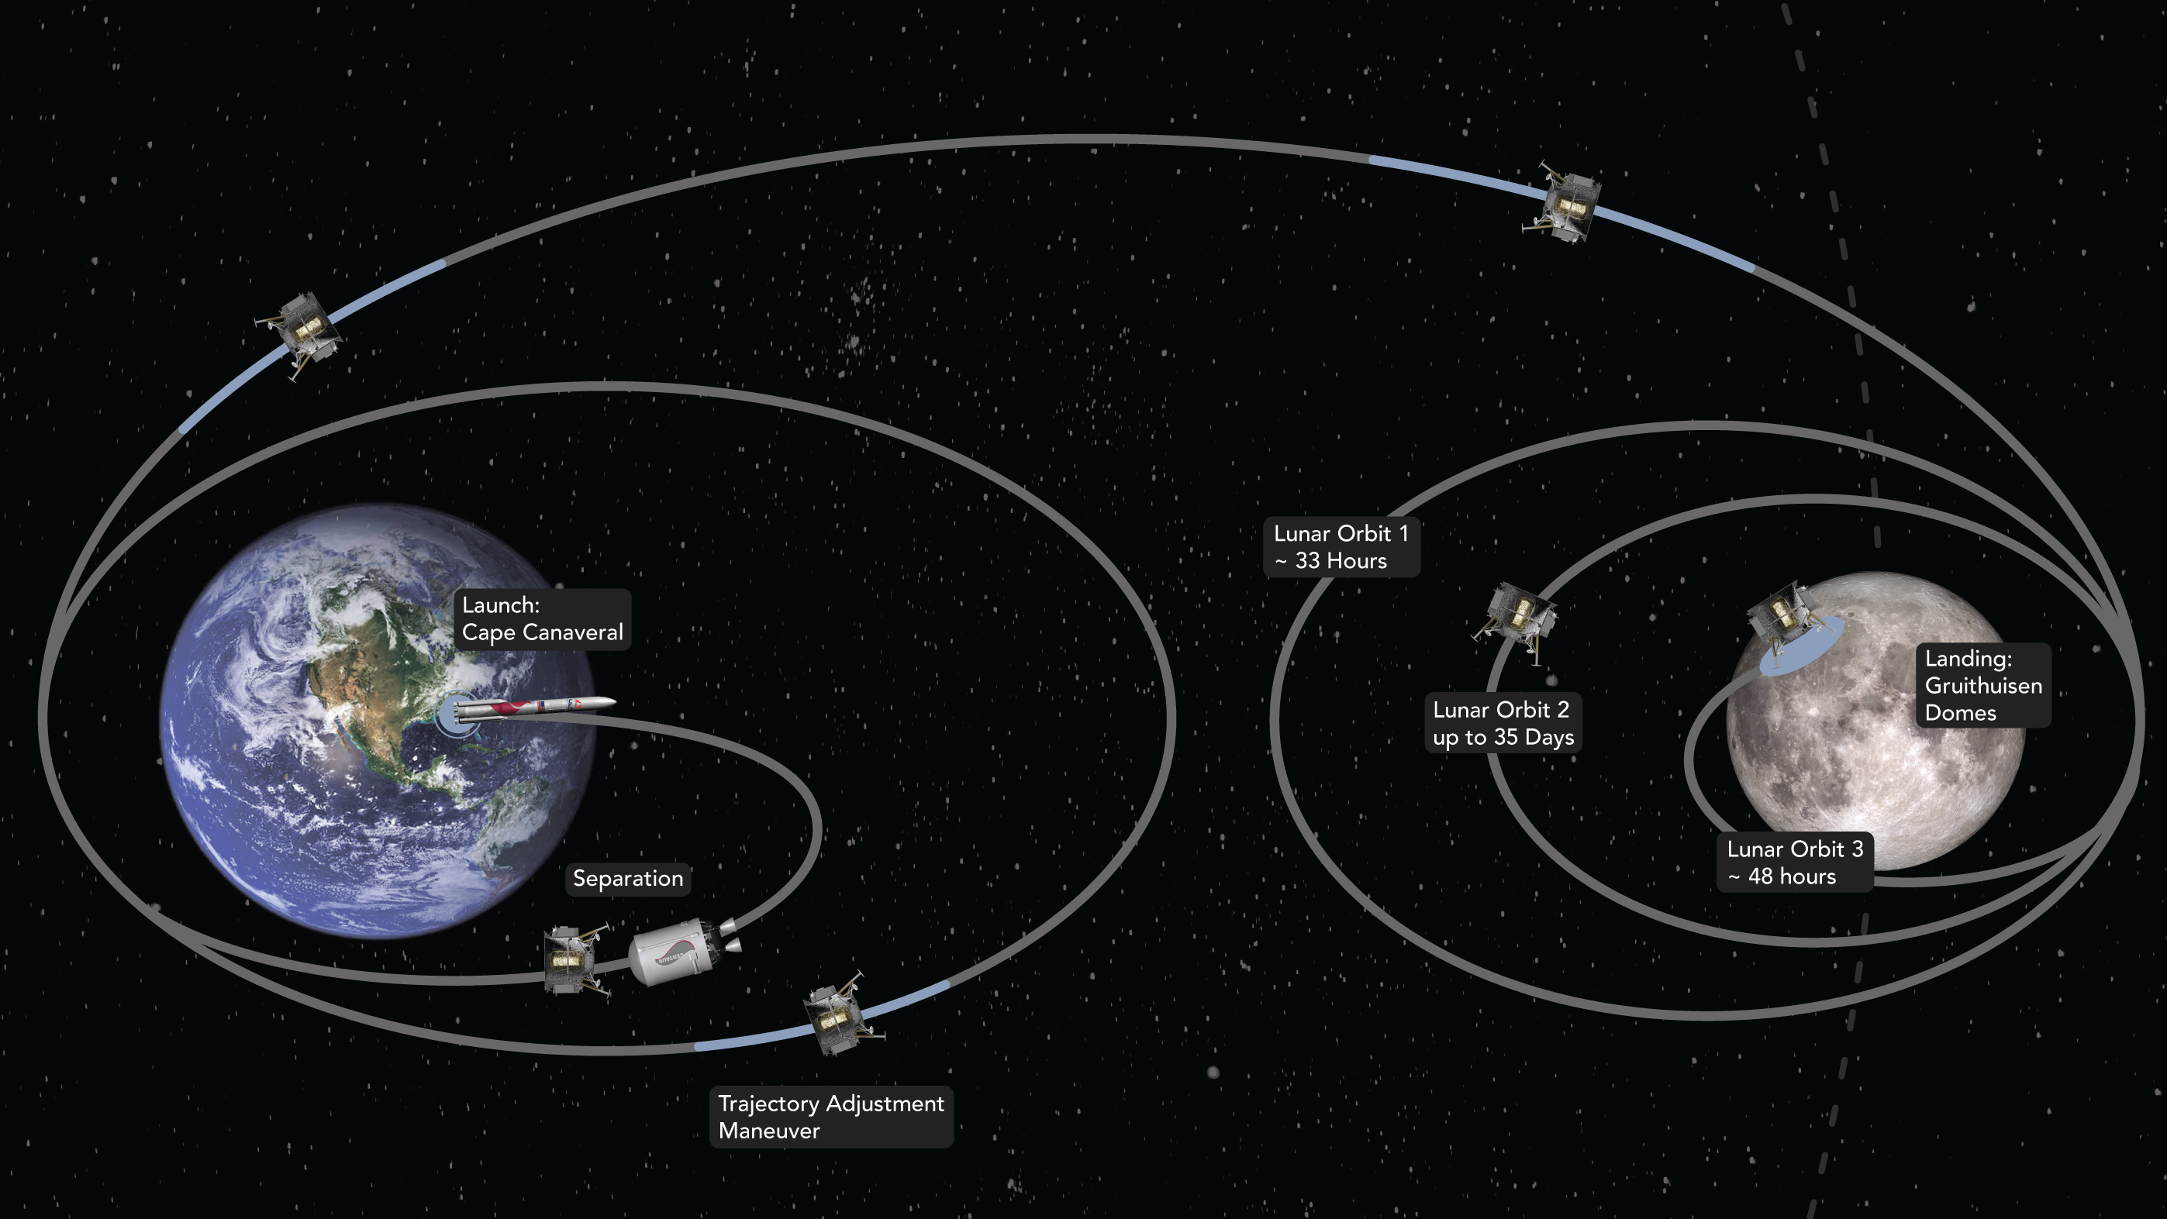

PM1 Flight PATH
PM1 PATH TO THE MOON
30-to-54-day transit

Slide 10







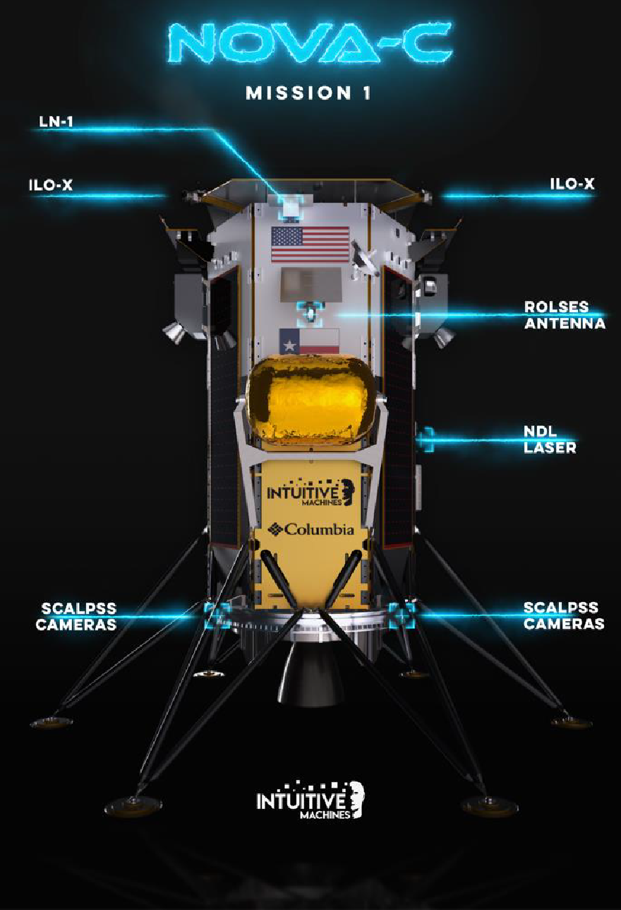

NASA CLPS Payloads (CLPS TO2)
Navigation Doppler Lidar (NDL)
Lunar Node-1 (LN-1)
Lunar Retroreflector Assembly (LRA)
Stereo Cameras for Lunar Plume Surface Studies (SCALPSS)
Radio wave Observations at Lunar Surface of photo Electron Sheath (ROLSES)
Commercial Payloads
Galaxy Legacy Lab
ILO-X, International Lunar Observatory
Association
Art Cube, 4Space & Jeff Koons
EagleCam, Embry Riddle
Omni-Heat Infinity, Columbia Sportswear
Lonestar Lunar, Lonestar Data Holdings

Slide 11








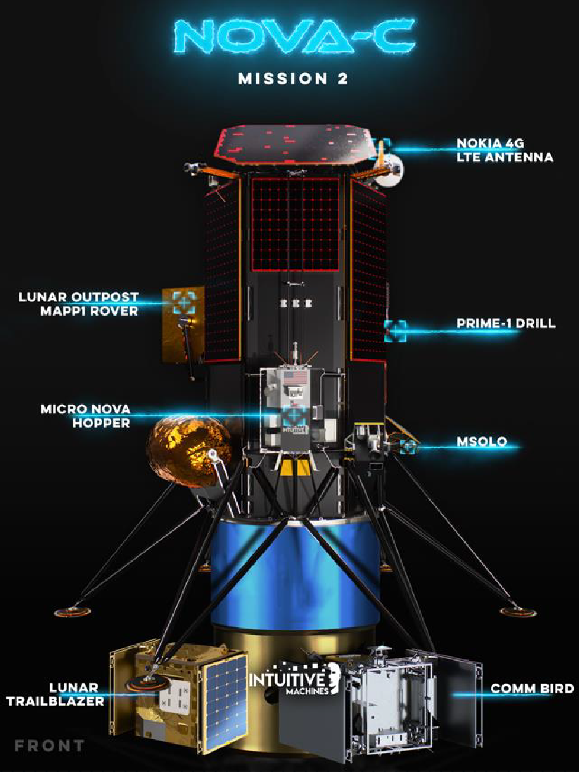
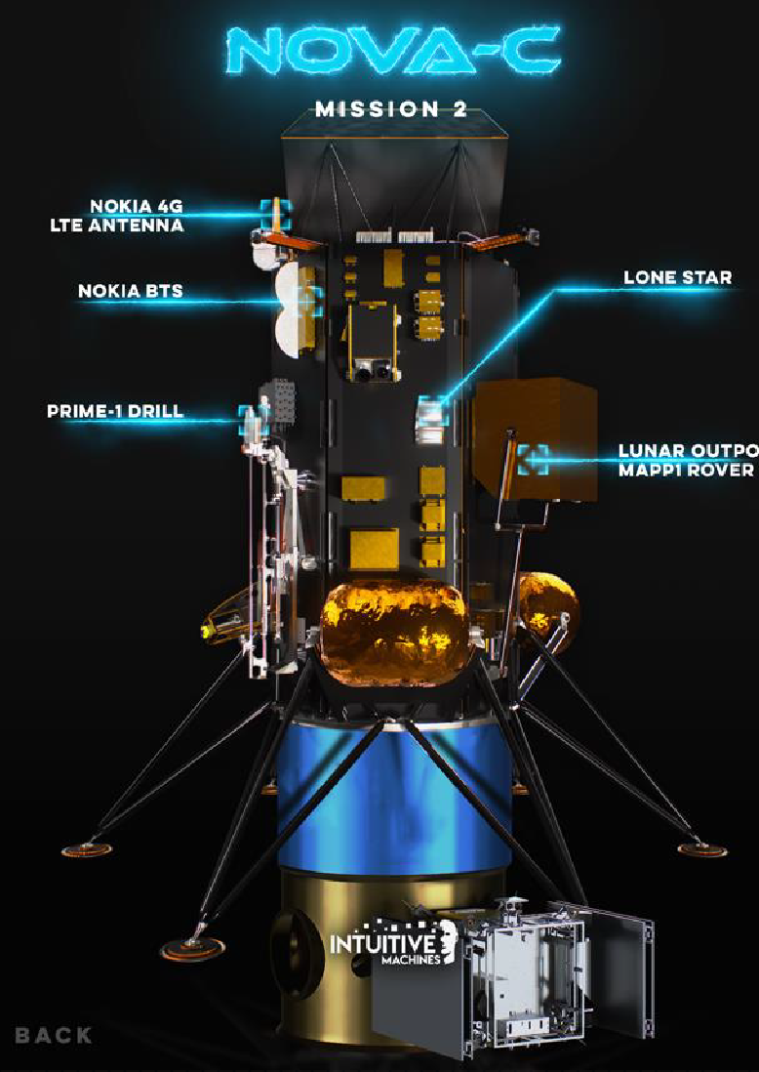

NASA CLPS PRIME-1
Polar Resources Ice Mining Experiment. TRIDENT Drill & Msolo mass spectrometer
Non-CLPS Payloads
STMD IM µ-Nova Hopper– hops into craters and photographs hard-to-reach areas
  Pyrometer. Temperatures in permanently shadowed regions
  Neutron spectrometer. Hydrogen
measurements in PSR
STMD Nokia LTE - first LTE/4G communications system in space
Yaoki Rover, Dymon
Lonestar
Rideshare Payloads
NASA LunarTrailblazer
Astroforge 1

Slide 12
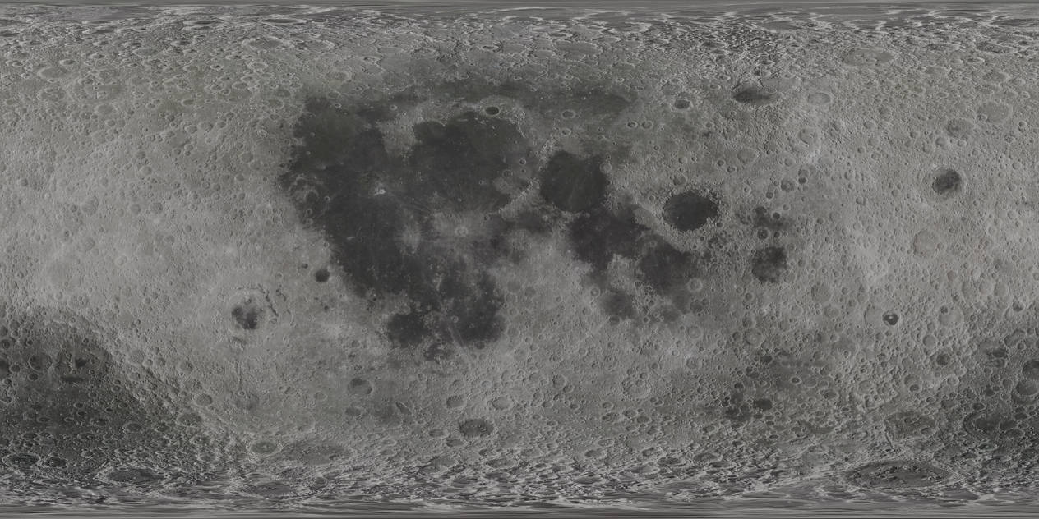
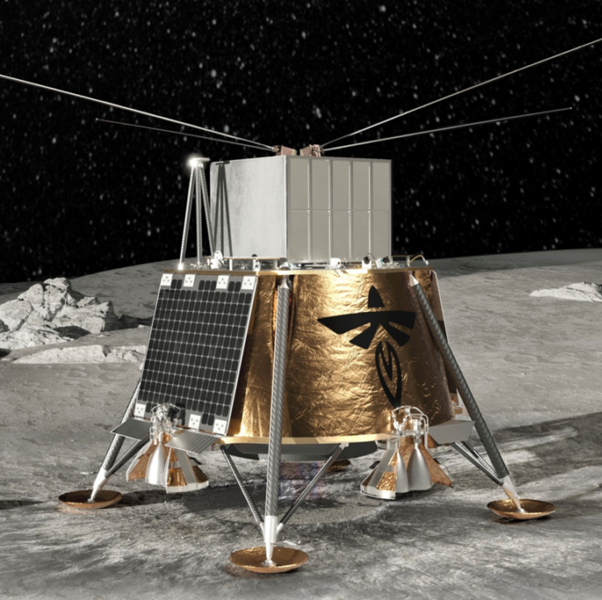
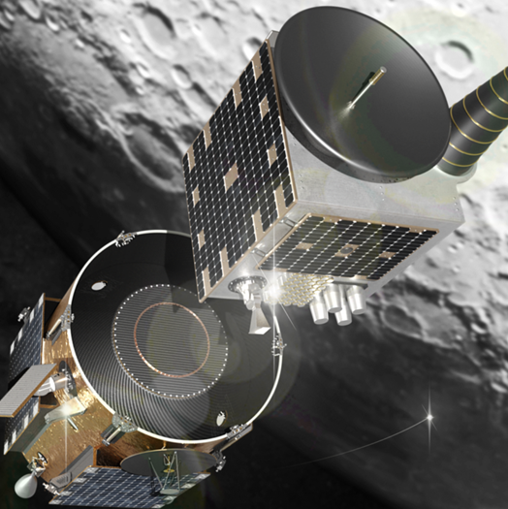
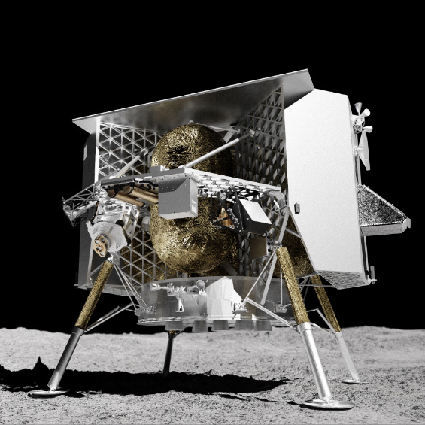
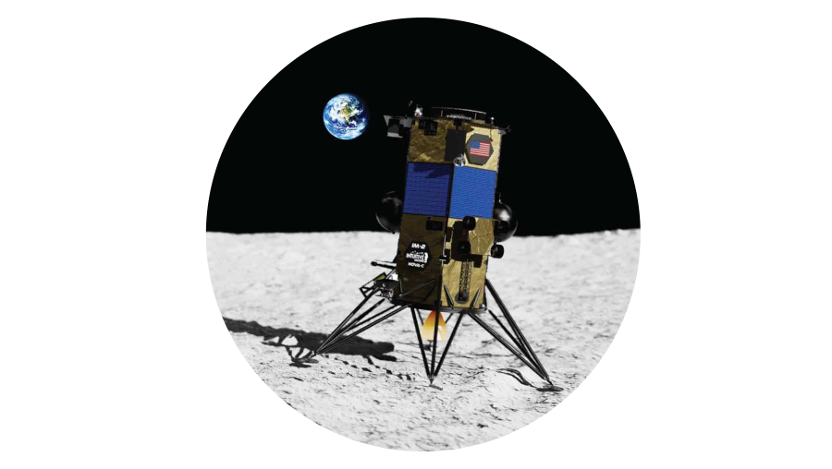
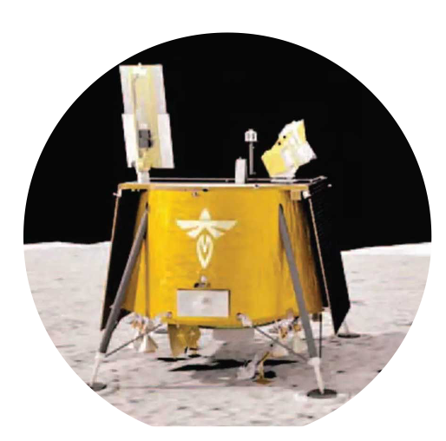
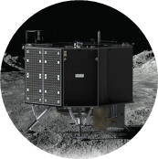
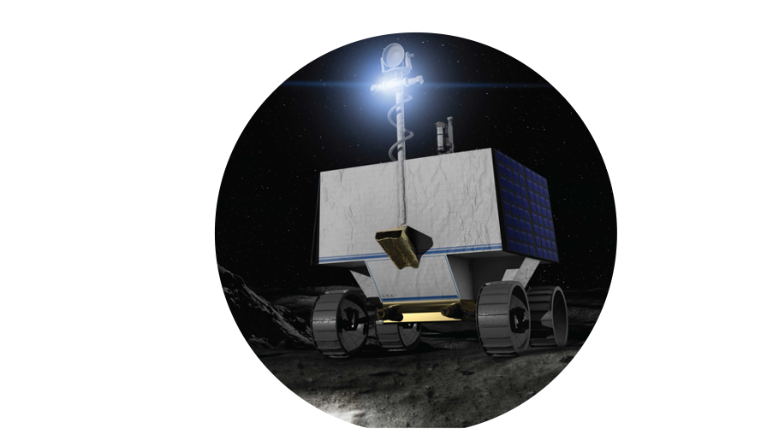
CLPS Deliveries
2023-2027
Delivery Site:
Lunar Far Side & Orbit Insertion
Provider: Firefly
CS-3 & CS-4 │ 2025
Delivery Site:
Gruithuisen Domes
Provider TBD
CP-21 │ 2026
Delivery Site:
Sinus Viscositatis
Provider: Astrobotic
TO2-AB │ Dec 2023
Delivery Site:
Reiner Gamma
Provider: IM
CP-11 │ 2024
Delivery Site:
Ina Irregular Mare Patch
Provider: TBD
CP-32 │ 2027
Delivery Site:
Mare Crisium
Provider: Firefly
TO19D │ 2024
Delivery Site:
Shackleton Connecting Ridge Provider: IM
TO PRIME-1 │2024
Delivery Site: Malapert A
Provider: Intuitive Machines (IM)
TO2-IM │ Jan 2024
Delivery Site:
Schrödinger Basin
Provider: Draper
CP-12 │ 1H 2025
Delivery Site:
South Pole Region
Provider TBD
CP-22 │ 2026
Delivery Site:
Mons Mouton
Provider : Astrobotic
VIPER │Nov 2024
Updated 11/7/2023

Slide 13
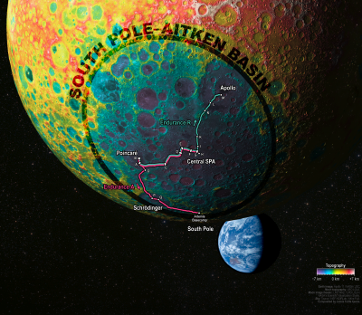
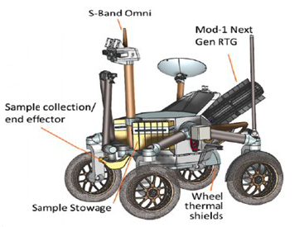
Human Enabled Decadal-Level Science at the Moon
Endurance A: South Pole-Aitken Sampling Campaign
Top lunar priority of the Planetary Science Decadal Survey: “Endurance A”
  long-duration rover
  traverses ~2000km
  Brings ~100kg of samples, taken at strategic sites throughout the South Pole-Aitken basin, to South Pole for HLS to Earth
Address five lunar science objectives, including:
  Solar System Chronology: Anchors the earliest impact history of the Solar System, tests the giant planet instability, impact cataclysm, and late heavy bombardment hypotheses, and anchors the “middle ages” of solar system chronology
  Planetary Evolution: Tests the lunar magma ocean hypothesis, characterizes the thermochemical evolution of terrestrial planets, and explores the geologic diversity of a giant impact basin from floor to rim
Simulated view of lunar farside,
Endurance’s traverse and the Earth
Recommendation: Endurance-A should be implemented as a strategic medium-class mission as the highest priority of the Lunar Discovery and Exploration Program. Endurance-A would utilize CLPS to deliver the rover to the Moon, a long-range traverse to collect a substantial mass of high-value samples, and astronauts to return them to Earth. – Origins, Worlds, and Life (Planetary Decadal), 22-17
The full Endurance Report is available at https://tinyurl.com/2p88fx4f
Notes:
An example of a recommended mission that uses both robotics and astronauts is Endurance-A.
It uses Astronaut explorers to measure, curate and package priority samples and use the HLS to return them to Earth
New: Astronaut and Robotic Synergy

Slide 14
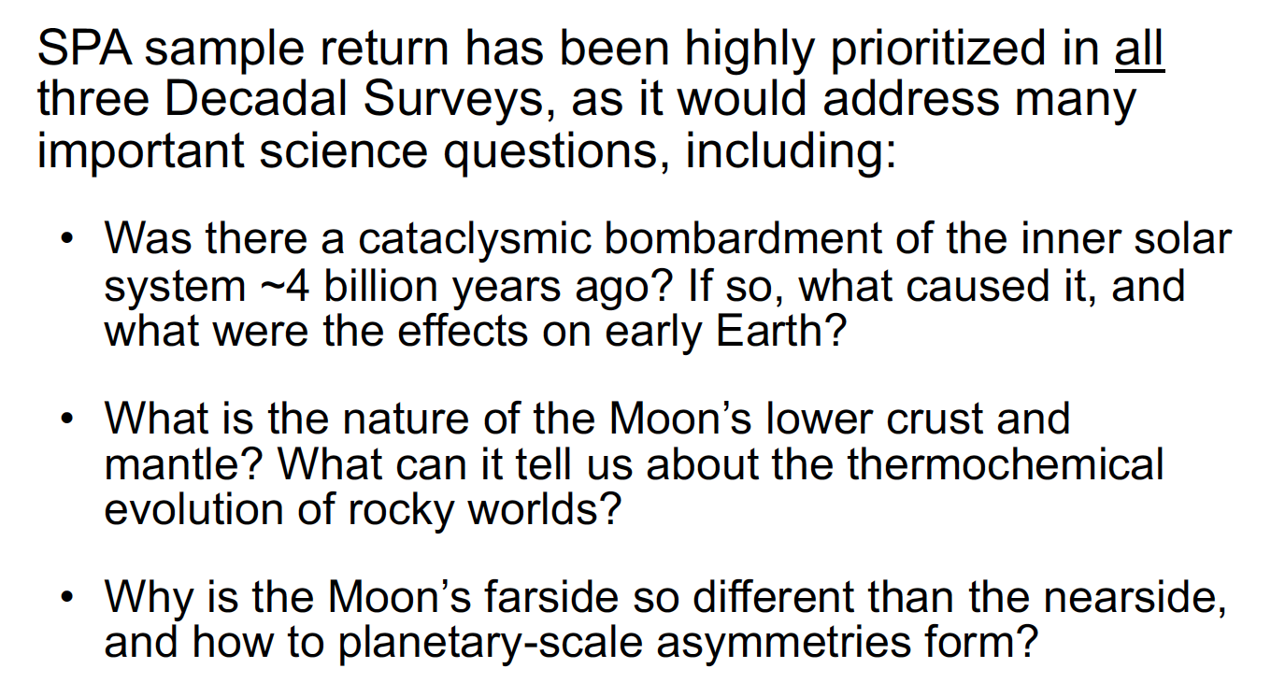


Slide 15
